Slide 1
Sharing This Information
The Heart Rhythm Society develops presentation slides as an educational tool for electrophysiologists, cardiologists, and other licensed health care practitioners. You may download and retain a single copy for your personal use.
Please contact clinicaldocs@hrsonline.org to learn more about options for sharing this content beyond your personal use.
This slide set is adapted from the 2019 HRS/EHRA/APHRS/LAHRS Expert Consensus Statement on Catheter Ablation of Ventricular Arrhythmias, published in Heart Rhythm, Europace, the Journal of Arrhythmia, and the Journal of Interventional Cardiac Electrophysiology.
The full-text consensus statement is also available on the HRS website: https://www.hrsonline.org/guidance/clinical-resources

Slide 2
2019 HRS/EHRA/APHRS/LAHRS Expert Consensus Statement on Catheter Ablation of Ventricular Arrhythmias
Developed in partnership with and endorsed by the European Heart Rhythm Association (EHRA), the Asia Pacific Heart Rhythm Society (APHRS), and the Latin American Heart Rhythm Society (LAHRS). Developed in collaboration with and endorsed by the American College of Cardiology (ACC), the American Heart Association (AHA), the Japanese Heart Rhythm Society (JHRS), the Pediatric and Congenital Electrophysiology Society (PACES), and the Sociedade Brasileira de Arritmias Cardíacas (SOBRAC). Endorsed by the Canadian Heart Rhythm Society.
Edmond M. Cronin, MB, BCh, BAO, FHRS, CCDS, CEPS-A (Chair); Frank M. Bogun, MD (Vice-Chair); Philippe Maury, MD (EHRA Chair); Petr Peichl, MD, PhD (EHRA Vice-Chair); Minglong Chen, MD, PhD, FHRS (APHRS Chair); Narayanan Namboodiri, MBBS, MD (APHRS Vice-Chair); Luis Aguinaga, MD, PhD, FESC, FACC (LAHRS Chair); Luiz Roberto Leite, MD, PhD, FHRS (LAHRS Vice-Chair); Sana M. Al-Khatib, MD, MHS, FHRS, CCDS; Elad Anter, MD; Antonio Berruezo, MD, PhD; David J. Callans, MD, FHRS, CCDS; Mina K. Chung, MD, FHRS; Phillip Cuculich, MD; Andre d’Avila, MD, PhD; Barbara J. Deal, MD, FACC; Paolo Della Bella, MD; Thomas Deneke, MD, PhD, FHRS; Timm-Michael Dickfeld, MD, PhD, FACC, FHRS; Claudio Hadid, MD; Haris M. Haqqani, MBBS, PhD, FHRS; G. Neal Kay, MD, CCDS; Rakesh Latchamsetty, MD, FHRS; Francis Marchlinski, MD, FHRS; John M. Miller, MD, FHRS; Akihiko Nogami, MD, PhD; Akash R. Patel, MD, FHRS, CEPS-P; Rajeev Kumar Pathak, MBBS, PhD, FHRS; Luis C. Saenz Morales, MD; Pasquale Santangeli, MD, PhD; John L. Sapp, Jr., MD, FHRS; Andrea Sarkozy, MD, PhD, FEHRA; Kyoko Soejima, MD; William G. Stevenson, MD, FHRS; Usha B. Tedrow, MD, MS, FHRS; Wendy S. Tzou, MD, FHRS; Niraj Varma, MD, PhD; Katja Zeppenfeld, MD, PhD, FESC, FEHRA

Slide 3
Methodology
Unique to this consensus statement is the systematic review “Systematic Review and Meta-analysis of Catheter Ablation of Ventricular Tachycardia in Ischemic Heart Disease” commissioned specifically for this document as part of HRS’s efforts to adopt rigorous methodology required for guideline development.
The systematic review was performed by an experienced Evidence-Based Practice Committee based at the University of Connecticut, and it examined the question of VT ablation versus control in patients with VT and IHD.

Slide 4
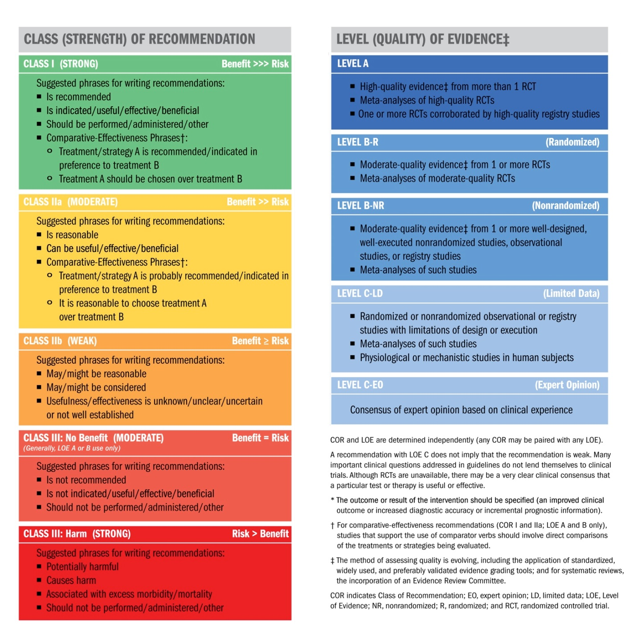
Applying Class of Recommendation and Level of Evidence to Clinical Strategies, Interventions, Treatments, or Diagnostic Testing in Patient Care*
Reproduced with permission of the American College of Cardiology (ACC) and the American Heart Association (AHA)

Slide 5
Clinical Evaluation
Recommendation for clinical evaluation of patients with ventricular arrhythmias (VAs)
COR | LOE | Recommendation
I | C-EO | A careful clinical evaluation including history, physical examination, review of available cardiac rhythm data, prior imaging, and relevant laboratory workup should be performed in patients presenting with VAs.
Recommendations for resting 12-lead ECG
COR | LOE | Recommendations
I | B-NR | In patients with wide complex tachycardia, a 12-lead ECG during tachycardia should be obtained whenever possible.
I | B-NR | In patients with suspected or documented VA, a 12-lead ECG should be obtained in sinus rhythm to look for evidence of underlying heart disease.
Recommendations for assessment of structural heart disease (SHD) and myocardial ischemia
COR | LOE | Recommendations
I | B-NR | In patients with known or suspected VA, echocardiography is recommended for evaluation of cardiac structure and function.
IIa | B-NR | In patients presenting with VA who are suspected of having SHD, even after normal echocardiographic evaluation, advanced cardiac imaging can be useful to detect and characterize underlying SHD.
IIa | C-EO | In patients with VA in whom myocardial ischemia is suspected, stress testing and/or coronary angiography and subsequent revascularization can be beneficial before catheter ablation to avoid significant ischemia during induced VT.
III: No Benefit | B-NR | In patients presenting with monomorphic VT, revascularization alone is not effective to prevent VT recurrence.

Slide 6
Clinical Evaluation
Risk Stratification in the Setting of Frequent Premature Ventricular Complexes
Recommendations for cardiac magnetic resonance imaging (CMR) in patients with frequent premature ventricular complexes (PVCs) and for programmed electrical stimulation (PES) in patients with SHD and frequent PVCs
COR | LOE | Recommendations
IIa | B-NR | CMR can be useful for risk stratification for sudden cardiac death in patients with frequent PVCs.
IIa | C-LD | PES can be useful for risk stratification for sudden cardiac death in patients with SHD undergoing ablation of frequent PVCs.
Longitudinal Follow-up in the Setting of Frequent Premature Ventricular Complexes
Recommendation for longitudinal follow-up of patients with frequent PVCs
COR | LOE | Recommendation
IIa | B-NR | Periodic monitoring of PVC burden and LV function and dimensions can be useful in patients with frequent, asymptomatic PVCs and normal LV function and dimensions.

Slide 7
Indications for Catheter Ablation
Idiopathic Outflow Tract Ventricular Arrhythmia
Recommendations for catheter ablation of idiopathic outflow tract VA
COR | LOE | Recommendations
I | B-R | In patients with frequent and symptomatic PVCs originating from the RVOT in an otherwise normal heart, catheter ablation is recommended in preference to metoprolol or propafenone.
I | B-NR | In patients with symptomatic VAs from the RVOT in an otherwise normal heart for whom antiarrhythmic medications are ineffective, not tolerated, or not the patient’s preference, catheter ablation is useful.
I | B-NR | In patients with symptomatic idiopathic sustained monomorphic VT, catheter ablation is useful.
IIa | B-NR | In patients with symptomatic VAs from the endocardial LVOT, including the SV, in an otherwise normal heart for whom antiarrhythmic medications are ineffective, not tolerated, or not the patient’s preference, catheter ablation can be useful.
IIa | B-NR | In patients with symptomatic VAs from the epicardial OT or LV summit in an otherwise normal heart for whom antiarrhythmic medications are ineffective, not tolerated, or not the patient’s preference, catheter ablation can be useful.

Slide 8
Indications for Catheter Ablation
Idiopathic Nonoutflow Tract Ventricular Arrhythmia
Recommendations for catheter ablation of nonoutflow tract VAs in the absence of SHD
COR | LOE | Recommendations
I | B-NR | In patients with symptomatic VAs from the RV at sites other than the outflow tracts (tricuspid annulus, moderator band, parietal band, or papillary muscles) in an otherwise normal heart for whom antiarrhythmic medications are ineffective, not tolerated, or not the patient’s preference, catheter ablation is useful.
I | B-NR | In patients with symptomatic VAs from the LV at sites other than the outflow tracts (mitral annulus, papillary muscles, or AMC) in an otherwise normal heart for whom antiarrhythmic medications are ineffective, not tolerated, or not the patient’s preference, catheter ablation is useful.
IIa | B-NR | In patients with symptomatic VAs from the epicardial coronary venous system in an otherwise normal heart for whom antiarrhythmic medications are ineffective, not tolerated, or not the patient’s preference, catheter ablation can be useful.
IIa | B-NR | In patients with symptomatic VAs from para-Hisian sites in an otherwise normal heart for whom antiarrhythmic medications are ineffective, not tolerated, or not the patient’s preference, catheter ablation can be useful.
IIa | C-LD | In patients with symptomatic VAs from the posterior-superior process of the LV in an otherwise normal heart for whom antiarrhythmic medications are ineffective, not tolerated, or not the patient’s preference, catheter ablation from the LV endocardium, right atrium, or CS, can be useful.

Slide 9
Indications for Catheter Ablation
Premature Ventricular Complexes With or Without Left Ventricular Dysfunction
Recommendations for catheter ablation of PVCs in patients with or without LV dysfunction
COR | LOE | Recommendations
I | B-NR | In patients with cardiomyopathy suspected to be caused by frequent and predominately monomorphic PVCs and for whom AADs are ineffective, not tolerated, or not preferred for long-term therapy, catheter ablation is recommended.
IIa | B-NR | In patients with SHD in whom frequent PVCs are suspected to be contributing to a cardiomyopathy and for whom AADs are ineffective, not tolerated, or not preferred for long-term therapy, catheter ablation can be useful.
IIa | B-NR | In patients with focally triggered VF refractory to AADs and triggered by a similar PVC, catheter ablation can be useful.
IIa | C-LD | In nonresponders to cardiac resynchronization therapy with very frequent unifocal PVCs limiting optimal biventricular pacing despite pharmacological therapy, catheter ablation can be useful.

Slide 10
Indications for Catheter Ablation
Ventricular Arrhythmia in Ischemic Heart Disease
Recommendations for catheter ablation of VAs in patients with IHD
COR | LOE | Recommendations
I | B-R | In patients with IHD who experience recurrent monomorphic VT despite chronic amiodarone therapy, catheter ablation is recommended in preference to escalating AAD therapy.
I | B-NR | In patients with IHD and recurrent symptomatic monomorphic VT despite AAD therapy, or when AAD therapy is contraindicated or not tolerated, catheter ablation is recommended to reduce recurrent VT.
I | B-NR | In patients with IHD and VT storm refractory to AAD therapy, catheter ablation is recommended.
IIa | C-EO | In patients with IHD and recurrent monomorphic VT, in whom AADs are not desired, catheter ablation can be useful.
IIb | A | In patients with IHD and an ICD who experience a first episode of monomorphic VT, catheter ablation may be considered to reduce the risk of recurrent VT or ICD therapies.
IIb | C-LD | In patients with prior myocardial infarction and recurrent episodes of symptomatic sustained VT for whom prior endocardial catheter ablation has not been successful and who have ECG, endocardial mapping, or imaging evidence of a subepicardial VT substrate, epicardial ablation may be considered.

Slide 11
Indications for Catheter Ablation
Nonischemic Cardiomyopathy
Recommendations for catheter ablation of VT in nonischemic cardiomyopathy (NICM)
COR | LOE | Recommendations
I | B-NR | In patients with NICM and recurrent sustained monomorphic VT for whom antiarrhythmic medications are ineffective, contraindicated, or not tolerated, catheter ablation is useful for reducing recurrent VT and ICD shocks.
I | B-NR | In patients with NICM and electrical storm refractory to AAD therapy, catheter ablation is useful for reducing recurrent VT and ICD shocks.
IIa | B-NR | In patients with NICM, epicardial catheter ablation of VT can be useful after failure of endocardial ablation or as the initial ablation approach when there is a suspicion of an epicardial substrate or circuit.
IIa | B-NR | In patients with cardiac sarcoidosis and recurrent VT despite medical therapy, catheter ablation can be useful to reduce the risk of VT recurrence and ICD shocks.
IIa | C-EO | In patients with NICM and recurrent sustained monomorphic VT for whom antiarrhythmic medications are not desired, catheter ablation can be useful for reducing recurrent VT and ICD shocks.
IIb | B-NR | In patients with NICM related to lamin A/C (LMNA) mutations and recurrent VT, catheter ablation may be considered as a palliative strategy for short-term arrhythmia control.

Slide 12
Indications for Catheter Ablation
Ventricular Arrhythmia Involving the His-Purkinje System, Bundle Branch Reentrant Ventricular Tachycardia, and Fascicular Ventricular Tachycardia
Recommendations for catheter ablation of bundle branch reentrant VT and for catheter ablation of fascicular VT
COR | LOE | Recommendations
I | B-NR | In patients with bundle branch reentrant VT, catheter ablation is useful for reducing the risk of recurrent VT.
I | B-NR | In patients with idiopathic left fascicular reentrant VT for whom medications are ineffective, not tolerated, or not the patient’s preference, catheter ablation is useful.
I | B-NR | In larger pediatric patients (≥15 kg) with idiopathic left fascicular reentrant VT in whom medical treatment is ineffective or not tolerated, catheter ablation is useful.
I | B-NR | In patients with focal fascicular VT with or without SHD, catheter ablation is useful.
I | B-NR | In patients with postinfarction reentrant Purkinje fiber-mediated VT, catheter ablation is useful.

Slide 13
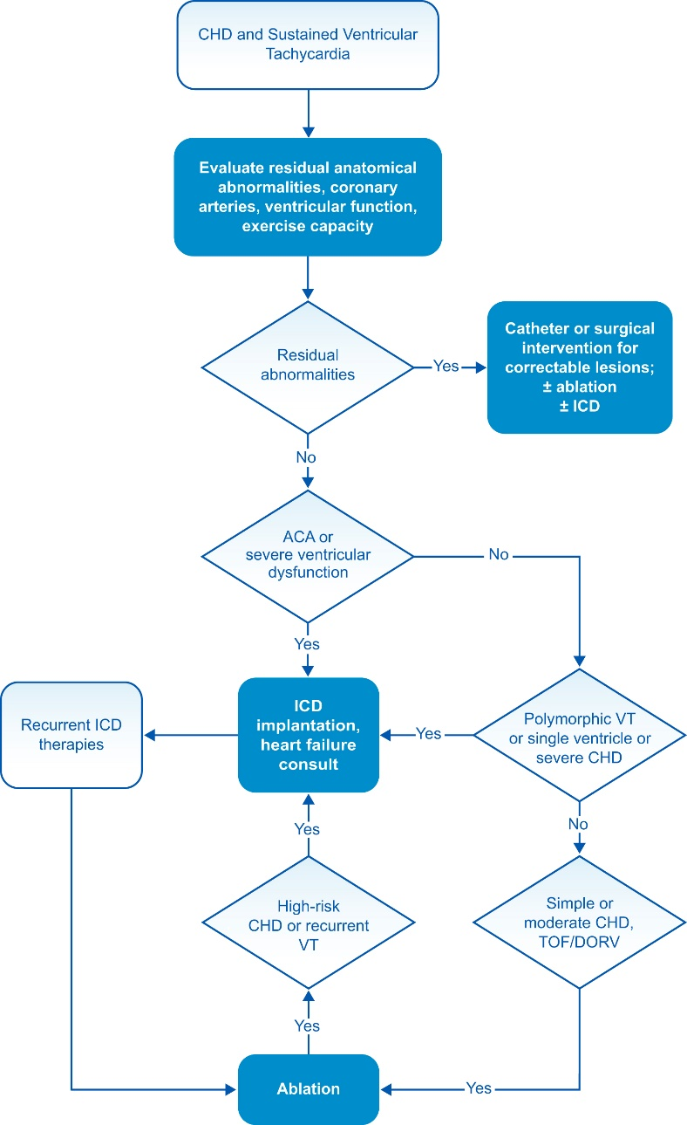
Indications for Catheter Ablation
Congenital Heart Disease
Recommendations for catheter ablation of VA in patients with CHD
COR | LOE | Recommendations
I | B-NR | In patients with CHD presenting with sustained VAs, evaluation for potential residual anatomical or coronary abnormalities should be performed.
I | B-NR | In patients with CHD presenting with sustained VT in the presence of important hemodynamic lesions, treatment of hemodynamic abnormalities as feasible should be performed in conjunction with consideration for ablation.
I | B-NR | In patients with repaired tetralogy of Fallot and sustained monomorphic VT or recurrent appropriate ICD therapy for VAs, catheter ablation is effective.
IIa | B-NR | In select patients with CHD and clinical episodes of sustained VT who are undergoing surgical repair of residual hemodynamic abnormalities, surgical ablation of VT guided by preoperative or intraoperative electroanatomical mapping (EAM) can be beneficial.

Slide 14
Indications for Catheter Ablation
Inherited Arrhythmia Syndromes
Recommendations for catheter ablation of VA in inherited primary arrhythmia disorders
COR | LOE | Recommendations
I | B-NR | In patients with arrhythmogenic right ventricular cardiomyopathy (ARVC) who experience recurrent sustained VT or frequent appropriate ICD interventions for VT in whom AAD therapy is ineffective or not tolerated, catheter ablation, at a center with specific expertise, is recommended.
I | B-NR | In patients with ARVC who have failed one or more attempts of endocardial VT catheter ablation, an epicardial approach for VT ablation is recommended.
IIa | B-NR | In patients with ARVC who experience recurrent sustained VT or frequent appropriate ICD interventions for VT in whom AAD therapy is not desired or preferred, catheter ablation, at a center with specific expertise, is reasonable.
IIa | B-NR | In patients with Brugada syndrome who experience recurrent sustained VAs or frequent appropriate ICD interventions, catheter ablation can be useful.
IIa | C-LD | In patients with ARVC, a first-line combined endocardial/epicardial approach for VT ablation is reasonable.
Ventricular Arrhythmia in Hypertrophic Cardiomyopathy
Recommendation for VA ablation in hypertrophic cardiomyopathy (HCM)
COR | LOE | Recommendation
IIa | B-NR | In patients with HCM and recurrent monomorphic VT in whom AAD therapy is ineffective or not tolerated, catheter ablation can be useful.

Slide 15
Procedural Planning
PAAINESD Score
The PAAINESD Score, developed to predict the risk of periprocedural hemodynamic decompensation
Variable | Points
Pulmonary disease (COPD) | 5
Age (>60 years) | 3
General anesthesia | 4
Ischemic cardiomyopathy | 6
NYHA class (III/IV) | 6
EF (<25%) | 3
VT storm | 5
Diabetes mellitus | 3
Maximum 35 (or 31 if GA not used)
Risk of AHD increases across tertiles
PAAINESD score ≥15-17 identifies a high-risk cohort (24% risk of AHD)
COPD, chronic obstructive pulmonary disease; EF, ejection fraction; NYHA, New York Heart Association; VT, ventricular tachycardia
Santangeli et al. Circ A&E 2015

Slide 16
Procedural Planning
Risk Scoring Systems
Santangeli et al. Circ A&E 2015
Santangeli et al. JACC 2017

Slide 17
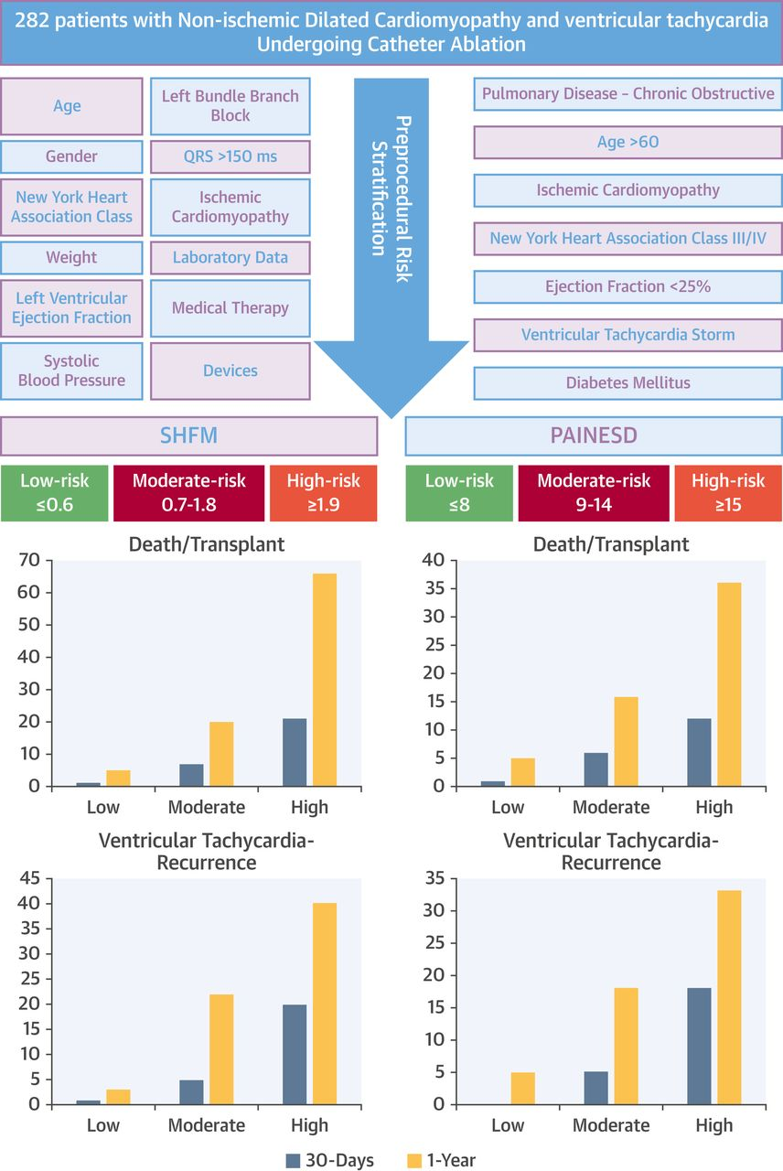
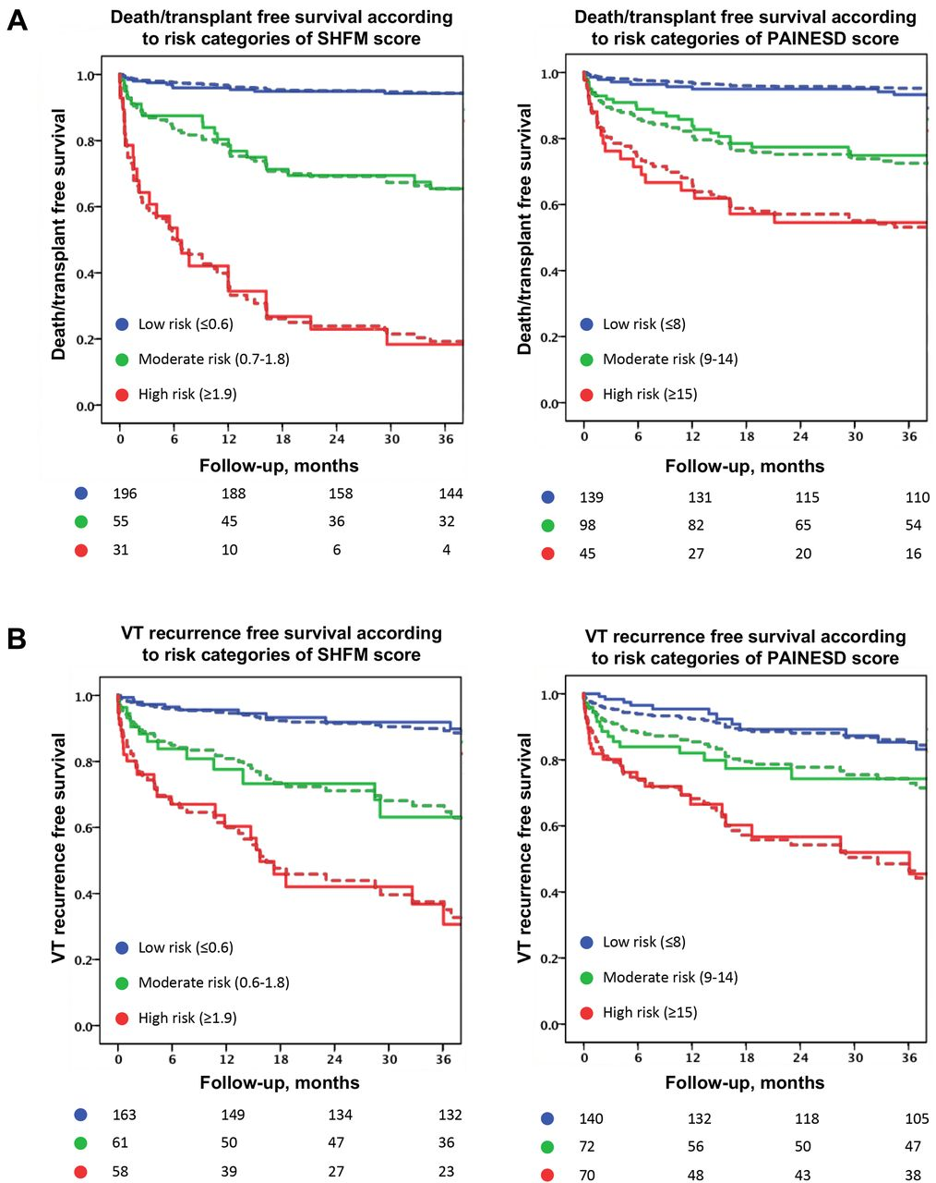
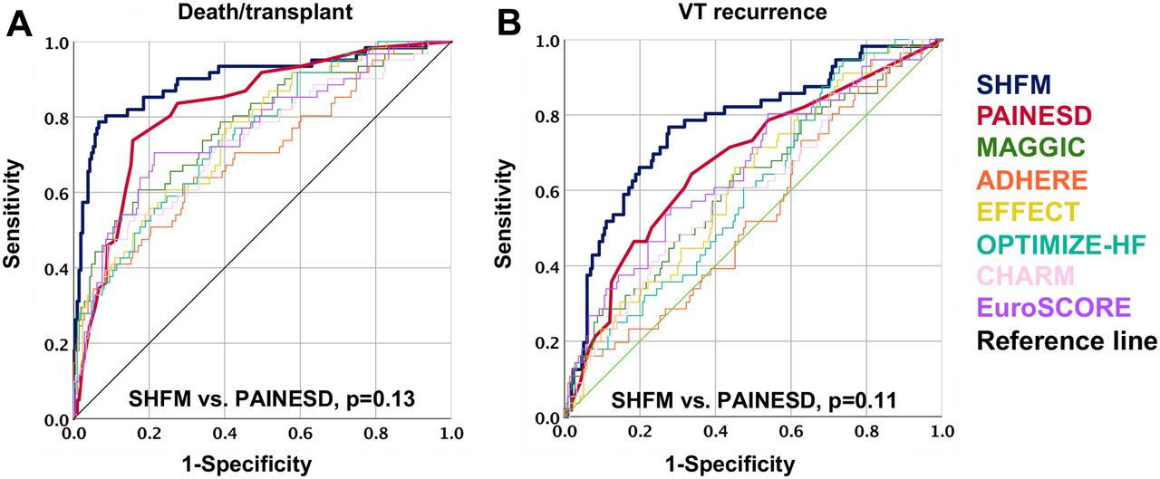
Santangeli et al. JACC CE 2019

Slide 18
Procedural Planning
Facilities for the Procedure
Preprocedural planning should involve communication with other subspecialties, including cardiothoracic surgeons and physicians with expertise in heart failure management, to optimize patient safety. In general, VT ablation in patients with advanced heart disease should only be performed by experienced operators in centers with expertise for complex electrophysiological procedures with onsite cardiosurgical backup and expertise in HS. All personnel and equipment should meet institutional requirements and training requirements for treating patients with complex cardiac pathologies. Integrity and functionality of the equipment should be regularly maintained as required by institutional standards.
Personnel
Institutional accreditation of training and experience to perform complex VT ablation procedures (including ongoing maintenance of experience and certification)
Catheter operator / electrophysiologist (+/- trainees)
Nurses, technicians, mapping system operators
Anesthesiologists, nurse/physician sedation
Back-up interventional cardiologists and CT surgeons
Cronin, Bogun et. al. HRJ 2019

Slide 19
Procedural Planning
Laboratory Equipment
The electrophysiology laboratory for VT ablation should meet standard requirements for any type of catheter ablation procedure, with availability of emergent echocardiography to rule out cardiac tamponade. Laboratory specifications include a dedicated workspace and fluoroscopy system (mono- or biplane, capability of cinefluoroscopy or angiography), a programmed stimulator, an electrophysiology recording system with EAM ability, as well as the possibility to perform cardiac catheterization procedures with hemodynamic monitoring capabilities. The electrophysiology lab should be equipped with a biphasic defibrillator and an ECG monitor, and a backup defibrillator should be immediately accessible. Continuous connection of the defibrillator to the patient (eg, using attached defibrillator pads) is used in many labs for fast and easy defibrillation. A code cart with standard advanced cardiac life support medications is mandatory. For surgical access, such as epicardial surgical windows, institutional hygienic standards should be maintained.
Programming devices for the patient’s specific ICDs should be available in the electrophysiology lab to allow pre- and intraprocedural programming and device interrogation as well as emergency internal shock delivery if required. For patients with implanted left or right VADs, the appropriate equipment and personnel should be available as required.
Epicardial access for mapping and ablation might be needed in a subgroup of patients with VT. Epicardial instrumentation is a complex part of VT ablation and requires high expertise and experience with epicardial puncture or surgical access. Continuous availability of an ICD programmer and the capability of delivering internal shocks can be crucial to terminate VAs in case of external defibrillation failure due to pericardial fluid and/or air and in cases of suboptimal defibrillator pad location.
Patient monitoring is crucial for safety during ablation of VT, independent of the underlying cardiac disease. A physiological recorder capable of monitoring pulse oximetry, noninvasive and invasive arterial blood pressure, and ECG is recommended.
Electrophysiology laboratory equipment should undergo routine maintenance by a biomedical engineering department to ensure appropriate functionality and should be available for troubleshooting.
Cronin, Bogun et. al. HRJ 2019

Slide 20
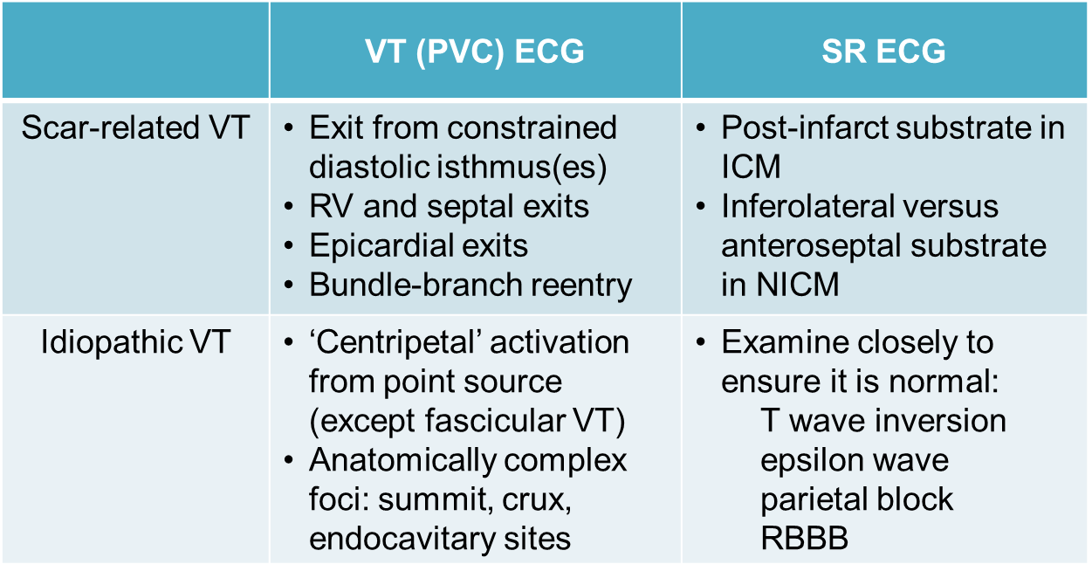
Procedural Planning
12-Lead Electrocardiogram and Body Surface Mapping Before VT Ablation
The standard 12-lead ECG has been shown to be a valuable tool in planning catheter ablation procedures for treatment of VAs, including VT and PVC, and in the case of hemodynamically tolerated VAs, every effort should be taken to record the 12-lead ECG.
Body surface mapping has been used for many years as a predictor of VA exit site, starting with skin surface potential minima and more recently as electrocardiographic imaging (ECGI). The latter integrates unipolar electrograms obtained during the arrhythmia while the patient is wearing a 256-electrode vest, with ventricular anatomy derived from a CT or CMR scan with the vest in place.
However, no matter how specific the ECG algorithm or ECGI map is, it remains as a guide to where mapping efforts should begin or focus, rather than pinpointing an actual site at which ablation will be certain to eliminate the arrhythmia. Careful mapping is still needed in all situations.

Slide 21
Examples of PVC morphologies from several common sites of origin in the RV and LV
Examples of 12-lead ECGs of premature ventricular complexes from different RV sites, as corroborated by successful focal ablation.
Examples of 12-lead ECGs of premature ventricular complexes from different LV sites, as corroborated by successful focal ablation.

Slide 22
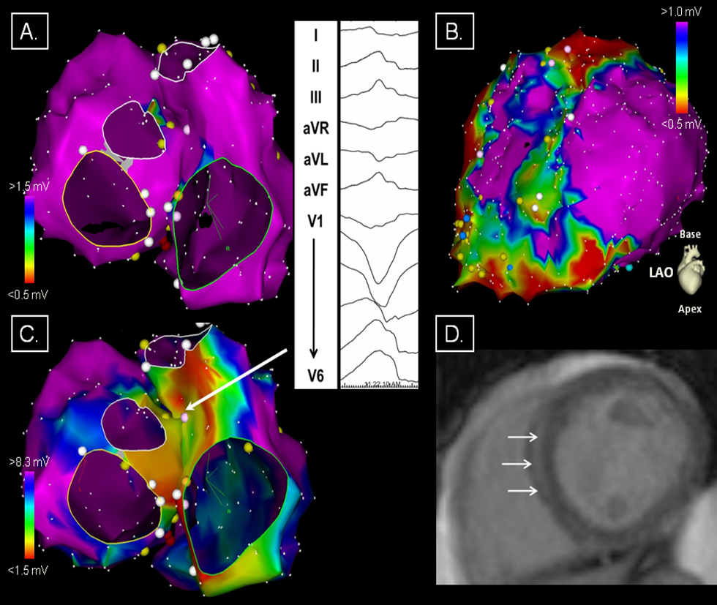
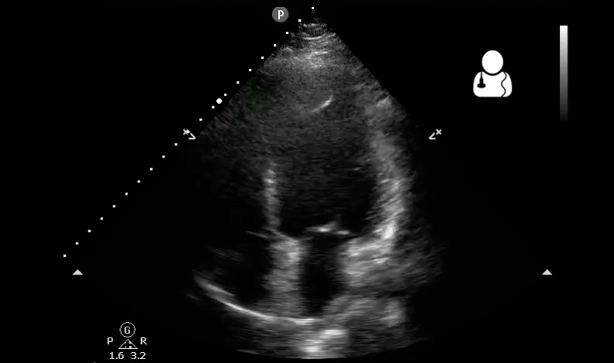
Procedural Planning
Preprocedural Imaging
Intramural septal scar in a 33-year-old man with nonischemic cardiomyopathy (ejection fraction 40%) and left bundle branch block configuration VT (one of four VTs). Haqqani et al. HRJ 2011

Slide 23
Procedural Planning
Preprocedural Imaging
Recommendations for preprocedural imaging for VA catheter ablation
COR | LOE | Recommendations
I | B-NR | In patients with LV dysfunction undergoing catheter ablation of VA, preprocedural or intraprocedural imaging is recommended to rule out cardiac thrombi.
IIa | B-NR | In patients with NICM or ICM undergoing catheter ablation of VT, preprocedural CMR can be useful to reduce VT recurrence.
IIa | B-NR | In patients with NICM or ICM undergoing catheter ablation of VA, preprocedural imaging can be useful for procedural planning.
IIa | C-EO | In patients with NICM, CMR can be useful prior to ICD implantation to allow imaging without device-related artifact for diagnostic purposes and identification of potential arrhythmogenic substrate.
IIb | C-EO | In patients with ICM, CMR may be considered prior to ICD implantation to allow imaging without device-related artifact for identification of the potential arrhythmogenic substrate.

Slide 24
Patient Preparation
Informed consent; NPO >6 hours
Optimize heart failure, correct metabolic/electrolyte issues, reverse myocardial ischemia where possible
Define associated cardiac and noncardiac comorbidities, e.g., critical AS, severe PVD, renal failure
Plan access routes (venous, retrograde, transseptal, epicardial, transapical)
Management of preexisting anticoagulation will depend on type (VKA vs. NOAC), indication (e.g., mech. MVR), access routes, access closure/ hemostasis techniques and operator bridging preferences
Cronin, Bogun et. al. HRJ 2019

Slide 25
Intraprocedural Patient Care
Anesthesia
Recommendations for anesthesia during catheter ablation of VA
COR | LOE | Recommendations
I | C-EO | Provision of variable depth of sedation, analgesia, and anesthesia during mapping and ablation of VA is recommended.
I | C-EO | In patients undergoing VA ablation, careful preprocedural assessment is indicated to define the ideal strategy for sedation and analgesia.
IIa | C-LD | It is reasonable to avoid general anesthesia and deeper levels of sedation in patients with idiopathic VA, particularly if the arrhythmia is suspected to be catecholamine-sensitive or was not inducible at a prior procedure.
IIb | B-NR | Moderate to deep sedation under close hemodynamic and respiratory monitoring might be considered for VA ablation in stable patients with idiopathic or scar-related Vas expected to have a longer procedure or undergo a painful technique, such as epicardial access.
Vascular Access
Recommendation for vascular access during catheter ablation of VA
COR | LOE | Recommendation
I | B-NR | Ultrasound-guided femoral arterial and venous access is recommended to reduce the incidence of vascular access complications during VA ablation.

Slide 26
Intraprocedural Patient Care
Epicardial Access
Recommendations for epicardial access for catheter ablation
COR | LOE | Recommendations
I | C-EO | In patients undergoing epicardial VT ablation, imaging of the epicardial coronary arteries by coronary arteriography or coronary CT angiogram prior to ablation is recommended to reduce the risk of arterial injury.
I | C-EO | In patients undergoing epicardial VT ablation via a percutaneous approach, provision for immediate echocardiography, blood transfusion, and onsite cardiothoracic surgical backup is recommended.
I | C-EO | In patients with prior cardiac surgery or pericardial adhesions for whom epicardial VT ablation via a percutaneous approach is considered, careful assessment of the risk/benefit ratio and alternative therapies such as surgical dissection are recommended.
I | C-EO | In patients undergoing epicardial VT ablation, pacing with high stimulus intensity from the ablation electrode to rule out diaphragmatic stimulation is recommended to avoid phrenic nerve injury.
Intraprocedural Hemodynamic Support
Recommendations for catheter ablation of VA with mechanical hemodynamic support (HS)
COR | LOE | Recommendations
I | C-EO | In select patients at risk of requiring HS, a decision to proceed with catheter ablation of VA should be made in collaboration with specialists in advanced heart failure management.
IIa | B-NR | In select patients, HS with a percutaneous VAD and extracorporeal membrane oxygenation during VT ablation can be useful to avoid acute hemodynamic deterioration.
IIb | B-NR | Mechanical HS may be considered in select cases to allow mapping and ablation of unstable VTs.

Slide 27
Intraprocedural Patient Care
Intraprocedural Anticoagulation
Recommendations for intraprocedural anticoagulation
COR | LOE | Recommendations
I | B-NR | In patients undergoing endocardial LV catheter mapping and/or ablation, intraprocedural systemic anticoagulation with intravenous heparin is recommended.
I | C-EO | In patients undergoing RV endocardial mapping and/or ablation who are considered high risk for thromboembolism, intraprocedural systemic anticoagulation with intravenous heparin is recommended.
IIa | C-LD | In patients undergoing epicardial access after systemic heparinization, reversal of heparin with protamine is reasonable.
Antibiotic Prophylaxis
Prophylactic antibiotics are not generally indicated for sterile procedures such as VA ablation. However, patients with ICDs undergoing VA ablation, in which catheters might be in direct contact with the intravascular leads, could present a special circumstance. No data exist to support this practice, nor is a specific antibiotic preferred over another.
Fluid Balance
Careful monitoring of fluid balance is essential in patients undergoing VA ablation, especially given that many have impaired ventricular function, putting them at risk of volume overload, and they might have renal impairment. Various irrigated catheters are currently in use, allowing for different flow rates, and hence, different volume loads. A urinary catheter might not be required for cases performed under sedation when the anticipated procedure duration is short, but for longer ablation procedures, it should be considered. This permits more precise assessment of the fluid balance, which becomes particularly important for patients in whom irrigated-tip RF catheters are used. However, urinary catheters can cause urinary tract infection and bleeding; thus, a sterile technique is essential during insertion and after-care.

Slide 28
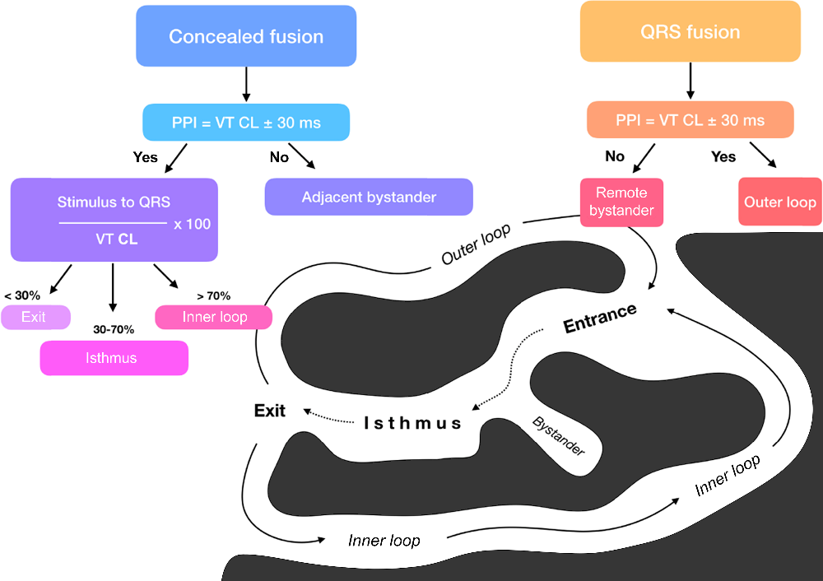
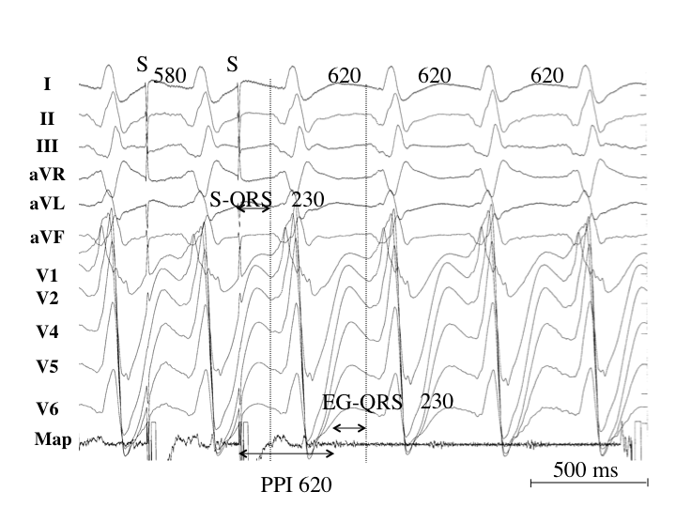
Mapping and Imaging Techniques
Entrainment responses from components of reentrant VT circuit
Pacing from the protected isthmus of a VT circuit; entrainment mapping during VT
Activation and entrainment mapping are used in tolerated VT to identify critical VT isthmuses and to perform localized VT ablation – highly specific, ischemic VT.
Advantage over substrate-based ablation: individual VTs can reliably be eliminated with few ablations.
Pace mapping is a technique used to locate the origin of a PVC or VT by stimulating the myocardium to reproduce the clinical 12-lead morphology in the absence of VT; it is particularly useful if the targeted arrhythmia is difficult to induce or is hemodynamically unstable.

Slide 29
Mapping and Imaging Techniques
Substrate Mapping in Sinus Rhythm
Recommendations for substrate mapping in sinus rhythm
COR | LOE | Recommendations
I | B-NR | In patients with scar-related VT, substrate-guided ablation is useful for prevention of arrhythmia recurrences.
IIa | B-NR | High-density multielectrode mapping to obtain a more comprehensive characterization of the arrhythmogenic tissue during catheter ablation of scar-related VT can be useful.
IIa | B-NR | In patients with no or minimal endocardial bipolar electrogram abnormalities, reduced unipolar voltage can be useful for detection of epicardial or intramural scar.
Intraprocedural Imaging During Catheter Ablation of Ventricular Arrhythmias
Recommendations for intraprocedural imaging during catheter ablation of VAs
COR | LOE | Recommendations
I | B-NR | Coronary angiography or ICE is recommended to localize the ostia of the coronary arteries prior to ablation within the SV.
I | B-NR | Coronary angiography is recommended to identify the course of the coronary arteries when ablation is performed in the coronary venous system or in the epicardium.
I | B-NR | ICE is beneficial to identify and target the papillary muscles with ablation and to assess for catheter stability.
I | B-NR | ICE or transthoracic echocardiography is useful to assess for pericardial effusion in case of hemodynamic deterioration of the patient.
I | C-LD | ICE is useful for early recognition of complications, including pericardial effusion.
IIb | B-NR | ICE may be useful as an adjuvant technique to identify wall segments with wall thinning, wall motion abnormalities, and segments with increased echogenicity, and also to identify intracardiac thrombi.

Slide 30
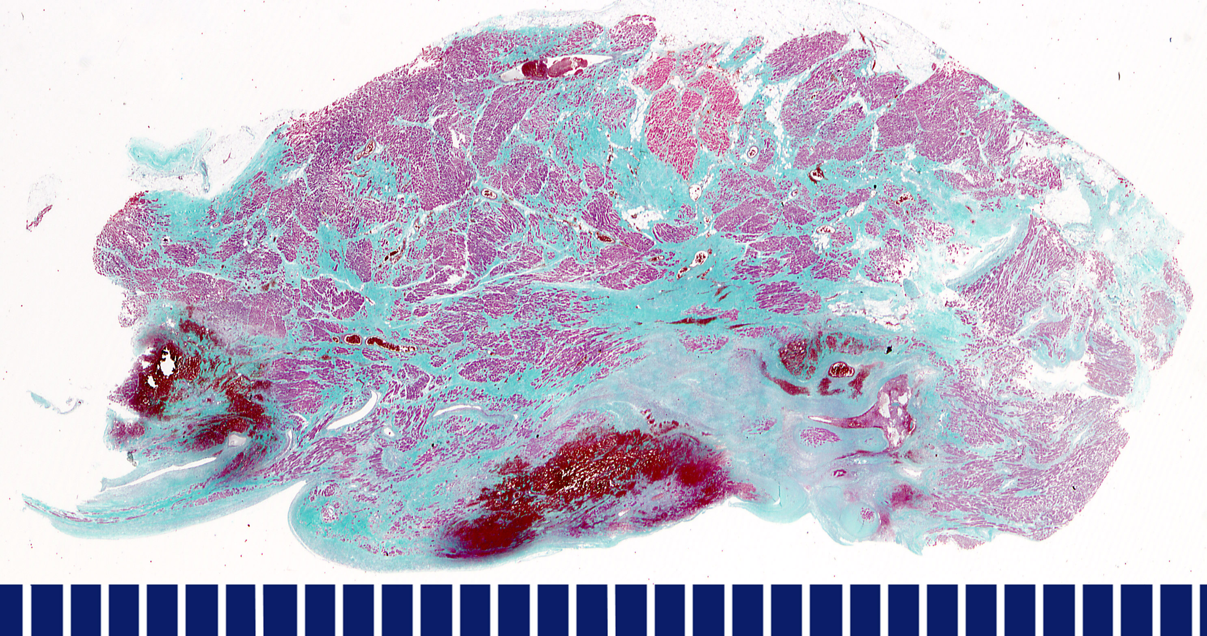
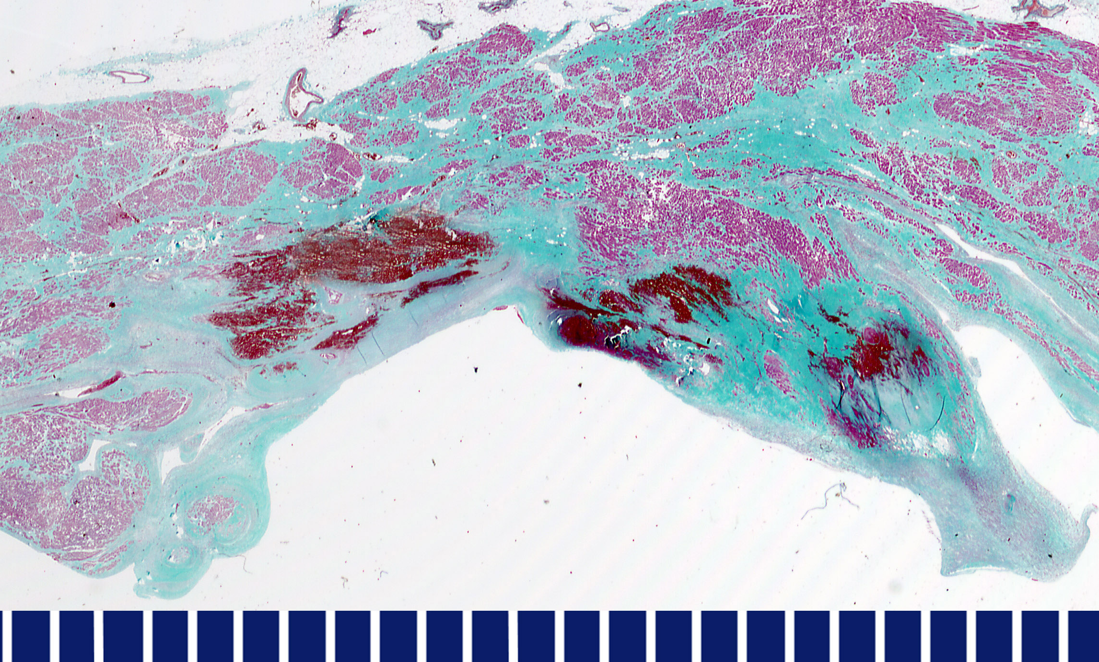
Sinus Rhythm Substrate Mapping
Ideally, ablation targets identified with substrate mappping act as diastolic channels for reentrant VT maintenance.
Only 30% of identified isthmi are related to VTs (increased if LPs detected).
Abnormal electrograms (identified with micro-electrode catheters) may help to identify conducting channels.
Arenal et al. Circulation 2004; Mountantonakis et al. JACC 2013

Slide 31
Mapping and Imaging Techniques
Electroanatomical Mapping Systems and Robotic Navigation
Recommendations for the use of EAM systems and remote navigation in ablation procedures for VAs
COR | LOE | Recommendations
I | B-NR | In patients with VA due to SHD undergoing an ablation procedure, EAM is useful.
IIa | B-NR | In patients with idiopathic VA undergoing an ablation procedure, EAM can be useful.
IIa | B-NR | In patients undergoing an ablation procedure for VA, magnetic catheter navigation can be useful to reduce fluoroscopy use.
Regardless of the type of EAM available, knowledge of the first principles of cardiac electrophysiology remains essential to create maps that accurately represent the physiology and anatomy.
Catheter-based ablation of VA requires significant demands on the skill and experience of the operator. The concept of remote or robotic catheter navigation is appealing to reduce the physical demands of the procedure while developing more advanced abilities to achieve stable and precise catheter location than traditional catheters can afford. Several technologies have been developed to achieve these goals.

Slide 32
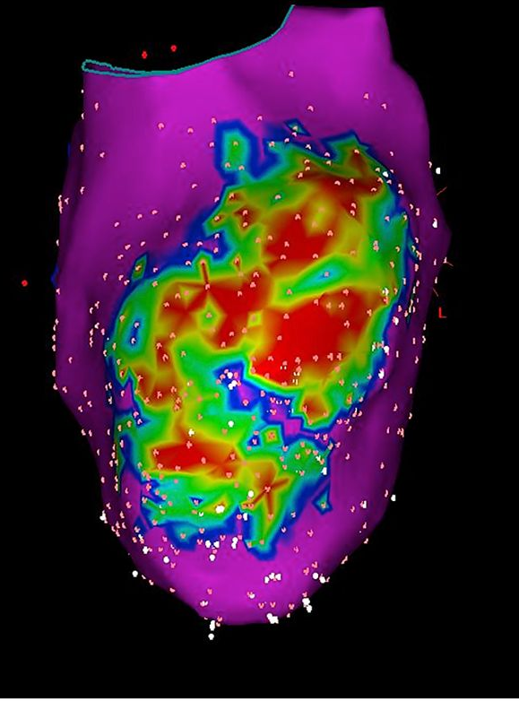
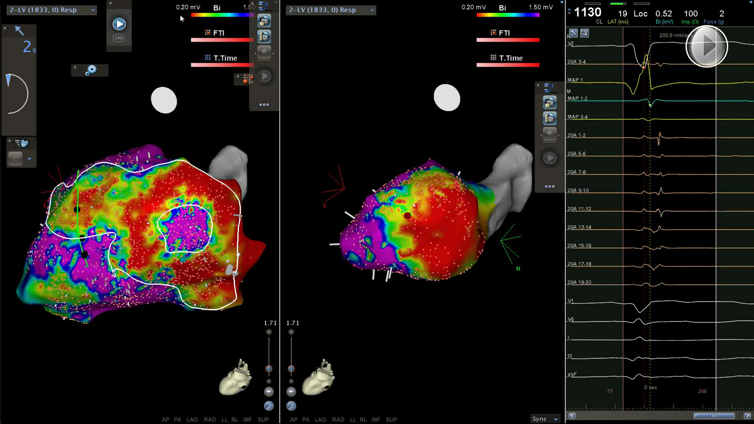
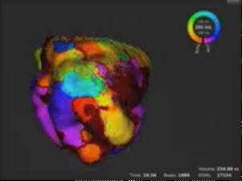
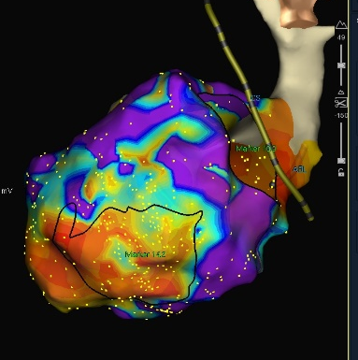
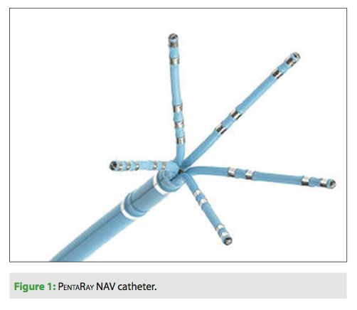
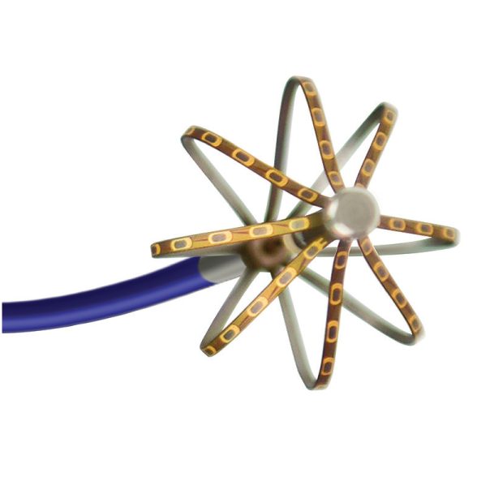
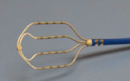
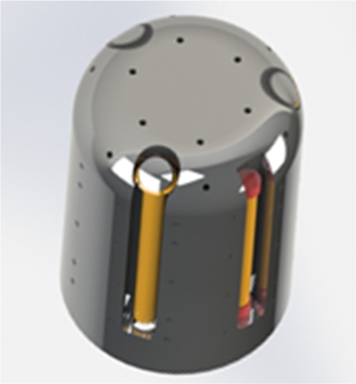
High-Density Mapping
Pentaray (BW) (20x 1mm poles, 2-6-2mm spacing, 5 arms)
IntellaMap Orion (BS) (64pole 8-spline basket, 0.4mm², 2.5mm spacing)
HD-Grid (SJM) (18x; 1mm poles, 2mm spacing; 4 splines)
Q-Dot (BW) (3.5mm irrigated tip; 3 embedded micro-electrodes)
Anter et al. Circ A&E 2015; Nayyar et al. Circ A&E 2014; Thajudeen et al. PACE 2015; Masse et al. Circ A&E 2016

Slide 33
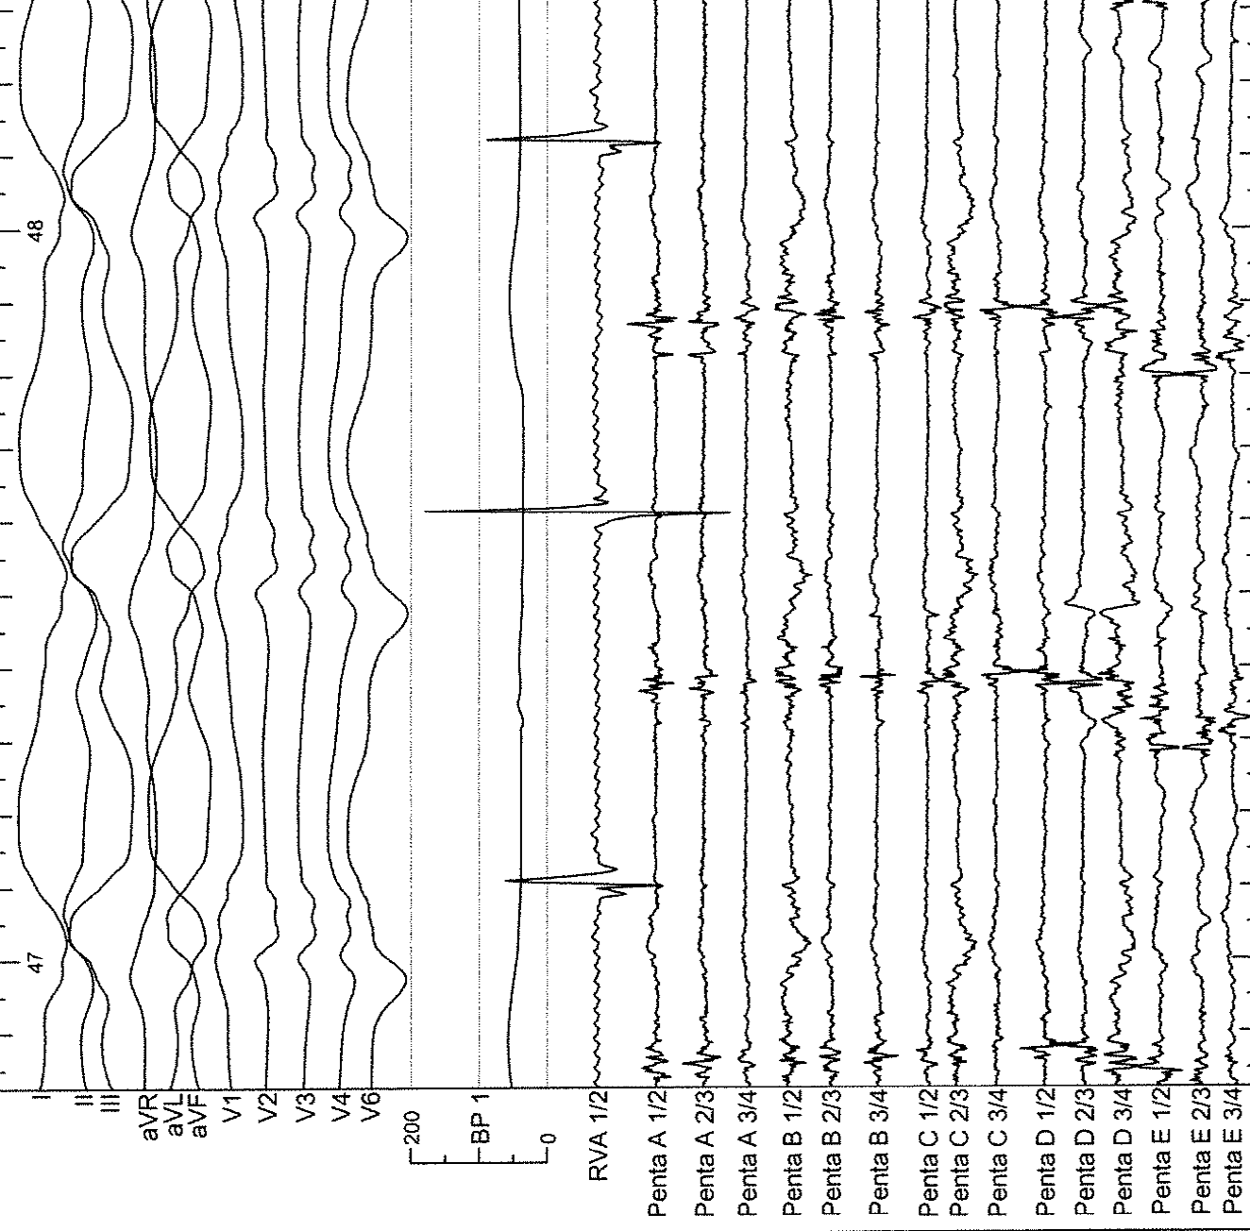
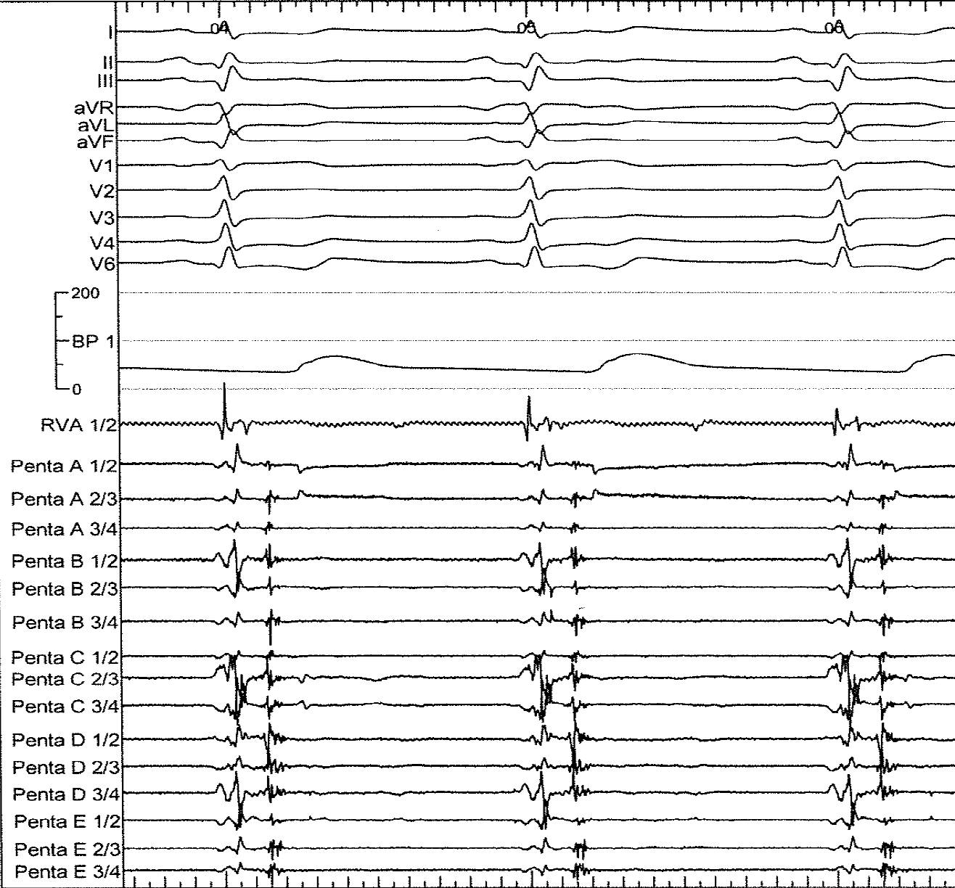
High-Density Mapping
High-density mapping increases sampling of electrical micro-signal information.

Slide 34
Summary: Mapping
1
Substrate-based approaches are recommended for structural VT but should implement classical EP maneuvers and require EAM.
2
HD mapping can be helpful to increase spatial and electrical resolution leading to shorter procedures and ablations.
3
EAM systems are recommended in structural and can be useful in idiopathic VAs.
4
Intraprocedural imaging helps to reduce complications and allows for early detection, may increase efficacy in a subset of VAs.

Slide 35
Practical Aspects of Catheter Ablation of Ventricular Arrhythmias
Access considerations
Important anatomical considerations
Avoiding complications
Ablation endpoint considerations
Overcoming challenges to effectively ablate

Slide 36
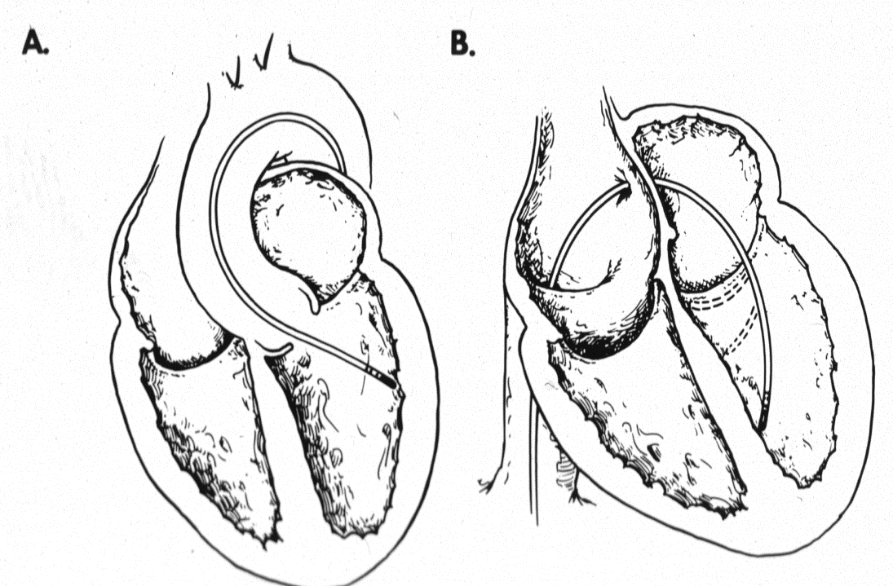
Anatomical Approach to the LV Endo: Considerations
Vascular/valvular disease (aorta atheroma, aortic/mitral disease)
Technical skill/experience of the operator
Anticipated region of interest in the LV (improve catheter stability)
Retrograde
Transseptal
Fascicular VT
Basal septal substrate in NICM
Basal Lateral Scar in NICM
Retrograde Lateral
Transseptal Septal

Slide 37
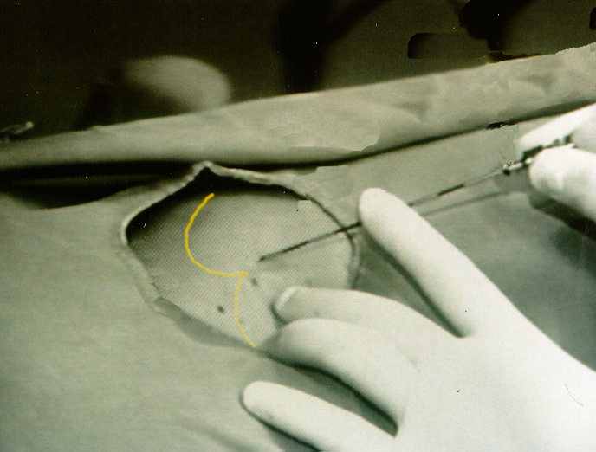
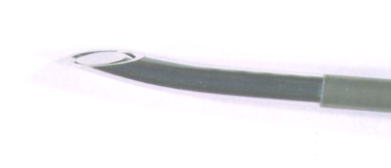
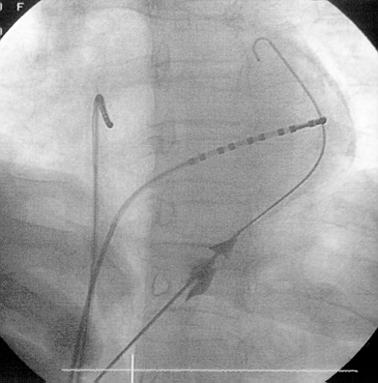
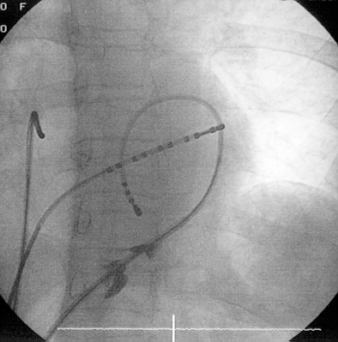
Percutaneous Epicardial Access
Epicardial Mapping and Ablation Underlying Substrate
Epicardial Mapping and Ablation
Underlying Substrate
N=587 procedures
18
53
24
72
Xyphoid
87
333
Guide wire
UPENN EXPERIENCE -
Epicardial
catheter
LAO
LAO
JCE 1996;7:531
JACC 2000;35:1442
Sosa and Colleagues/University of Sao Paolo, Brazil

Slide 38
Identification of Epicardial Substrate in ARVC with Unipolar Endo Mapping
PREDOMINANTLY EPI PREDICTED BY ENDO UNIPOLAR EGs

Slide 39
Epicardial Mapping/Ablation
Factors Limiting Percutaneous Access
Assess subxiphoid region – Prior abdominal surgery at site of access?
History of pericarditis – Adhesions?
History of prior epicardial ablation (How much ablation? Was there bleeding? Were intrapericardial steroids given?)
History of prior valve surgery (May still get percutaneous access – epicardial mapping typically limited around the valve area)
Prior coronary surgery (Very high risk – Surgical access typically needed)

Slide 40
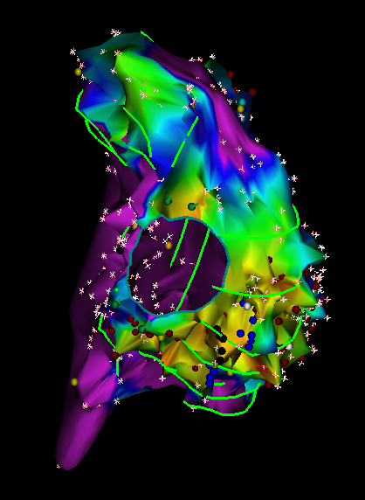
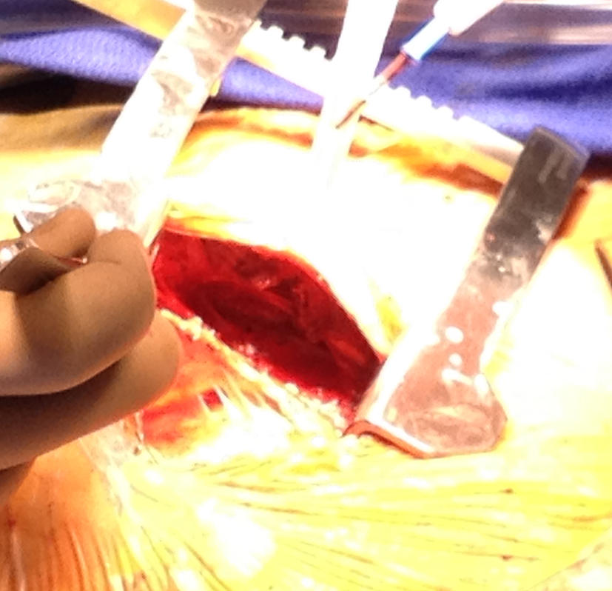
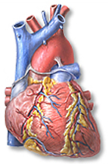
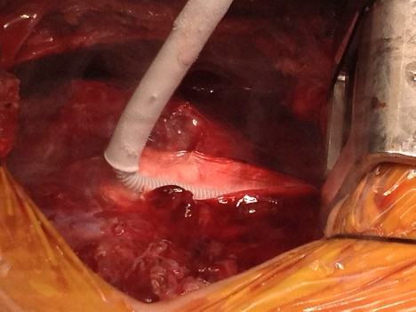
History of Prior Epicardial Ablation with Hemopericardium/ Severe Pericarditis
Consider Epicardial Surgical Cryoablation after Endocardial Catheter Ablation
Target perivalvular scar
Endo Scar
Adhesions
Matted Pericardium
ARVC Ablation Strategy
Cryoablation
Cryoablation targeting the RV free wall perivalvular scar
No inducible VT after surgery

Slide 41
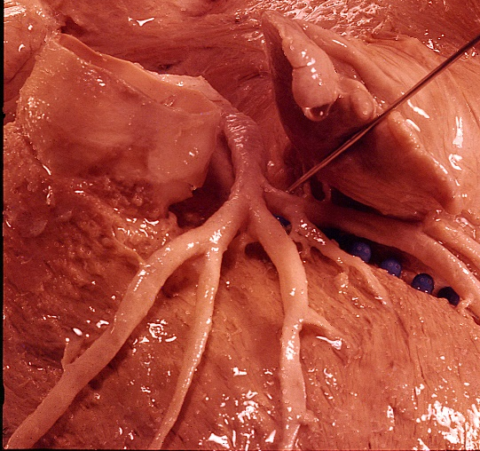
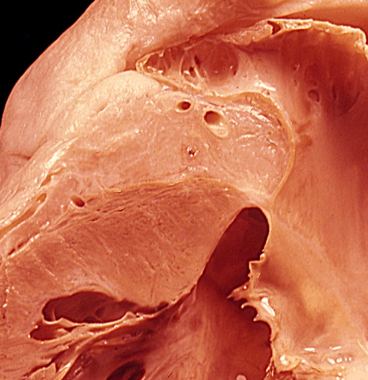
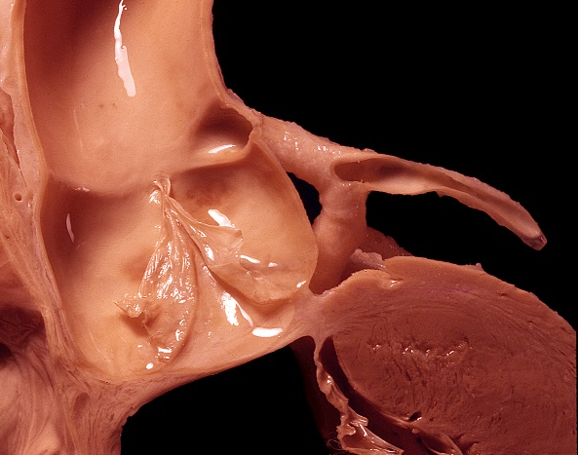
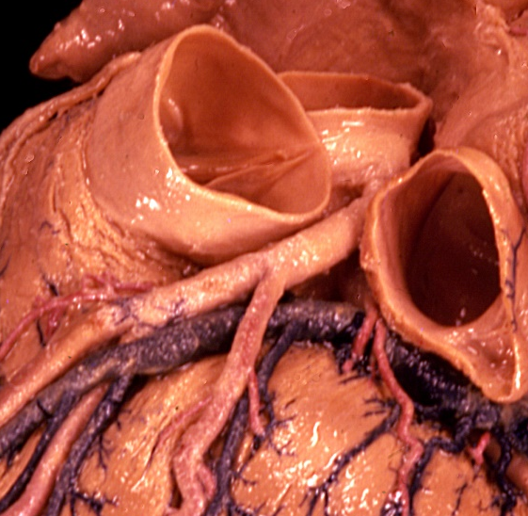
Proximal Epicardial LV SUMMIT (Top of LV) – Proximal Inaccessible
The limitation to access epicardially is the coronary arteries and epicardial fat
Left Main
Left Main
LAD
LAA
LAA
PA
Fat
NCC
LCC
Fat
RVOT
LV
AMC
LV
Map from the Coronary Venous Circulation (AIV/GCV)
Santangeli et al. Circulation EP 2015;8:337-343
Yamada et al. Circulation EP 2010;3:616-623
W.A. McAlpine Collection-UCLA Cardiac Arrhythmia Center (with permission)
PA
Left Main
Courtesy of Dr. Fermin Garcia/UCLA Team
RVOT
LAA
AIV
GCV

Slide 42
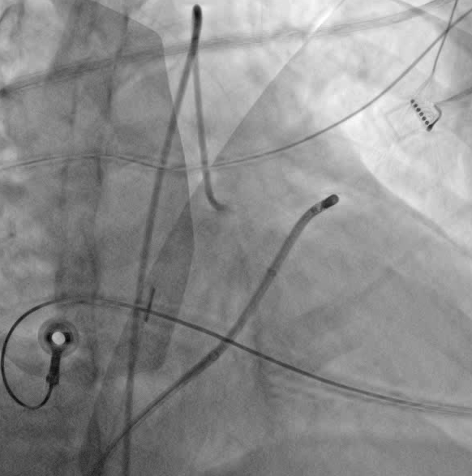
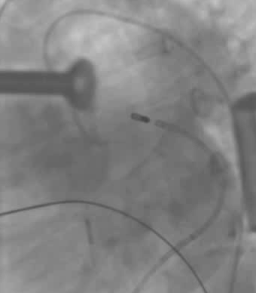
RAO
Risk – Coronary Injury with Ablation in Coronary Venous System
Coronary injury after ablating in venous system
LAO
Repeal Cath – 1 month after ablation
Catheter tip in distal great cardiac vein/ proximal AIV
Repeal Cath – 1 month after ablation

Slide 43
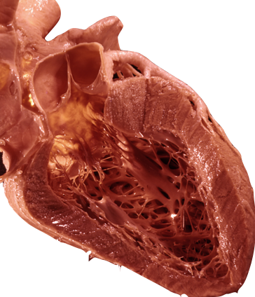
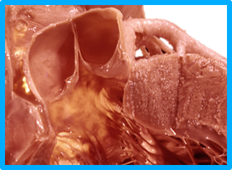
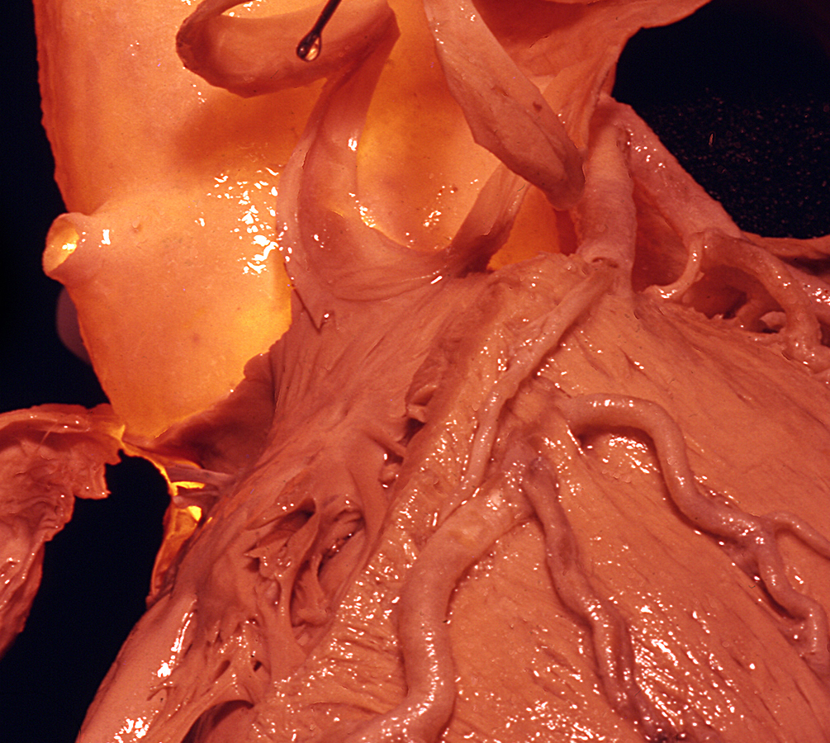
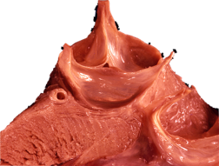
Proximal LV Summit
1
2
Ablation Strategies:
1 - From the GCV/AIV (gold standard)
From Surrounding Structures
2 - From the LCC
3 - From the LV endocardium (just in front of aortic valve)
4 - From the RVOT
3
Left Main
PA
4
PV
Ablation from adjacent site —
How close to earliest vein site do you need to be?
LAD
4
LV
LCC
Heart Rhythm 2012;9:865-873 Heart Rhythm 2017;14:141-148
Circ A&E 2014;7:978-981
Circ A&E 2014;7:906-912
W.A. McAlpine Collection-UCLA Cardiac Arrhythmia Center (with permission)

Slide 44
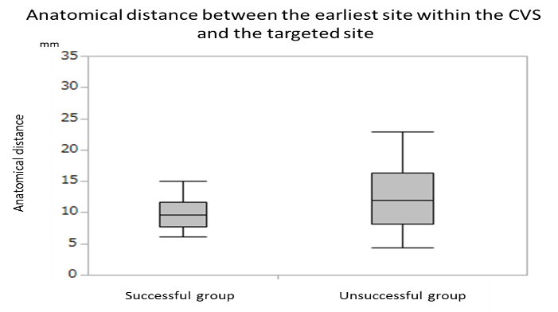
Importance of Anatomical Proximity for Success
53 pts - CVS earliest activation but energy not delivered or unsuccessful
46 (87%) proximity to coronary vessels
7 ineffective (13%)
Anatomical approach adjacent structures was successful in 26 (49%) patients
Proximity is Key!!!
7 (27%) from coronary cusps
2 (8%) from the anterior-septal RVOT
13.8 mm ± 6.5mm
17 (65%) from the Endocardial LVOT just in front of aortic valve
9.7±2.4 mm
Heart Rhythm 2012;9:865-873;
Europace 2019;21:484-491
>12.8 mm anatomical approach successful in 1/13 (8%).

Slide 45
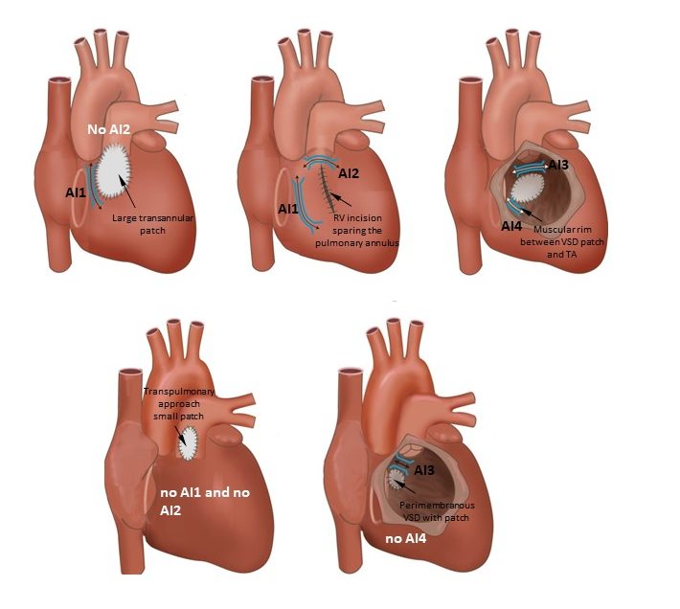
Potential Isthmuses for Macroreentry Based on Type of TET Repair Surgery
Free wall – Patch or incision -TV
Septal patch - PV
Free wall – Patch or incision - PV
Septal patch - TV

Slide 46
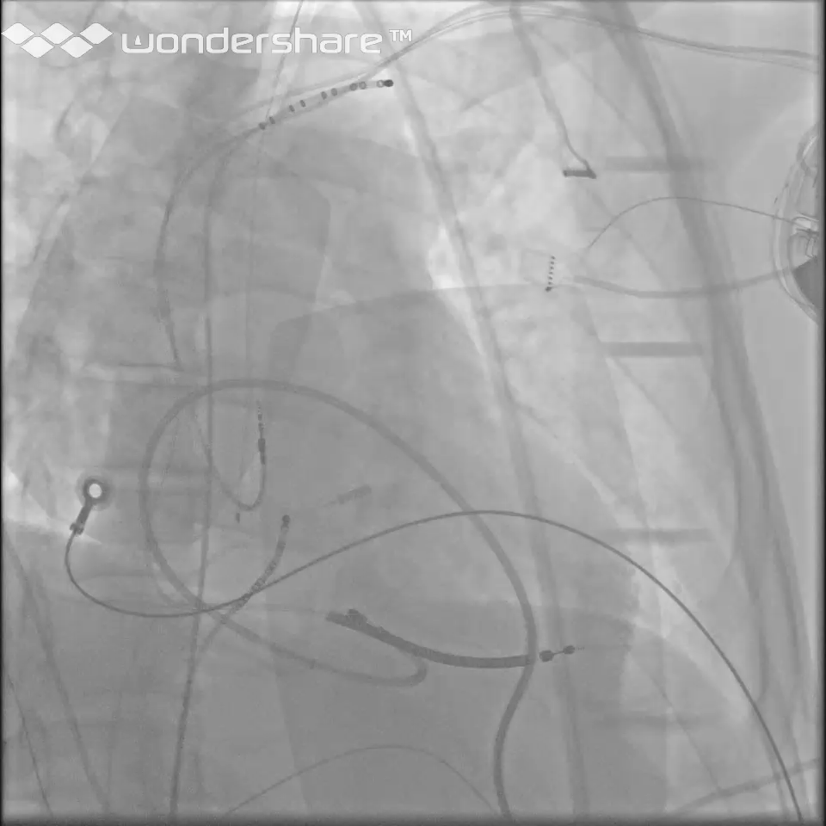
Phrenic Nerve Capture from RVOT Free Wall/LV Summit
Atypical course of left phrenic
near RVOT + LV summit
Typical course of left phrenic
Use vascular balloon to push out of way!
Lateral
Pacing Phrenic at L Subclavian to monitor for injury!
Medial
Medial
Circ A&E 2015;8:241-242

Slide 47
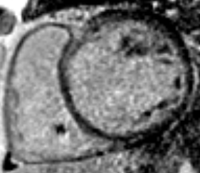
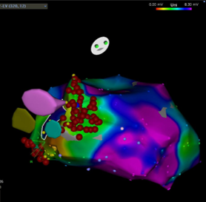
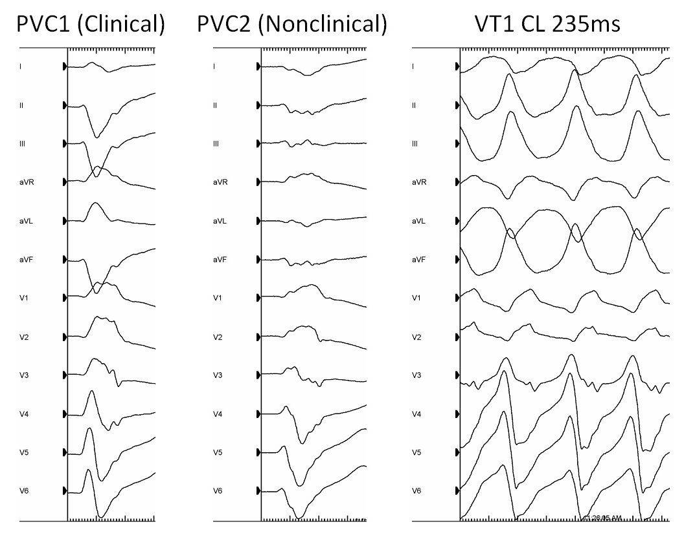
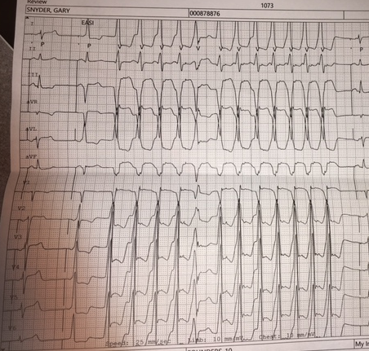
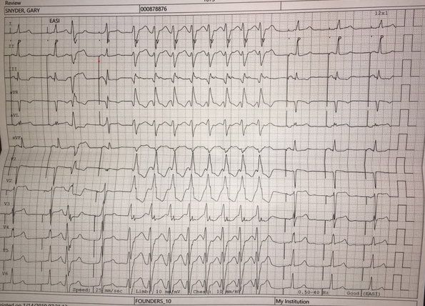
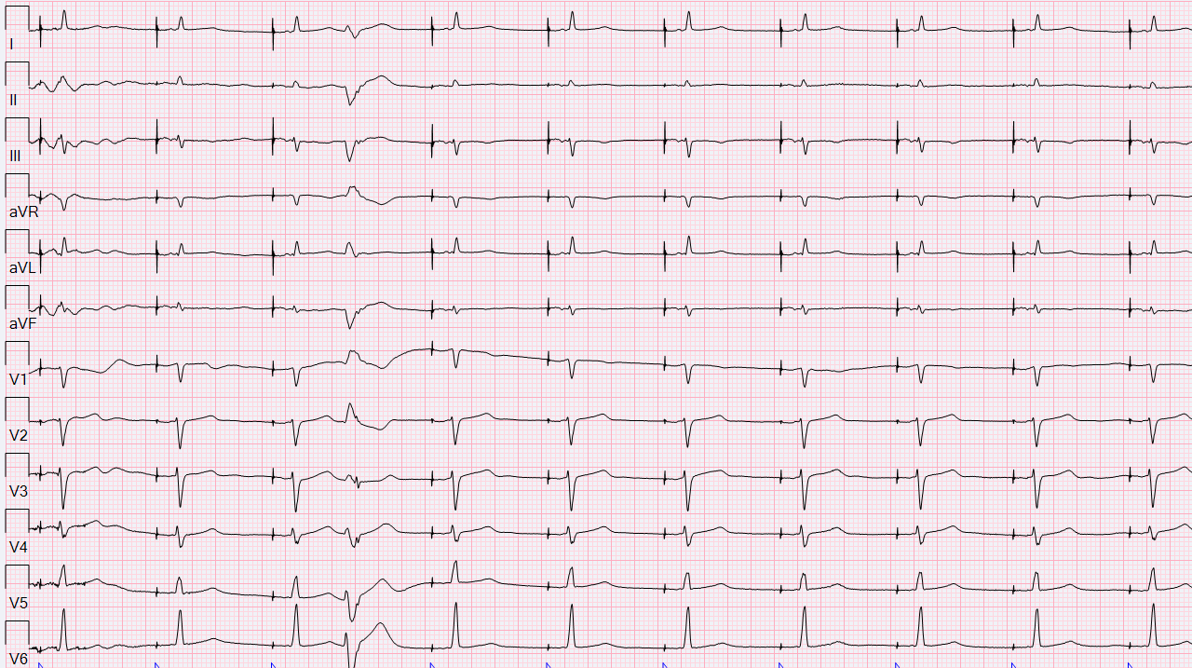


Multiple VT Exiting Adjacent to Septum
Target Septum but Spare the HPS
VT #1
VT #2
VT #3
A paced QRS

Slide 48

Noninducibility – VT Ablation Endpoint (Gold Standard)
Noninducibility of VT through triple extrastimuli from two RV sites — associated with decrease in recurrence
Ghanbari et al. Circulation 2014 (multicenter meta-analysis)

Slide 49


Repeat Noninvasive Programmed Stimulation (via ICD) at 1-3 Days after VT Ablation to Improve Predictive Value of Noninducibility
132 patients
45 patients
(11pts)
(34pts)
P < 0.004
24 patients (18%)
Clinical VT Ablated
Clinical VT Not Ablated
Frankel et al. J Am Coll Cardiol 2012;59:1529-1535; Muser et al. JACC Clin Electrophysiol 2019;5:719-727

Slide 50


Targets and Endpoints for VT Ablation
Beyond Noninducibility for Unstable VT
Elimination of late potentials
Elimination of LAVAs
  Multicomponent EGs brought out by pacing and prematures

Slide 51
Challenges in Using LPs/LAVA Ablation/Elimination as Endpoint
How many/which sites to pace to demonstrate LPs or LAVAs?
How do we deal with dead end/extraneous stuff?
What size electrodes should we use?
  Smaller is better, but is it necessary to use two catheters?
How long do you ablate at each site?
What is our endpoint?
  Elimination of all/most LAVAs /LP
How often do we remap?

Slide 52




Other Targets and Endpoints for VT Ablation
Beyond Noninducibility
Elimination of Channels
Scar Homogenization
Voltage Channel
LP + Voltage Channel
Voltage Threshold: 0.5 mV
Arenal et al. Circulation 2004;110:2568-2574
Hsia et al. Heart Rhythm 2006;3:503-512
Mountantonakis. JACC 2013;61:2088-2095
Berruezo. Circ Arrhythm Electrophysiol 2012;5:111-121
Di Biase et al. J Am Coll Cardiol 2012;60:132-141

Slide 53


VT Core Isolation with Entrance and Exit Block
Key elements of VT circuit form sinus or VT mapping (LPs, good Entrain) inside the planned area to be isolated
- “THE CORE”
Not transmural – just reach denser mid myocardial scar
CORE”
CORE”
From Endpoints for Ablation of VT Santangeli, Frankel, Marchlinski. Circ A&E 2014;7:949-960 +
From VT Core Isolation… Tzou, Frankel et al. Circ A&E 2015;8:353

Slide 54

Catheter Techniques When Stability a Challenge
Gordon et al. J Cardiovasc Electrophysiol 2018;29:1654-1663

Slide 55




NICM and VT Ablation
More Drugs and Repeat Procedures to Achieve Reasonable Outcome Challenge – Mid Myocardial Scar
>1 procedure: 36%
Muser, Santangeli et ali. Circ AE 2016
Dinov et al. Circulation 2014
RV Endo
LV Endo
Tokuda et al. JAHA 2013; Bogun et al. JACC 2009;53:1138

Slide 56

NICM and VT Ablation — More Effective Transmural Lesion When Longer ENDO/EPI, RV/LV Unipolar Lesions Ineffective?
Dictated by vessel location!
Transcoronary arterial/venous
ethanol
Bipolar ablation (investigational)
Simultaneous two-site unipolar ablation
Half normal saline irrigant
Needle catheter ablation
(investigational)
Intracoronary Alcohol Tokuda et al. Circ A&E 2011; Venous Alcohol Ablation Kreidieh et al. Circ A&E 2016; Bipolar Ablation Koruth et al. Heart Rhythm 2012;9:1932-1941;Half Normal Saline Nguyen et al. JACC EP 2017; Needle Electrode Sapp et al. Circulation 2013, JCE 2006

Slide 57

EP-guided Cardiac Radioablation
N Engl J Med 2017
25Gy
Immobilization
VT Substrate Ablation – Alternative to Catheter Ablation?

Slide 58
Mapping and Ablation
Key Points
Ablation Power Sources and Techniques
Idiopathic Outflow Tract VA
An impedance drop ≥10 ohms or a contact force ≥10 g is commonly used as a target for RF energy delivery.
The use of half normal saline generates larger ablation lesions but can result in steam pops.
Simultaneous bipolar or unipolar ablation can result in larger ablation lesions.
Cryoablation can be beneficial for achieving more stable contact on the papillary muscles.
Ethanol ablation can generate lesions in areas where the arrhythmogenic substrate cannot be otherwise reached, provided that suitable target vessels are present.
Stereotactic radiotherapy is an emerging alternative to ablation, requiring identification of a region of interest that can be targeted prior to the radiation treatment.
The RVOT, pulmonary arteries, SVs, LV epicardium and endocardium contain most of the OT arrhythmias.
Activation mapping and pace mapping can be used to guide ablation in the RVOT.
Imaging of coronary artery ostia is essential before ablation in the aortic SVs.
The LV summit is a challenging SOO, often requiring mapping and/or ablation from the RVOT, LVOT, SVs, coronary venous system, and sometimes the epicardial space.
Deep intraseptal VA origins can be challenging to reach.

Slide 59
Mapping and Ablation
Key Points
Idiopathic Nonoutflow Tract VA
Bundle Branch Reentrant VT and Fascicular VT
VAs originating from the papillary muscles can be challenging due to multiple morphologies of the VA and the difficulty in achieving and maintaining sufficient contact during ablation.
VAs originate in LV papillary muscles more often than in RV papillary muscles; they more often originate from the posteromedial than the anterolateral papillary muscle and occur more often at the tip than at the base.
Pace mapping is less accurate than in other focal VAs.
ICE is particularly useful for assessing contact and stability.
Cryoablation can also aid in catheter stability during lesion delivery.
BBR can occur in a variety of patients in whom the conduction system can be affected, including patients with DCM, valvular heart disease, MI, myotonic dystrophy, Brugada syndrome, and ARVC, among others.
Ablation of either the RBB or LBB eliminates BBRVT but does not eliminate other arrhythmic substrates.
A correct diagnosis of BBRVT is crucial and should employ established criteria prior to ablation of either of the bundle branches.
Ablation of the AV node does not cure BBRVT.
Ablation of either bundle branch does not cure interfascicular VT.
For posterior fascicular VTs, the P1 potential is targeted during VT; if P1 cannot be identified or VT is not tolerated, an anatomical approach can be used.
Purkinje fibers can extend to the papillary muscles, and these can be part of the VT circuit.
For anterior fascicular VTs, the P1 potential is targeted with ablation.
Focal nonreentrant fascicular VT is infrequent and can occur in patients with IHD; however, it cannot be induced with programmed stimulation, and the target is the earliest Purkinje potential during VT.

Slide 60
Mapping and Ablation
Key Points
Postinfarction VT
Dilated Cardiomyopathy
In cases of multiple inducible VTs, the clinical VT should be preferentially targeted.
Elimination of all inducible VTs reduces VT recurrence and is associated with prolonged arrhythmia-free survival.
For tolerated VTs, entrainment mapping allows for focal ablation of the critical isthmus.
For nontolerated VTs, various ablation strategies have been described, including targeting abnormal potentials, matching pace mapping sites, areas of slow conduction, linear lesions, and scar homogenization.
Imaging can be beneficial in identifying the arrhythmogenic substrate.
Epicardial ablation is infrequently required, but epicardial substrate is an important reason for VT recurrence after VT ablation in patients with prior infarcts.
Identifying the location and extent of scarring on CMR is beneficial in procedural planning and has improved the outcomes of ablation in patients with DCM.
The ablation strategy is similar to postinfarction VT.
An intramural substrate is more frequently encountered in DCM than in postinfarction patients and requires a different ablation strategy than for patients with either epicardial or endocardial scarring.
Epicardial ablation is beneficial if the scar is located in the epicardium of the LV free wall.
For intramural circuits involving the septum, epicardial ablation is not beneficial.
In the absence of CMR, unipolar voltage mapping has been described as a method to indicate a deeper-seated scar.

Slide 61
Mapping and Ablation
Key Points
VT Ablation in Hypertrophic Cardiomyopathy
Brugada Syndrome
Polymorphic VT and VF are the most common VAs in HCM; monomorphic VT is less common.
The arrhythmogenic substrate in HCM often involves the septum but can extend to the epicardium, often necessitating combined endocardial and epicardial ablation procedures to eliminate the VT.
VT associated with apical aneurysms is often ablated endocardially.
PVC-triggered VF or polymorphic VT are the most prevalent VAs that motivate device therapy in patients with Brugada syndrome.
Monomorphic VT is less frequent but can be caused by BBRVT in patients with Brugada syndrome.
The arrhythmogenic substrate is located in the RV epicardium and can be demonstrated by sodium channel blockers.
Ablation targets include fractionated prolonged electrograms on the epicardial aspect of the RV.

Slide 62
Mapping and Ablation
Key Points
Polymorphic VT/VF Triggers
ARVC
Recurrent PVC-induced VF is most often triggered by PVCs originating from Purkinje fibers, located in the RVOT, the moderator band, or the LV.
Patients with a single triggering PVC are better ablation candidates; however, there are often multiple triggers.
Patients with healed MI often require extensive ablation of the Purkinje fiber system within or at the scar border.
Ischemia should be ruled out as a trigger for VF prior to ablation.
The arrhythmogenic substrate in ARVC is located in the epicardium and can involve the endocardium in advanced stages.
The most commonly affected areas are the subtricuspid and RV outflow regions.
LV involvement is not uncommon.
Endocardial-epicardial ablation is often required and results in higher acute success and lower recurrence rates compared with endocardial ablation alone.
Conventional mapping and ablation techniques, including entrainment mapping of tolerated VT, pace mapping, and substrate ablation, are used.

Slide 63
Mapping and Ablation
Key Points
Mapping and Ablation in CHD
Sarcoidosis
Patients with a VT substrate after congenital heart defect surgery include those with repaired tetralogy of Fallot, repaired VSD, and repaired d-transposition of the great arteries (D-TGA), as well as Ebstein’s anomaly among other disease processes.
VT isthmuses are often located between anatomical barriers and surgical incisions or patch material.
An AI can be identified and targeted during sinus rhythm.
For tolerated VTs, entrainment mapping is the method of choice for identifying critical components of the reentry circuit.
The arrhythmogenic substrate in cardiac sarcoidosis is often intramurally located but can include the endocardium and epicardium.
A CMR is beneficial in planning an ablation procedure in cardiac sarcoidosis.
The arrhythmogenic substrate can be complex and can include areas of active inflammation and chronic scarring.
The VT recurrence rate after ablation is high.

Slide 64
Mapping and Ablation
Key Points
Chagas Disease
Miscellaneous Diseases and Clinical Scenarios With VT
The pathogenesis of the Chagas disease is poorly understood but often results in an inferolateral LV aneurysm.
The arrhythmogenic substrate is located intramurally and on the epicardial surface, often necessitating an epicardial ablation procedure.
Lamin cardiomyopathy often has a poor prognosis, progressing to end-stage heart failure.
VT ablation is challenging due to intramural substrates.
VT recurrence rate is high after ablations.
VT in patients with noncompaction tends to originate from regions of noncompacted myocardium where scar can be identified in the midapical LV.
VT ablation in patients with LVAD can be challenging due to the limitation of preprocedural imaging, and the electromagnetic noise generated by the LVAD.

Slide 65
Mapping and Ablation
Key Points
Surgical Therapy
Sympathetic Modulation
Surgery-facilitated access to the epicardium via a limited subxiphoid incision can be helpful in the case of adhesions.
Cryoablation via thoracotomy is possible for posterolateral substrates and via sternotomy for anterior substrates.
Sympathetic modulation targeting the stellate ganglia by video-assisted thoracoscopy may be considered for failed VT ablation procedures or VF storms.
A temporary effect can be obtained with the percutaneous injection or infusion of local anesthetics.
Endpoints of Catheter Ablation of VT
Noninducibility of VT by PES after ablation is a reasonable endpoint and predictor for VT recurrence after VT ablation in patients with SHD.
Due to the limitations of programmed stimulation, endpoints other than noninducibility have been described, including elimination of excitability, elimination of LPs or LAVA, dechanneling, substrate homogenization, core isolation, image-guided ablation, and anatomically fixed substrate ablation.

Slide 66
Postprocedural Care
Postprocedural Care: Access
Recommendations for management of venous access sites after catheter ablation of VA
COR | LOE | Recommendations
I | A | Manual compression is effective in achieving hemostasis after venous access for VT ablation.
IIa | B-R | Venous access closure using temporary purse-string or figure-of-8 suture techniques can be useful in achieving faster hemostasis and earlier ambulation and reducing pain or discomfort associated with hemostasis compared to manual compression.
Recommendation for management of arterial access sites after catheter ablation of VA
COR | LOE | Recommendation
I | A | Achieving arterial access site hemostasis using either manual compression or a vascular closure device is recommended.
Recommendations for management of epicardial access sites after catheter ablation of VA
COR | LOE | Recommendations
I | C-EO | If pericardial bleeding or cardiac tamponade has occurred during epicardial VT ablation, a pericardial drain should be left in place until bleeding has resolved.
IIa | B-NR | The instillation of intrapericardial corticosteroids can be effective in reducing pericarditic chest pain after epicardial VT mapping or ablation.
IIa | B-NR | To reduce pericardial pain after epicardial VT ablation, unless pericardial bleeding or cardiac tamponade has occurred, it is reasonable to remove all pericardial access sheaths at the end of the procedure.
IIb | C-EO | Leaving a pericardial drain in place might be reasonable in patients at high risk for late bleeding or cardiac tamponade after epicardial VT ablation.

Slide 67
Postprocedural Care
Postprocedural Care: Anticoagulation
Recommendations for anticoagulation after VA ablation procedures
COR | LOE | Recommendations
IIa | C-LD | After less extensive endocardial VT ablation, treatment with an antiplatelet agent for a limited period of time is reasonable.
IIa | C-LD | Heparin reversal with protamine for sheath removal after ablation is reasonable.
IIb | C-LD | After extensive endocardial VT ablation, treatment with an oral anticoagulant for a limited period of time might be reasonable.
IIb | C-EO | The use of heparin bridging after endocardial VT ablation may be considered but can be associated with an increased risk of periprocedural bleeding.
Postprocedural Care: Disposition
After completion of VT ablation, patients are generally monitored on telemetry in the hospital for at least 1 day, and often longer for VT ablation in cases of SHD or heart failure.
A survey of the writing committee showed that 42% routinely have patients monitored in an intensive care unit after ventricular ablation. Stable patients are kept in the hospital for 1 day (overnight) by 35%, 2 days by 52%, 3 days by 9%, and >3 days by 4% of the writing committee members.

Slide 68
Postprocedural Care
Incidence and Management of Complications
Higher in patients with structural heart disease
Major complications: 8-10%
Vascular damage and pericardial complications are the most common
Higher complications rates in procedures initiated after 2 p.m.
Pothineni et al. Int J Cardiol 2015; Peichl et al. Circ A&E 2014

Slide 69
Complications of VT Ablation
Complication | Incidence | Mechanisms | Prevention
Early/in-hospital mortality | 0-3% | VT recurrence, HF, complication of ablation | Optimize clinical status before ablation
Long-term mortality | 3-35% (12-39 months of follow-up) | VT recurrence/HF progression | Heart transplant
Neurological complications | 0-2.7% | Emboli from LV, aorta and cerebral bleeding | Careful anticoagulation control; use of ICE
Pericardial complications | 0-2.7% | Catheter manipulation, RF delivery, perforation | Contact force, careful in RF delivery in perivenous foci and RVOT
AV block | 0-1.4% | Energy delivery near the conduction system | Careful monitoring during ablation
Coronary artery damage/MI | 0.4-1.9% | Catheter manipulation in the aortic root and ablation near coronary artery | Limiting power near coronary arteries; ICE is useful to visualize the coronary ostium
Heart failure/pulmonary edema | 0-3% | External irrigation, sympathetic response due to ablation, and VT induction | Urinary catheter and careful attention to fluid balance and diuresis; optimize clinical status before ablation; reduce irrigation volume if possible (decrease flow rates or use closed irrigation catheters)
Acute hemodynamic decompensation/ cardiogenic shock | 0-11% | Fluid overload, general anesthesia, sustained VT | Close monitoring of fluid infusion, optimize medical status before ablation; Substate mapping preferred
Valvular injury | 0-0.7% | Catheter manipulation, especially retrograde crossing the aortic valve and entrapment in the mitral valve; energy delivery to subvalvular structures, including papillary muscle | Careful catheter manipulation; ICE can be useful for identification of precise location of energy delivery
Vascular injury | 0-6.9% | Access to femoral arterial and catheter manipulation | Ultrasound-guided access

Slide 70
Predictors of Early Mortality
Fluid and electrolytes disturbances
Smoking
Hypothyroidism
Chronic renal failure
Peripheral vascular disease
Lower LVEF
History of AF
Ischemic cardiomyopathy
Multiple slow VTs
VT ablation in low- or medium-volume centers

Slide 71
Postprocedural Care
Hemodynamic Deterioration and Proarrhythmia
Recommendation for echocardiography after VA ablation
COR | LOE | Recommendation
I | C-LD | Echocardiography should be performed in case of hemodynamic deterioration post-VT ablation to assess for pericardial effusion and cardiac tamponade.
Extensive ablation in viable myocardium and repeated VT episodes with hypotension that can cause myocardial ischemia can lead to worsening of heart failure or cardiogenic shock in patients with impaired ventricular function.
Close monitoring of LV function and potential need for continued hemodynamic monitoring and/or support might be necessary after such ventricular ablation procedures.

Slide 72
Postprocedural Care
Follow-up after VT Ablation
Recommendation for noninvasive programmed stimulation (NIPS) after catheter ablation of VT
COR | LOE | Recommendation
IIa | B-NR | NIPS can be useful in the several days following VT catheter ablation to inform further management, including ICD programming, predicting the risk of VT recurrence, and/or considering a repeat VT catheter ablation.
Close follow-up of patients after VT catheter ablation is critically important because complications can be detected and addressed during this period, and decisions regarding postprocedural management are made. These decisions relate to whether to perform NIPS, whether to maintain the patient on an AAD, and how to best program and follow ICDs in patients with such devices.

Slide 73

Assessing the Outcomes of Catheter Ablation
Important outcomes of clinical trials for VA catheter ablation include procedure-related complications and mortality, recurrent VA, long-term mortality, and quality of life. It is also important to recognize that outcomes are also impacted by the many factors following ablation that have the potential to influence the frequency and nature of arrhythmia recurrences.

Slide 74
Training and Institutional Requirements and Competencies
Recommendation for training requirements and competencies for catheter ablation of VA
COR | LOE | Recommendation
I | C-EO | For clinical cardiac electrophysiologists who perform catheter ablation of VAs, appropriate advanced training and continued lifelong learning is recommended.
Recommendations for institutional requirements for catheter ablation of VT
COR | LOE | Recommendations
I | C-EO | Patients with certain underlying medical conditions and comorbidities undergoing complex VA ablations who are deemed to have increased procedural risk should undergo procedures in a hospital-based electrophysiology laboratory.
I | C-EO | Onsite interventional cardiology expertise is recommended for electrophysiology procedures requiring coronary imaging to delineate coronary anatomy for epicardial ablation, aortography to delineate coronary ostia for SV VT ablation, and need for placement of HS devices.
I | C-EO | Onsite cardiothoracic surgical backup is recommended for electrophysiology procedures requiring pericardial access due to the potential need for emergent sternotomy and cardiopulmonary bypass.
I | C-EO | Availability of anesthesia personnel is recommended for all patients undergoing catheter ablation of VAs.

