Slide 1
Sharing This Information
The Heart Rhythm Society develops presentation slides as an
educational tool for electrophysiologists, cardiologists, and other licensed
health care practitioners. You may download and retain a single copy for your
personal use.
Please contact clinicaldocs@hrsonline.org to learn more about options for
sharing this content beyond your personal use.

Slide 2
2017 HRS/EHRA/ECAS/APHRS/SOLAECE Expert Consensus Statement on Catheter and Surgical Ablation of Atrial Fibrillation
Training Requirements, Surgical Ablation, and Clinical Trial Design
Eduardo B. Saad, MD, PhD, FHRS

Slide 3
Training Requirements
Fundamental Principles
Appropriate selection of patients
Knowledge of the anatomy of the atria and adjacent structures
Conceptual knowledge of strategies to ablate AF
Technical competence
Recognition, prevention, and management of complications
Appropriate follow-up and long-term management

Slide 4
Training Requirements
Technical Competence
LA access and instrumentation
Appropriate use of fluoroscopy, 3D mapping systems, and ICE
Principles of radiation safety
Interpretation of intracardiac EGMs (PVs)
Concomitant atrial arrhythmias
Energy sources (RF, Crio and Balloon Ablation)

Slide 5
Training Requirements
Procedural Experience
At least 50 AF ablations and 30 macroreentrant ATs
20 isthmus and 10 nonisthmus-dependent / macroreentry
Supportive of the 2015 ACC/AHA/HRS Advanced Training Statement
Several AF procedures per month to maintain competence
Underestimation of the experience required for a high degree of proficiency
To perform AF ablation indepedently
Aditional training after the standard fellowship if < 50 cases

Slide 6
Surgical and Hybrid AF Ablation
Terminology
Avoid the term “Lone AF” to describe population of AF patients
Stand-alone ablation
When no concomitant procedure is performed
Maze procedure
Refer only to the biatrial lesion set of the Cox-Maze surgery
Less extension lesion sets
Surgical AF ablation procedure (PVI or PVI + lesions)

Slide 7
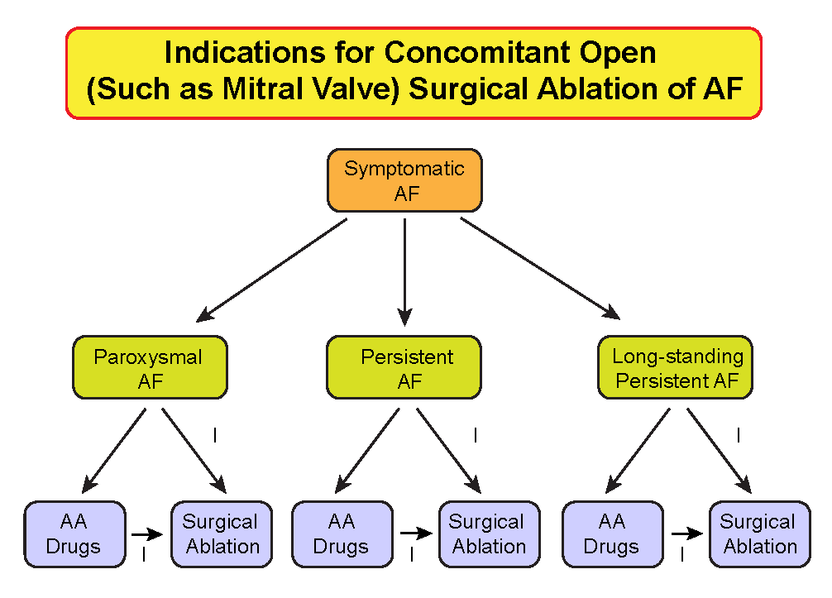
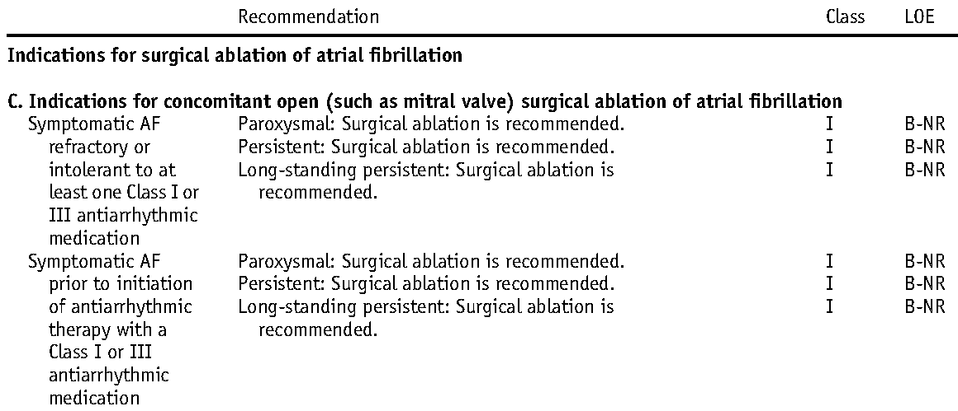
Surgical AF Ablation
Surgical AF Ablation

Slide 8
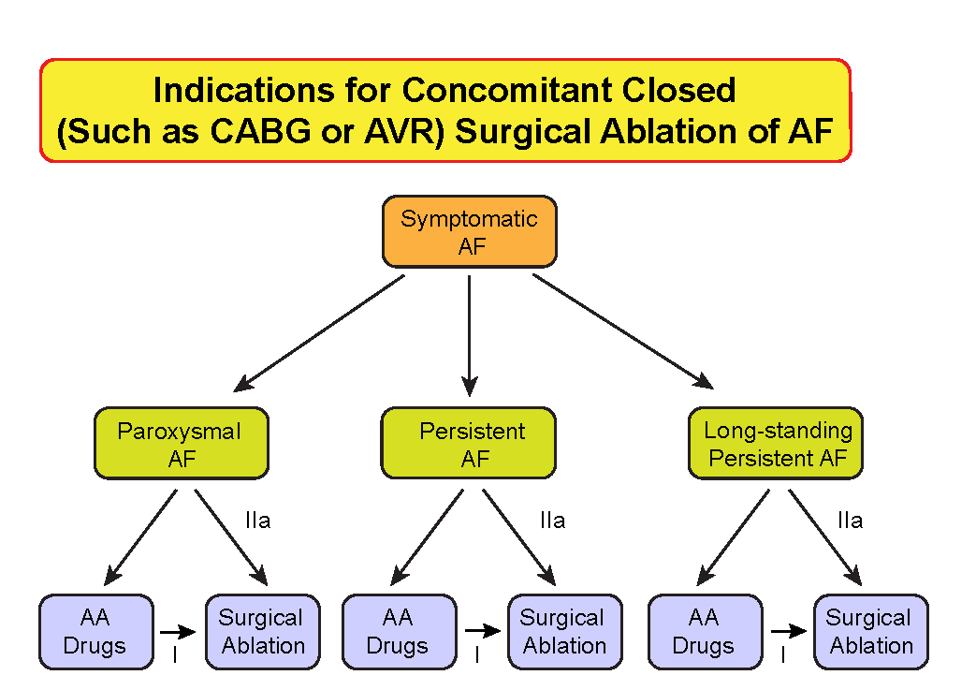
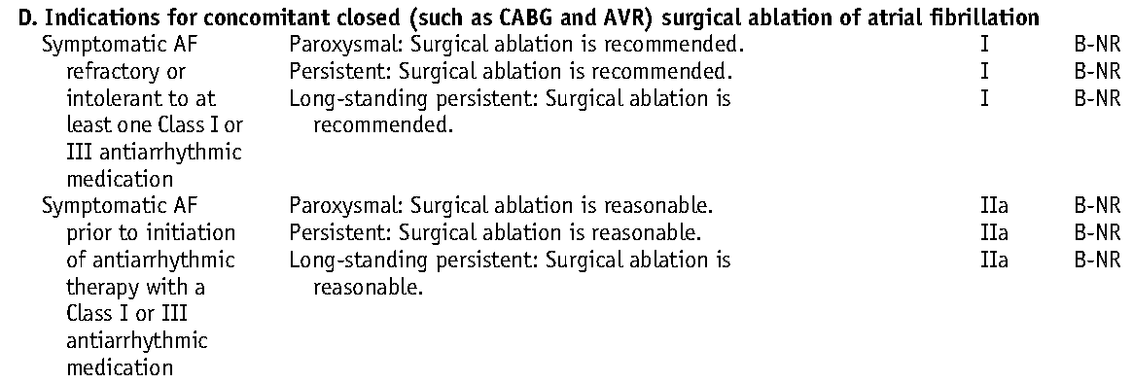
Surgical AF Ablation
AF vs Surgical Pathology?
Class IIa, LOE B

Slide 9
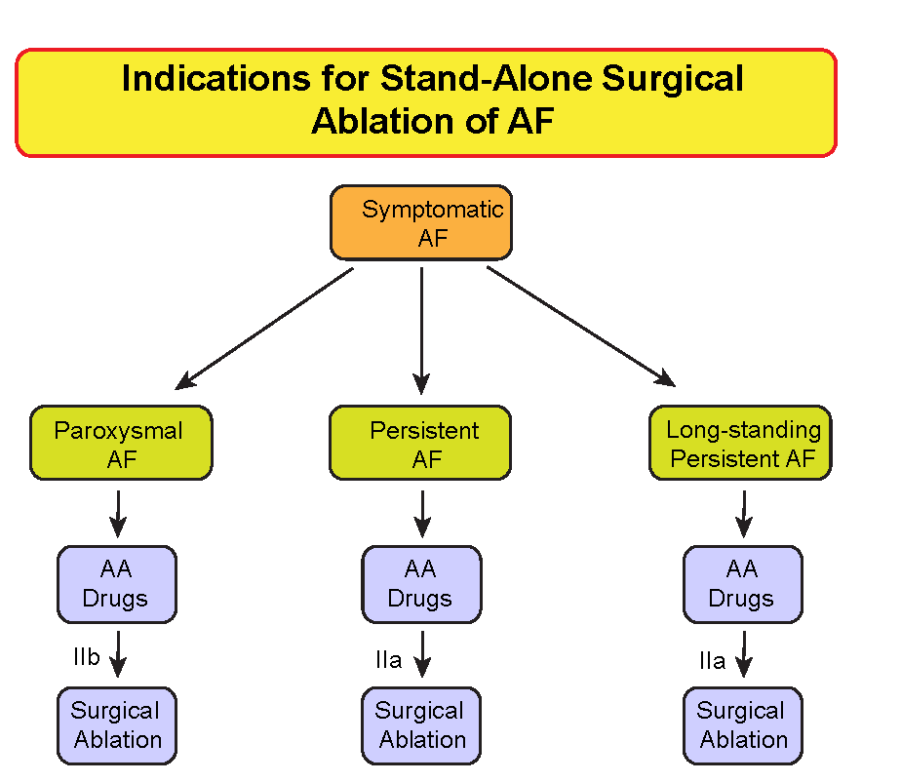
Surgical AF Ablation
After review of relative safety and efficacy vs catheter ablation
After failed 1 or more attempts at catheter ablation
LOE B

Slide 10
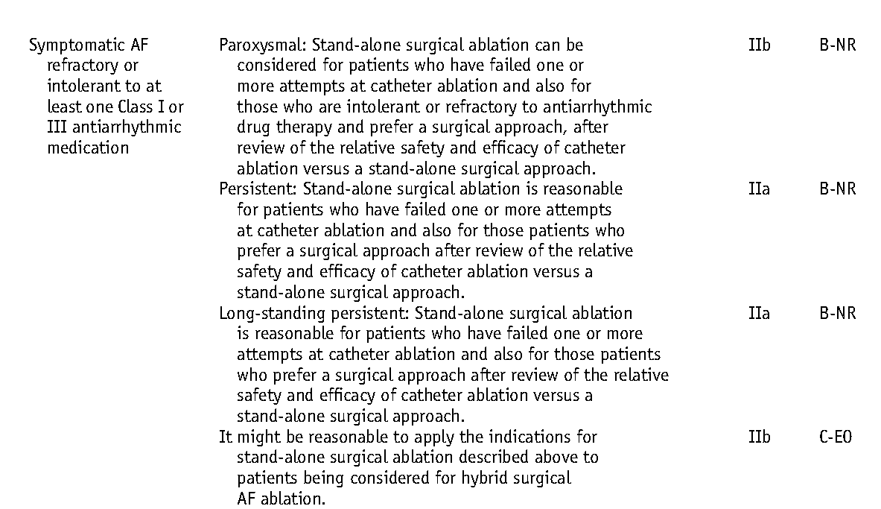
Surgical AF Ablation
Hybrid Procedures:
Complementary endo + epi ablation
Touch-up catheter ablation of surgical endocardial gaps
Catheter ablation of ICT, CS, flutters and focal triggers
Class IIb, LOE C

Slide 11
Clinical Trial Design
Clinical Endpoint Considerations
Multitude of different endpoints used in trials
Efficacy, QOL measures, non-AF recurrence endpoints, complications
Consistency in reporting by using standardized definitions
Success, complications, minimum monitoring after ablation

Slide 12
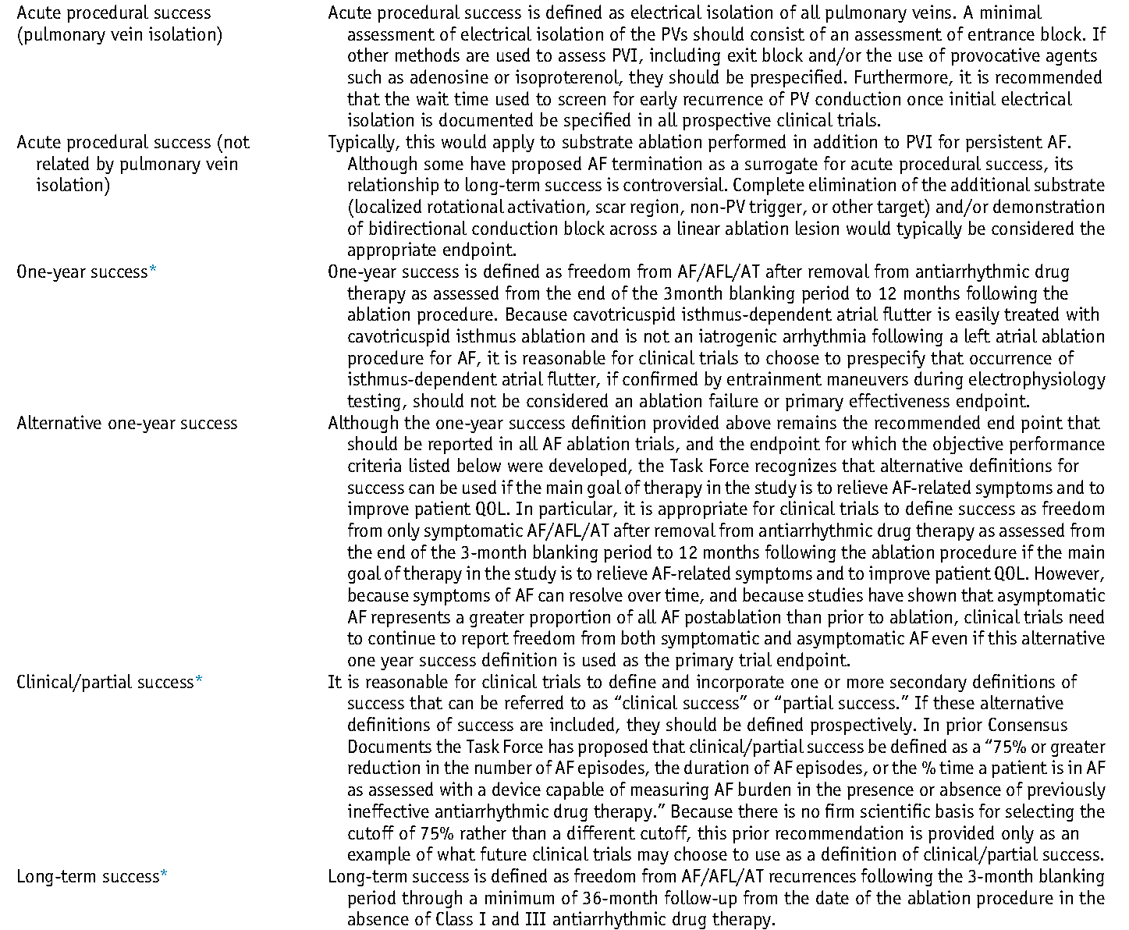
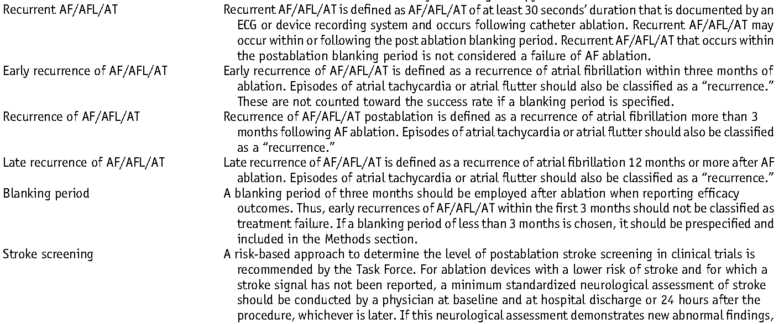
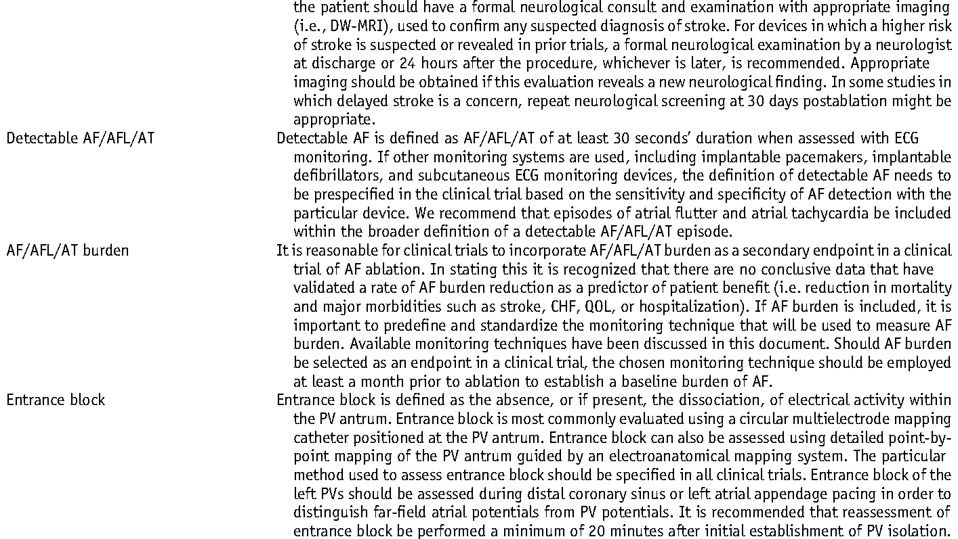
Clinical Trial Design
Definitions for Use When Reporting Outcomes and Designing Clinical Trials

Slide 13
Clinical Trial Design
AF Recurrence Endpoints
Freedom from any atrial arrhythmia (AF, AT, or AFL) >30s off AADs
Gold standard for reporting efficacy
All trials should report single-procedure off AAD efficacy with minimum
12-month follow-up

Slide 14
Clinical Trial Design
30s Cutoff for Arrhythmia Recurrence
Stringent and might not accurately reflect more clinically relevant
endpoints
Reduction in total AF burden, symptom abatement, improvement in QOL = underestimation of true benefits
2. More liberal endpoints suggested
Greater than 2 minutes (implantable monitoring technology detection limit)
Greater than 6 minutes, greater than 1 hour, or greater than 5-6 hours – stroke relevant duration

Slide 15
Clinical Trial Design
AF Burden
More optimal endpoint for assessing efficacy
Estimated on long-term monitoring
Truly defined only by implantable devices
Freedom from relevant AF
Low daily AF burden (<1%-2%) – might be an acceptable outcome
Reduction in AF burden >75% = clinical success
Number of episodes necessitating urgent or emergency care visits
Cost-effectiveness of the procedure

Slide 16
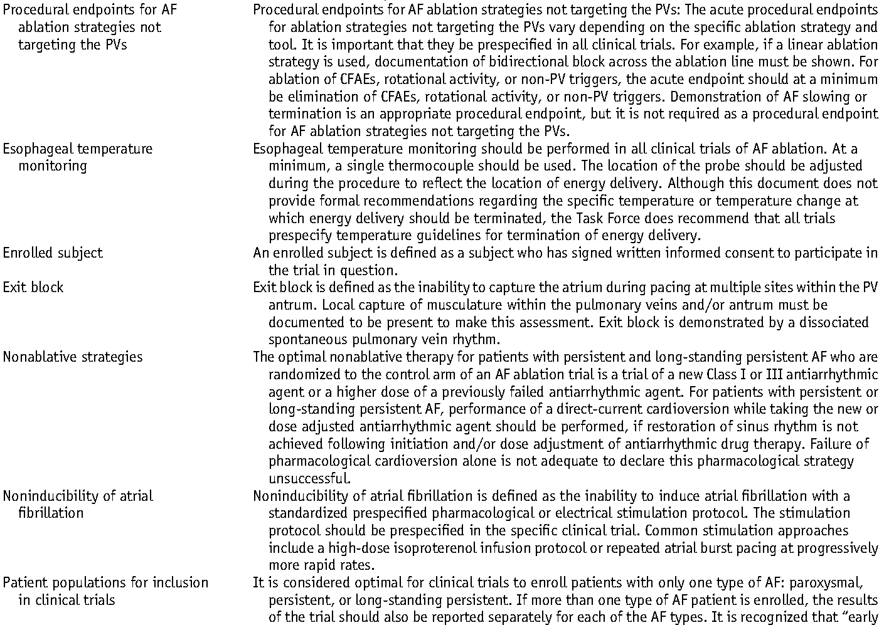
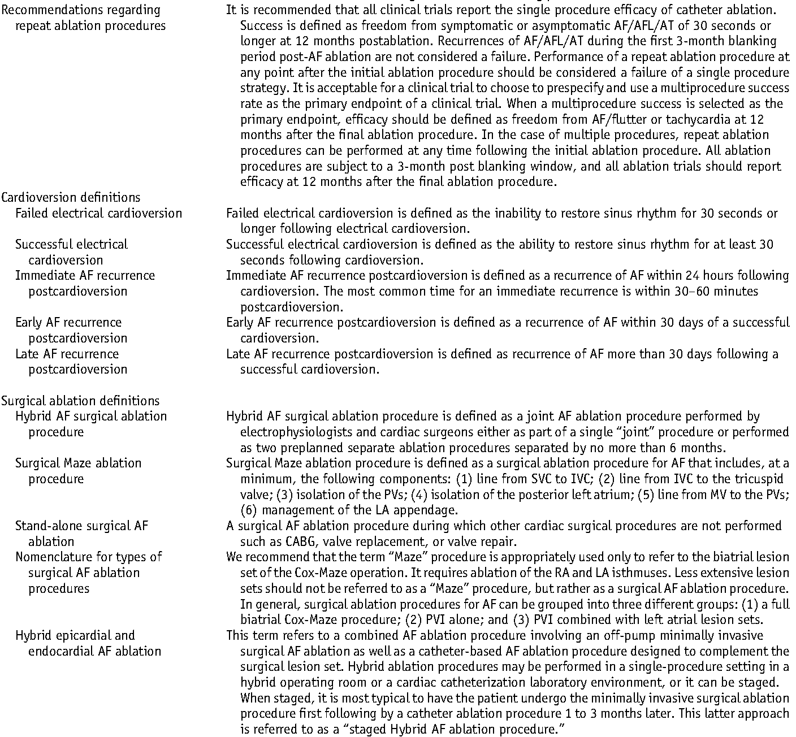
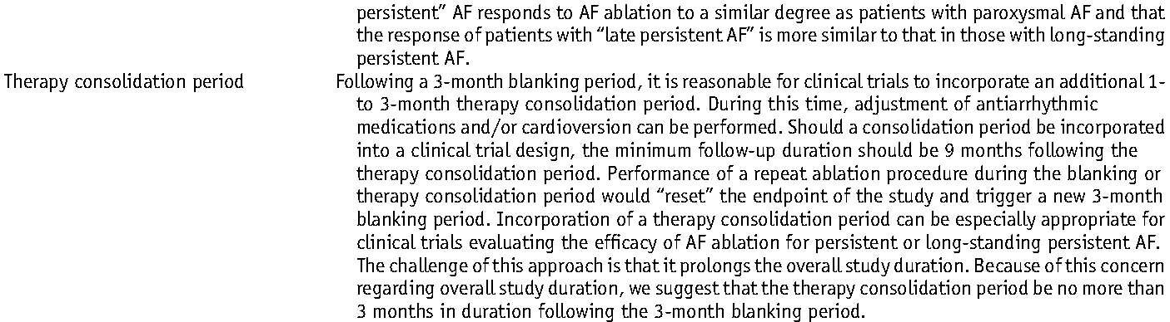
Clinical Trial Design
Definitions for Use When Reporting Outcomes and
Designing Clinical Trials

Slide 17
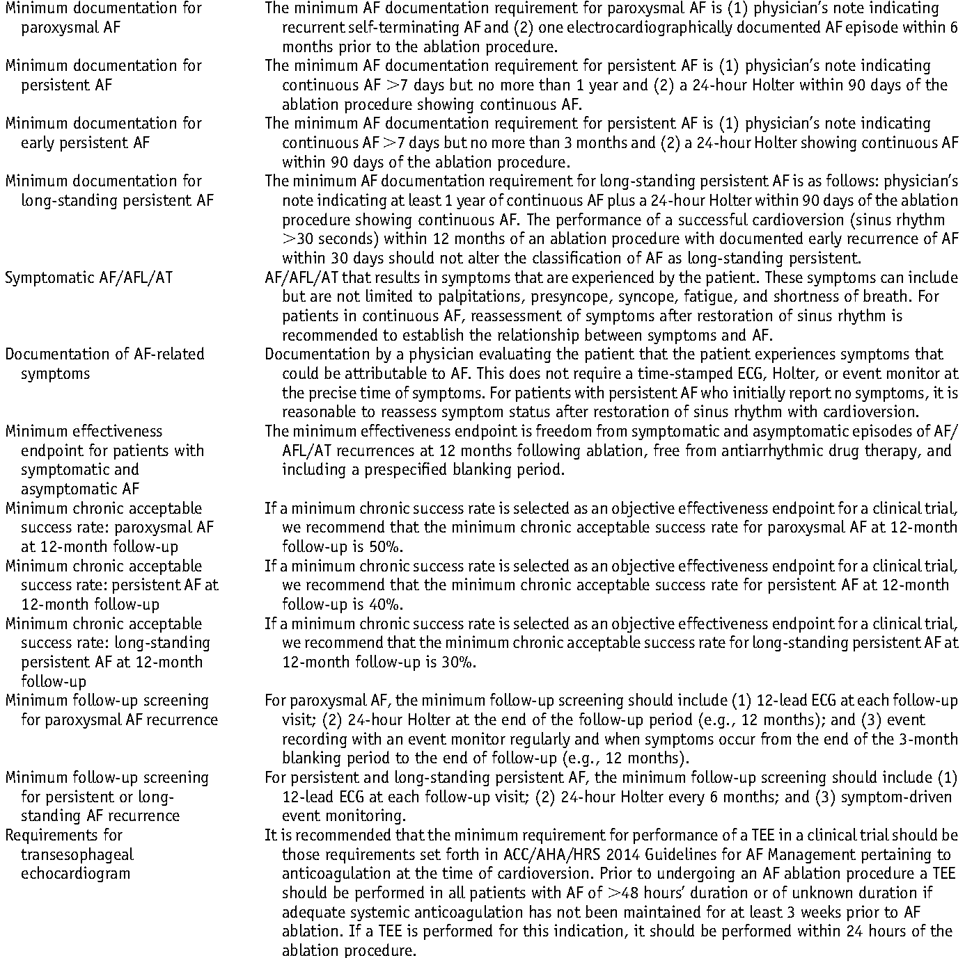
Clinical Trial Design
Minimum AF Documentation Endpoints. TEE and
Success Rates in Clinical Trials

Slide 18
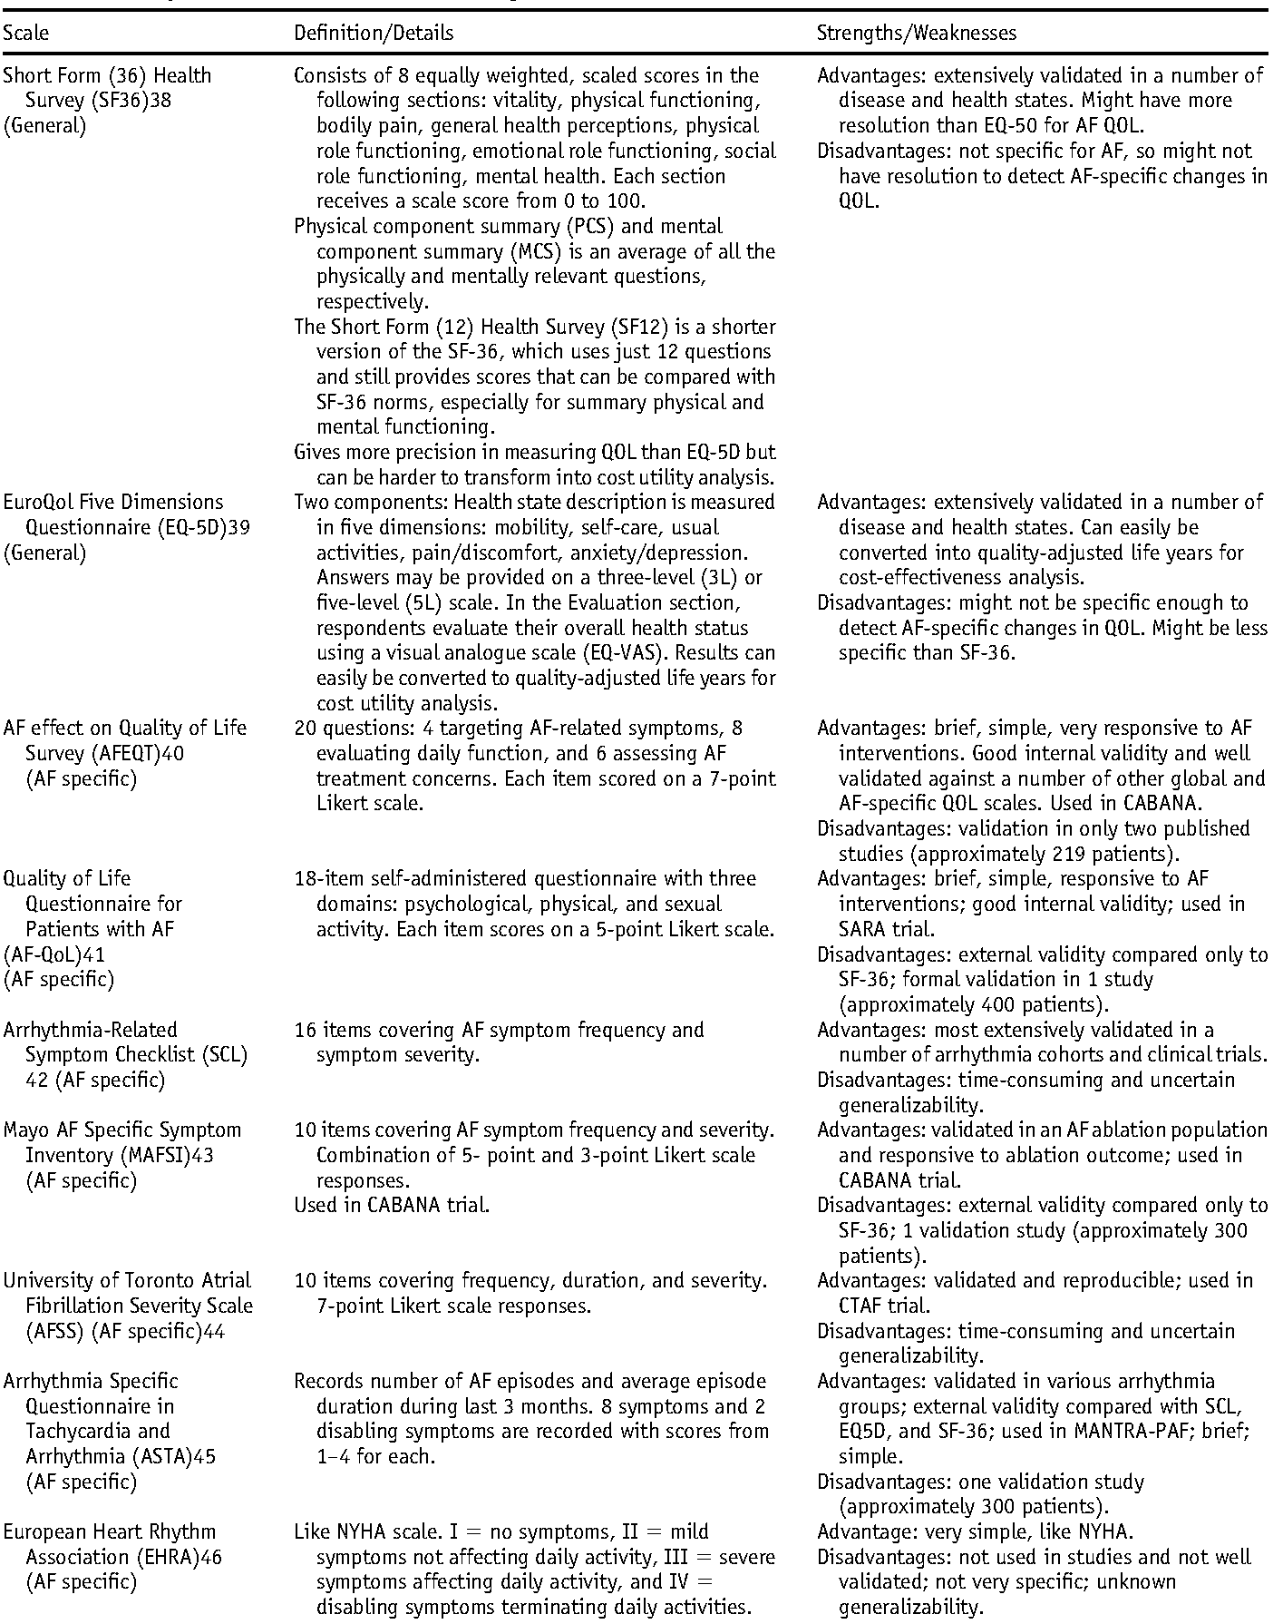
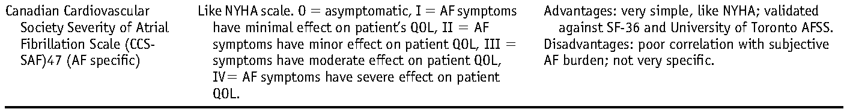
Clinical Trial Design
QOL Scales, Definitions, and Strengths

Slide 19
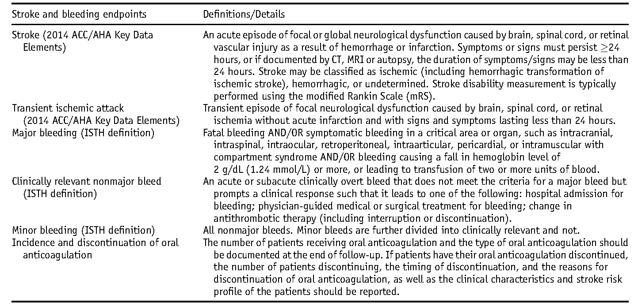
Clinical Trial Design
Non-AF Recurrence–Related Endpoints for Reporting in AF Ablation Trials

Slide 20
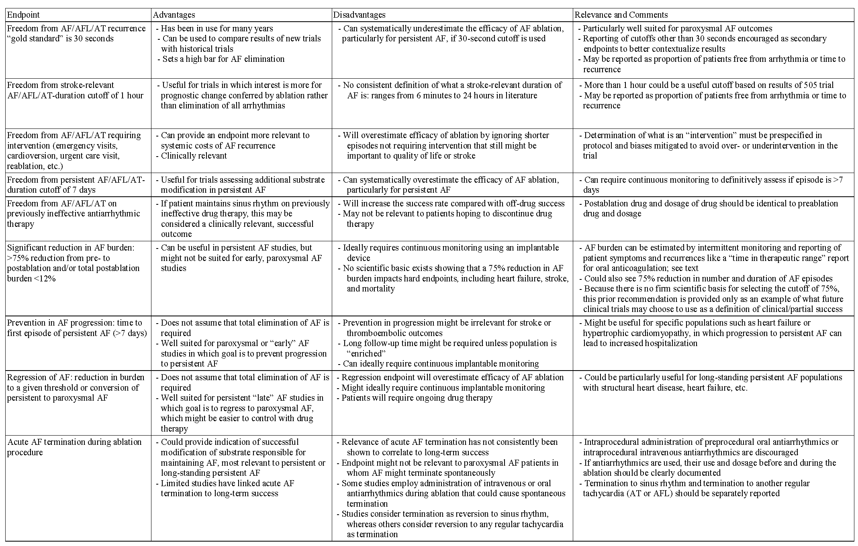
Clinical Trial Design
Advantages and Disadvantages of AF-Related Endpoints

Slide 21
2017 HRS/EHRA/ECAS/APHRS/SOLAECE Expert Consensus Statement on Catheter and Surgical Ablation of Atrial Fibrillation
Young-Hoon Kim, MD, PhD

Slide 22

FOLLOW-UP CONSIDERATIONS
1. Monitoring for Complications in the First Months After AF Ablation
Signs and Symptoms of Complications Within 1 Month Postablation
Signs and Symptoms of Complications More Than a Month Postablation
2. ECG Monitoring Pre- and Postablation
3. Available Methods for Arrhythmia Monitoring
4. Follow-up and Monitoring Guidelines for Routine Clinical Care
EARLY RECURRENCE AFTER ABLATION
Definition and Incidence
Causes of Recurrences
Early Recurrence as a Predictor of Failure
Antiarrhythmic Drugs
Corticosteroids
Colchicine
CARDIOVERSION
EARLY REABLATION
Atrial Tachycardias After AF Ablation
Antiarrhythmic and Other Pharmacological Therapy Postablation
Later-Term Repeat Ablation Procedures
Autonomic Alterations
Very Late Recurrence (More Than 1 Year) After AF Ablation

Slide 23
Signs and Symptoms Following AF Ablation
 |  | Differential | Suggested evaluation
Signs and symptoms of complications within a month postablation
Back pain | Musculoskeletal, retroperitoneal hematoma |  | Physical exam, CT imaging
Chest pain | Pericarditis, pericardial effusion, coronary stenosis (ablation related), pulmonary vein stenosis, musculoskeletal (after cardioversion), worsening reflux |  | Physical exam, chest X-ray, ECG, echocardiogram, stress test, cardiac catheterization, chest CT
Cough | Infectious process, bronchial irritation (mechanical, cryoballoon), pulmonary vein stenosis |  | Physical exam, chest X-ray, chest CT
Dysphagia | Esophageal irritation (related to transesophageal echocardiography), AE fistula |  | Physical exam, chest CT or MRI
Early satiety, nausea | Gastric denervation |  | Physical exam, gastric emptying study
Fever | Infectious process, pericarditis, AE fistula |  | Physical exam, chest X-ray, chest CT, urinalysis, laboratory blood work

Slide 24
 | Differential | Suggested evaluation
Signs and symptoms of complications within a month postablation
Fever, dysphagia, neurological symptoms | Atrial esophageal fistula | Physical exam, laboratory work, chest CT or MRI; avoid endoscopy with air insufflation
Groin pain at site of access | Pseudoaneurysm, AV fistula, hematoma | Ultrasound of the groin, laboratory blood work; consider CT if ultrasound negative
Headache | Migraine (related to anesthesia or transseptal access, hemorrhagic stroke), effect of general anesthetic | Physical exam, brain imaging (MRI)
Hypotension | Pericardial effusion/tamponade, bleedi- ng, sepsis, persistent vagal reaction | Echocardiography, laboratory blood work
Hemoptysis | PV stenosis or occlusion, pneumonia | CXR, chest CT or MR scan, VQ scan
Neurological symptoms | Cerebral embolic event, AE fistula | Physical exam, brain imaging, chest CT or MRI
Shortness of breath | Volume overload, pneumonia, pulmonary vein stenosis, phrenic nerve injury | Physical exam, chest X-ray, chest CT, laboratory blood work

Slide 25
Signs and symptoms of complications more than a month postablation
Fever, dysphagia, neurological symptoms | Atrial esophageal fistula | Physical exam, laboratory blood work, chest CT or MRI; avoid endoscopy with air insufflation
Persistent cough, atypical chest pain | Infectious process, PV stenosis | Physical exam, laboratory blood work, chest X-ray, chest CT or MRI
Neurological symptoms | Cerebral embolic event, atrial esophageal fistula | Physical exam, brain imaging, chest CT or MRI
Hemoptysis | PV stenosis or occlusion, pneumonia | CT scan, VQ scan

Slide 26
ECG Monitoring Pre- and Postablation
The two main reasons to perform arrhythmia monitoring following catheter ablation are clinical care and as part of a clinical research trial.
Complaints of palpitations often result from atrial or ventricular premature beats and are not an accurate predictor of recurrent AF.
Arrhythmia monitoring can also be of value in asymptomatic patients and can influence decision making regarding anticoagulant therapy after ablation.
Multiple studies have demonstrated that asymptomatic AF commonly occurs in patients following catheter ablation.
Detection of these asymptomatic episodes of AF impact the characterization of the procedure as “successful.”

Slide 27
Types of Ambulatory Cardiac Monitoring Devices
Type of recorder | Typical monitoring duration | Continuous recording | Event recording | Auto trigger | Unique features
Holter monitor | 24–48 hours, approximately 7–30 days | Yes | Yes | N/A | Short term, provides quantitative data on arrhythmia burden
Patch monitor | 1–3 weeks | Yes | Yes | N/A | Intermediate term, can provide continuous data for up to several weeks; improved patient compliance without lead wires
External loop recorder | 1 month | Yes | Yes | Variable | Good correlation between symptoms and even brief arrhythmias
External nonloop recorder | Months | No | Yes | No | May be used long term and intermittently; will not capture very brief episodes
Smartphone monitor | Indefinite | No | Yes | No | Provides inexpensive long-term intermittent monitoring; dependent on patient compliance; requires a smartphone
Mobile cardiac telemetry | 30 days | Yes | Yes | Yes | Real time central monitoring and alarms; relatively expensive
Implantable loop recorder | Up to 3 years | Yes | Yes | Yes | Improved patient compliance for long-term use; not able to detect 30-second episodes of AF due to detection algorithm; presence of AF needs to be confirmed by EGM review because specificity of detection algorithm is imperfect; expensive
Pacemakers or ICDs with atrial leads | Indefinite | Yes | Yes | Yes | Excellent AF documentation of burden and trends; presence of AF needs to be confirmed by ECG tracing review because specificity of detection algorithms is imperfect; expensive
Wearable multisensor ECG monitors | Indefinite | Yes | Yes | Yes | ECG 3 leads, temp, HR, HRV, activity tracking, respiratory rate, galvanic skin response

Slide 28
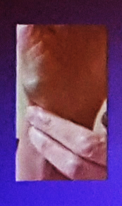
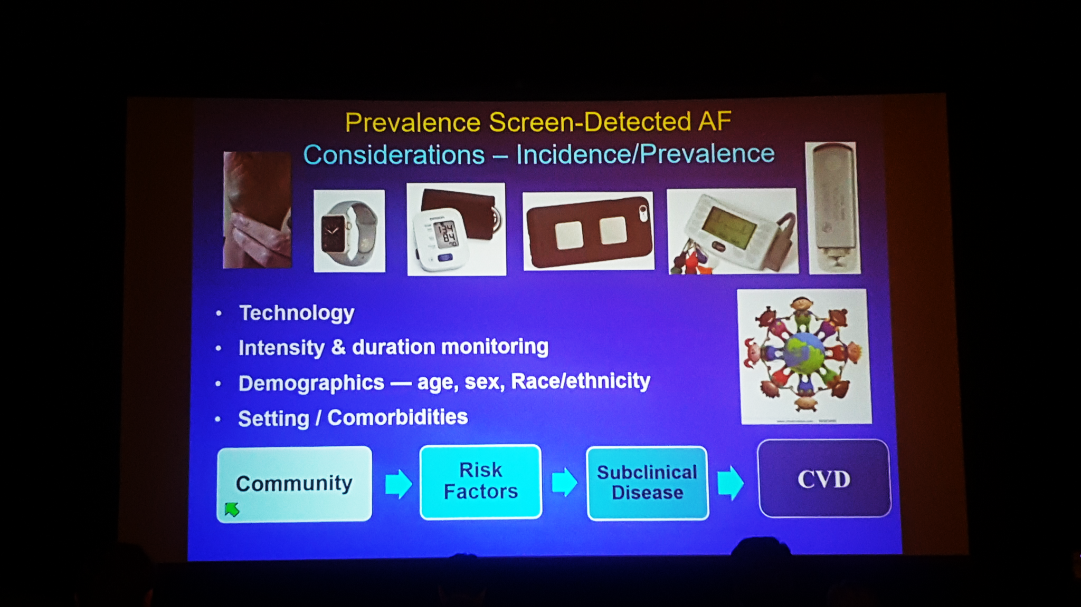
Types of Ambulatory Cardiac Monitoring Devices

Slide 29
Different Monitoring Methods to Detect AF
The more you look, the more you find!
Pacing Clin Electrophysiol 2007;30:458-462

Slide 30
The proportion of asymptomatic compared with symptomatic events might be higher after AF ablation.
1. Asymptomatic AF was 11%–35% prior to and
53%–65% after ablation
2. Asymptomatic AF was 53.8%, with an increase
in asymptomatic episodes changing from the
acute to the chronic period after ablation.

Slide 31
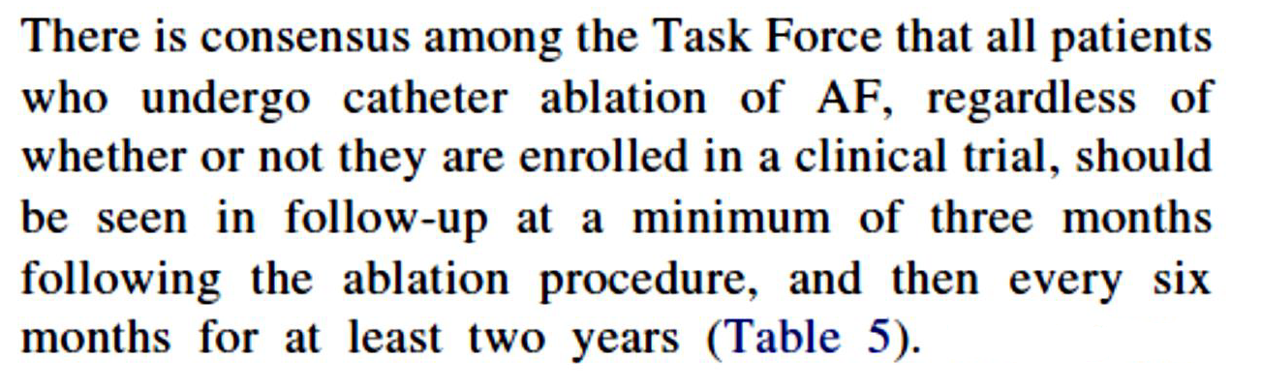
Follow-up and Monitoring Guidelines for Routine Clinical Care
There is a consensus among the writing group members that all patients who undergo catheter ablation of AF, regardless of whether they are enrolled in a clinical trial, should be seen in “follow-up a minimum of 3 months” following the ablation procedure.
There is also consensus that all patients who undergo catheter ablation should be seen by some type of physician (family physician, internist, cardiologist, or electrophysiologist) on an annual basis thereafter.
“2012 Document”

Slide 32
FOLLOW-UP CONSIDERATIONS
1. Monitoring for Complications in the First Months After AF Ablation
Signs and Symptoms of Complications Within 1 Month Postablation
Signs and Symptoms of Complications More Than a Month Postablation
2. ECG Monitoring Pre- and Postablation
3. Available Methods for Arrhythmia Monitoring
4. Follow-up and Monitoring Guidelines for Routine Clinical Care
EARLY RECURRENCE AFTER ABLATION
Definition and Incidence
Causes of Recurrences
Early Recurrence as a Predictor of Failure
Antiarrhythmic Drugs
Corticosteroids
Colchicine
CARDIOVERSION
EARLY REABLATION
Atrial Tachycardias After AF Ablation
Antiarrhythmic and Other Pharmacological Therapy Postablation
Later-Term Repeat Ablation Procedures
Autonomic Alterations
Very Late Recurrence (More Than 1 Year) After AF Ablation

Slide 33
Early recurrences of AF after AF ablation :
Recurrence of AF >30 seconds during the first 3 months of follow-up.
Late recurrence (LR): recurrence of AF >30 seconds between 3 and 12 months after AF.
The pathophysiological mechanisms
1. Incomplete isolation of the PVs
2. Acute inflammatory changes owing to energy delivery
3. Recovery of conduction in a previously isolated PV
4. Modification of the ANS
5. Changes in the atrial substrate
6. Delayed effect of RF ablation due to lesion consolidation
The occurrence of atrial arrhythmias early after ablation does not necessarily indicate treatment failure later during follow-up.
Nevertheless, early recurrences have been shown to predict arrhythmia recurrences late after catheter ablation of AF in some patients.

Slide 34
Management of Early Recurrences
1. AADs
The 5A study
Usefulness of initiation or discontinuation of AAD therapy during the postablation healing phase in an effort to improve long-term outcomes is unclear (Class IIb, LOE C-LD, Table 3).
2. Corticosteroid
Two different results, negative vs. positive effect of prevention of late recurrence of AF
(125 patients vs. 138 patients undergoing PV ablation)
3. Colchicine
Colchicine has been shown to reduce postoperative AF following cardiac surgery. Two studies were positive; however, 94% of the writing group members do not routinely administer colchicine.
Deleted “The impact of ARB/ACEI and statin on outcome of AF ablation” from 2012 document.

Slide 35
4. Early Cardioversion
“CV within 30 days of arrhythmia recurrence”
An aggressive approach with early DC CV after LA catheter ablation appears important to maintain SR in order to minimize late arrhythmia recurrences, reduce chronic AAD use, and prevent reablation procedures.
CV ≥3 times was a predictor of ablation failure (n = 40).
5. Early Reablation
Early reablation was associated with greater freedom from LR. Although the clinical benefit of early reablation was demonstrated, the first month following the procedure might not be the optimal time for a repeat intervention. Reablation is not recommended in an early recurrence of AF that might be a transient phenomenon.

Slide 36
FOLLOW-UP CONSIDERATIONS
1. Monitoring for Complications in the First Months After AF Ablation
Signs and Symptoms of Complications Within 1 Month Postablation
Signs and Symptoms of Complications More Than a Month Postablation
2. ECG Monitoring Pre- and Postablation
3. Available Methods for Arrhythmia Monitoring
4. Follow-up and Monitoring Guidelines for Routine Clinical Care
EARLY RECURRENCE AFTER ABLATION
Definition and Incidence
Causes of Recurrences
Early Recurrence as a Predictor of Failure
Antiarrhythmic Drugs
Corticosteroids
Colchicine
CARDIOVERSION
EARLY REABLATION
Atrial Tachycardias After AF Ablation
Antiarrhythmic and Other Pharmacological Therapy
Later-Term Repeat Ablation Procedures
Autonomic Alterations
Very Late Recurrence (More Than 1 Year) After AF Ablation

Slide 37
Atrial Tachycardias After AF Ablation
Isthmus-dependent atrial flutter
Focal atrial tachycardia
Microreentrant AT
Perimitral atrial flutter
Roof-dependent AFL
Notes:
Schematic drawing showing mechanisms of atrial flutter and atrial tachycardia. A: Isthmus-dependent reverse common (clockwise) atrial flutter. B: Isthmus-dependent common (counter clockwise) atrial flutter. C: Focal atrial tachycardia with circumferential spread of activation of the atria (can arise from multiple sites within the left and right atrium). D: Microreentrant atrial tachycardia with circumferential spread of activation of the atria. E: Perimitral atrial flutter. F: Roof-dependent atrial flutter.

Slide 38
Atrial Tachycardias After AF Ablation
Antiarrhythmic and Other Pharmacological Therapy
#1. AADs have been used unsuccessfully prior to ablation; include flecainide, propafenone, sotalol, dofetilide, dronedarone, and amiodarone.
The short-term use of AADs after AF ablation decreased early recurrences of atrial arrhythmias and need for hospitalization or CV, but had no effect on the prediction or prevention of arrhythmia recurrence at 6 and 12 months.
#2. Corticosteroids/PPIs or H2 blockers/ARB or ACEI: remains unproven.
2. Later-Term Repeat Ablation Procedures
The first step in second AF ablation procedure is to check each PV for reconduction.
If, however, there is no evidence of PV reconduction, ablation can be guided by
1. LA substrate mapping
2. Electrogram voltage
3. CFAEs
4. Non-PV triggers or sites commonly associated with non-PVs triggers such as the SVC
5. Focal impulse and rotational activity mapping
6. Dormant PV conduction unmasked by adenosine

Slide 39
Atrial Tachycardias After AF Ablation
Antiarrhythmic and Other Pharmacological Therapy
Later-Term Repeat Ablation Procedures
Autonomic Alterations
Most autonomic alterations associated with AF ablation were self-terminating and asymptomatic. However, severe symptomatic periesophageal vagal nerve injury can occur after LA posterior wall ablation (25–30 W).
Very Late Recurrence (More Than 1 Year) After AF Ablation
Despite of late recurrence, a low incidence of progression (0.3% per year) from paroxysmal to persistent AF as well as stroke rates <1% have been reported.
More likely to have sporadic episodes and a better response to AADs and repeat ablation procedures than those with earlier recurrences.
The most consistent predictor of late recurrence
#1. Persistent AF
#2. Hypertension, age, LA size, diabetes, VHD and
LV dysfunction, and higher thromboembolic risk scores
#3. PV reconnection, non-PV foci, and gaps in prior ablation lines,
non-PV triggers from LAA and LA posterior wall

Slide 40
OUTCOMES AND EFFICACY
Overview/ Published Literature Review: Clinical Trials Performed for FDA Approval
1. AF Ablation as Second-Line Rhythm Control Therapy
2. Outcomes and Efficacy of Catheter Ablation of AF as First-Line Rhythm
Control Therapy
Published Literature Review: Survey Results
OUTCOMES OF AF ABLATION IN POPULATIONS NOT WELL REPRESENTED IN CLINICAL TRIALS
1. Outcomes of Catheter Ablation of Persistent and Long-Standing Persistent AF
2. Outcomes of AF Ablation in Elderly Patients
3. Outcomes of AF Ablation in Patients with Congestive Heart Failure and the
Impact of Ablation on Left Ventricular Function
4. Outcomes of AF Ablation in Patients with Hypertrophic Cardiomyopathy
5. Outcomes of AF Ablation in Young Patients
6. Outcomes of AF Ablation in Women
7. Outcomes of Cryoballoon Ablation
8. Outcome of Rotational Activity Ablation for AF
9. Outcomes of Laser Balloon Ablation
10. Long-Term Ablation Efficacy
11. Impact of Catheter Ablation of AF on QOL
12. Impact of Catheter Ablation of AF on LA Size and Function
13. Impact of Catheter Ablation on Stroke Risk
Predictors of Success Following AF Ablation
Cost-Effectiveness of AF Ablation

Slide 41
Selected Clinical Trials of Catheter Ablation of AF and/or for FDA Approval
Clinical Trials Performed for FDA Approval
Trial | Year | Type | N | AF type | Ablation strategy | Initial time frame
JAMA 2010; 303; 333-340 (ThermoCool AF) | 2010 | Randomized to RF ablation or AAD, multicenter | 167 | Paroxysmal | PVI, optional CFAEs and lines | 12 months
JACC 2013; 61: 1713-1723 (STOP AF) | 2013 | Randomized to cryoballoon ablation or AAD, multicenter | 245 | Paroxysmal | PVI | 12 months
Heart Rhythm 2014; 11: 202-209 (TTOP) | 2014 | Randomized to phased RF ablation or AAD/cardioversion, multicenter nonirrigated circumferential multielectrode ablation catheters with duty cycled phased RF energy | 210 | Persistent | PVI + CFAEs | 6 months
JACC 2014; 64: 647-656 (SMART-AF) | 2014 | Nonrandomized multicenter study of CF sensing RF catheter, comparing to performance goals | 172 | Paroxysmal | PVI, optional CFAEs and lines | 12 months
Circulation 2015; 132: 907-915 (TOCCASTAR) | 2015 | Randomized to CF sensing RF catheter or approved RF catheter, multicenter | 300 | Paroxysaml | PVI, optional triggers, CAFEs and lines in both arms | 12 months
JACC 2015; 66: 1350-1360 (HeartLight) | 2015 | Randomized to laser balloon or approved RF catheter, multicenter | 353 | Paroxysmal | PVI ± CTI ablation vs. PVI, optional CFAEs, and Lines | 12 months
Notes:
Prior to the publication of the initial consensus report in 2007, the majority of the published literature on AF ablation consisted of uncontrolled single- and multi-center reports [1]. Further, there had been no standardization in the design of clinical trials of AF ablation, and the 2007 and 2012 consensus documents were developed in part to generate standard terminology, definitions, and recommendations for end points, follow-up procedures, and outcome reporting in an effort to make studies more rigorous and consistent [1, 2].
Over the past 10–12 years, a large number of randomized trials have been completed addressing various aspects of AF ablation
Previous versions of the consensus report included a section on nonrandomized studies of AF ablation. Due to the very large number of studies reported, the lack of standardization among them, and their generally early time frame in the evolution of AF ablation
Each of these trials met its prespecified end points, generally confirming the safety and efficacy of AF ablation in patients with PAF, but none demonstrated the superiority of new technologies in the full study populations
For the purpose of regulatory approval, it is expected that future ablation technologies designed to treat PAF will continue to be compared with previously approved ablation systems in randomized studies

Slide 42
Selected Clinical Trials of Catheter Ablation of AF and/or for FDA Approval
Clinical Trials Performed for FDA Approval
Trial | Year | Type | N | AF type | Ablation strategy | Initial time frame
JAMA 2010; 303; 333-340 (ThermoCool AF) | 2010 | Randomized to RF ablation or AAD, multicenter | 167 | Paroxysmal | PVI, optional CFAEs and lines | 12 months
JACC 2013; 61: 1713-1723 (STOP AF) | 2013 | Randomized to cryoballoon ablation or AAD, multicenter | 245 | Paroxysmal | PVI | 12 months
Heart Rhythm 2014; 11: 202-209 (TTOP) | 2014 | Randomized to phased RF ablation or AAD/cardioversion, multicenter | 210 | Persistent | PVI + CFAEs | 6 months
JACC 2014; 64: 647-656 (SMART-AF) | 2014 | Non randomzied multicenter study of CF sensing RF catheter, comparing to performance goals | 172 | Paroxysmal | PVI, optional CFAEs and lines | 12 months
Circulation 2015; 132: 907-915 (TOCCASTAR) | 2015 | Randomized to CF sensing RF catheter or approved RF catheter, Multicenter | 300 | Paroxysaml | PVI, optional triggers, CAFEs and lines in both arms | 12 months
JACC 2015; 66: 1350-1360 (HeartLight) | 2015 | Randomized to laser balloon or approved RF catheter, Multicenter | 353 | Paroxysmal | PVI ± CTI ablation vs. PVI, optional CFAEs, and Lines | 12 months
Effectiveness endpoint | Ablation success | Drug/Control success | P value for success | Ablation Cxs | Drug/Control Cxs | FDA
Freedom from symptomatic PAF, acute procedural failure, or changes in specified drug regimen | 66% | 16% | < 0.001 | 4.9% | 8.8% | Approval (+)
Freedom from any detectable AF, use of nonstudy AAD, or non-protocol intervention for AF | 70% | 7% | < 0.001 | 3.1% | NA | Approval (+)
Acute procedural success, ≥90% reduction in AF burden, off AAD nonirrigated circumferential multielectrode ablation catheters with duty cycled phased RF energy | 56% | 26% | <0.001 | 12.3% 4 strokes (2.9%) | NA | Approval (-)
Freedom from symptomatic AF, flutter, tachycardia, acute procedural failure, or changes in AAD | 72.5% | N/A | <0.0001 | 7.5% | NA | Approval (+)
Acute procedural success + freedom from symptomatic AF/flutter/tachycardia off AAD | 67.8% | 69.4% | 0.0073 for noninferiority | 7.2% | 9.1% | Approval (+)
Freedom from symptomatic AF/flutter/tachycardia, acute procedural failure, AAD, or nonprotocol intervention | 61.1% | 61.7% | 0.003 for noninferiority | 5.3% | 6.4% | Approval (+)
Notes:
Prior to the publication of the initial consensus report in 2007, the majority of the published literature on AF ablation consisted of uncontrolled single- and multi-center reports [1]. Further, there had been no standardization in the design of clinical trials of AF ablation, and the 2007 and 2012 consensus documents were developed in part to generate standard terminology, definitions, and recommendations for end points, follow-up procedures, and outcome reporting in an effort to make studies more rigorous and consistent [1, 2].
Over the past 10–12 years, a large number of randomized trials have been completed addressing various aspects of AF ablation
Previous versions of the consensus report included a section on nonrandomized studies of AF ablation. Due to the very large number of studies reported, the lack of standardization among them, and their generally early time frame in the evolution of AF ablation
Each of these trials met its prespecified end points, generally confirming the safety and efficacy of AF ablation in patients with PAF, but none demonstrated the superiority of new technologies in the full study populations
For the purpose of regulatory approval, it is expected that future ablation technologies designed to treat PAF will continue to be compared with previously approved ablation systems in randomized studies

Slide 43
As in the past, future studies might compare novel ablation systems against medical management because, at this point, no ablation system is expressly approved for persistent or long-standing persistent AF in the United States.
Alternatively, a novel ablation system could be evaluated in single-arm trials with prespecified OPCs.
Objective Performance Criteria (OPC)

Slide 44
First-Line Therapy Trials
Trial | Year | Type | N | AF type | Ablation strategy | Initial time frame
JAMA 2005; 293: 2634-264 (RAAFT) | 2005 | Randomized to drug, multicenter | 70 | PAF (N=67), PeAF (N= 3) | PVI | 12 Ms
NEJM 2012; 367:1587-1595 (MANTRA-PAF) | 2012 | Randomized to drug, multicenter | 294 | PAF | PVI, roof line, optional mitral and CTI | 24 Ms
JAMA 2014; 311: 692-700 (RAAFT-2) | 2014 | Randomized to drug, multicenter | 127 | PAF | PVI + optional Non-PVI targets | 24 Ms

Slide 45
First-Line Therapy Trials
Trial | Year | Type | N | AF type | Ablation strategy | Initial time Frame
JAMA 2005; 293: 2634-2640 (RAAFT) | 2005 | Randomized to drug, multicenter | 70 | PAF (N=67), PeAF(N= 3) | PVI | 12 Ms
NEJM 2012; 367:1587-1595 (MANTRA-PAF) | 2012 | Randomized to drug, multicenter | 294 | PAF | PVI, roof line, optional mitral and CTI | 24 Ms
JAMA 2014; 311: 692-700 (RAAFT-2) | 2014 | Randomized to drug multicenter | 127 | paroxysmal AF | PVI + optional non PVI targets | 24 Ms
Effectiveness endpoint | Ablation success | Drug/Control success | P | Ablation Cxs | Drug /Control Cxs
Freedom from detectable AF | 84% | 37% | <0.01 | 9% | 11%
Cumulative AF burden | 13% AF burden | 19% AF burden | NS | 17% | 15%
Freedom from detectable AF, flutter, tachycardia | 45% | 28% | 0.02 | 9% | 4.9%
MANTRA-PAF negative result might be explained by the ablation techniques with discretional circumferential ablation without confirmation of PVI with a circular mapping catheter as well as by the choice of reduction in AF burden on 7-day Holter as a primary endpoint.
RAAFT: Whether such benefits extend to elderly patients with PAF, patients with associated SHD or non-PAF, is still controversial.

Slide 46
Other Paroxysmal AF Ablation Trials
Trial | Year | Type | N | AF type | Ablation strategy | Initial time frame
JACC 2006; 48: 2340-2347 (APAF) | 2006 | Randomized to drug single center | 198 | PAF | PVI, mitral line and tricuspid line | 12 months
Circulation 2008; 118: 2498-2505 (A4) | 2008 | Randomized to drug | 112 | PAF | PVI (optional LA lines, CTI, focal) | 12 months
NEJM 2016; 374: 2235-2245 (FIRE AND ICE) | 2016 | Randomized RF vs Cryo, multicenter | 762 | PAF | PVI | 12 months
JACC 2016; 68: 2747-2757 | 2016 | Randomized to hot balloon or drug, multicenter | 100 | PAF | PVI | 12 months

Slide 47
Other Paroxysmal AF Ablation Trials
Trial | Year | Type | N | AF type | Ablation strategy | Initial time frame
JACC 2006; 48: 2340-2347 (APAF) | 2006 | Randomized to drug single center | 198 | PAF | PVI, mitral line and tricuspid line | 12 months
Circulation 2008; 118: 2498-2505 (A4) | 2008 | Randomized to drug | 112 | PAF | PVI (optional LA lines, CTI, focal) | 12 months
NEJM 2016; 374: 2235-2245 (FIRE AND ICE) | 2016 | Randomized RF vs Cryo, multicenter | 762 | PAF | PVI | 12 months
JACC 2016; 68: 2747-2757 | 2016 | Randomized to hot balloon or drug, multicenter | 100 | PAF | PVI | 12 months
Effectiveness endpoint | Ablation success | Drug/Control success | P for success | Ablation Cxs | Drug/Control Cxs
Freedom from detectable AF, flutter, tachycardia | 86% | 22% | <0.001 | 1% | 23%
Freedom from AF | 89 | 23 | <0.0001 | 5.7% | 1.7%
Freedom from detectable AF, flutter, tachycardia | 64.1% (RF) | 65.4% (cryo) | NS | 12.8% | 10.2%
Freedom from AF | 59% | 5% | < 0.001 | 10.4% | 4.7%

Slide 48
Other Persistent AF Ablation Trials
Trial | Year | Type | N | AF type | Ablation strategy | Initial time frame
NEJM 2006; 354: 934-941 | 2006 | Randomized to RF ablation or to CV and short-term amio | 146 | PeAF | PVI, roof, mitral line | 12 months
EHJ 2014; 35: 501-507 (SARA) | 2014 | Randomized to drug (2:1 ablation to drug), multicenter | 146 | PeAF | PVI (optional LA lines, CFAEs) | 12 months
NEJM 2015; 372: 1812-1822 STAR AF II | 2015 | Randomized ablation strategies, multicenter | 589 | PeAF | PVI alone vs. PVI & CFAEs or PVI & lines | 18 months

Slide 49
Other Persistent AF Ablation Trials
Trial | Year | Type | N | AF type | Ablation strategy | Initial time frame
NEJM 2006; 354: 934-941 | 2006 | Randomized to RF ablation or to CV and short term amio | 146 | PeAF | PVI, roof, mitral line | 12 months
EHJ 2014; 35: 501-507 (SARA) | 2014 | Randomized to drug (2:1 ablation to drug), multicenter | 146 | PeAF | PVI (optional LA lines, CFAEs) | 12 months
NEJM 2015; 372: 1812-1822 STAR AF II | 2015 | Randomized ablation strategies, multicenter | 589 | PeAF | PVI alone vs. PVI & CFAEs or PVI & lines | 18 months
Effectiveness endpoint | Ablation success | Drug/Control success | P | Ablation Cxs | Drug/Control Cxs
No AF or flutter month 12 | 74% | 58% | 0.05 | 1.3% | 1.4%
Freedom from AF/ flutter lasting >24h | 70% | 44% | 0.002 | 6.1% | 4.20%
Freedom from AF with or without drugs | 59% (PVI alone) | 49% and 46% | NS | 6% | 4.3% and 7.6%

Slide 50
Other Mixed Paroxysmal and Persistent AF Ablation Trials
Trial | Year | Type | N | AF type | Ablation strategy | Initial time frame
J Med Assoc Thai 2003; 86 (Suppl 1): S8-S16 | 2003 | Randomized to RF ablation or amiodarone | 30 | Paroxysmal (70%), Persistent (30%) | PVI, mitral line, CTI, SVC to IVC | 12 months
EHJ 2006; 27: 216-221 | 2006 | Randomized to RF ablation or drug, multicenter | 137 | Paroxysmal (67%), Persistent (33%) | PVI, mitral line, CTI | 12 months
JCVEP 2009, 20: 22-28 | 2009 | Randomized to RF ablation or drug, multicenter | 70 | Paroxysmal (41%), Persistent (59%) and Type 2 DM | PVI, CTI, optional mitral line and roof line | 12 months

Slide 51
Other Mixed Paroxysmal and Persistent AF Ablation Trials
Trial | Year | Type | N | AF type | Ablation strategy | Initial time frame
J Med Assoc Thai 2003; 86(Suppl. 1): S8-S16 | 2003 | Randomized to RF ablation or amiodarone | 30 | Paroxysmal (70%), Persistent (30%) | PVI, mitral line, CTI, SVC to IVC | 12 months
EHJ 2006; 27: 216-221 | 2006 | Randomized to RF ablation or drug, multicenter | 137 | Paroxysmal (67%), Persistent (33%) | PVI, mitral line, CTI | 12 months
JCVEP 2009, 20: 22-28 | 2009 | Randomized to RF ablation or drug, multicenter | 70 | Paroxysmal (41%), Persistent (59%) & Type 2 DM | PVI, CTI, optional mitral line and roof line | 12 months
Effectiveness endpoint | Ablation success | Drug/Control success | P | Ablation Cxs | Drug/Control Cxs
Freedom from AF | 79% | 40% | 0.018 | 6.70% | 47%
Freedom from AF, flutter, tachycardia | 66% | 9% | < 0.001 | 4.40% | 2.90%
Freedom from AF and atypical atrial flutter | 80% | 43% | 0.001 | 2.90% | 17%

Slide 52
Ablation Concepts in Persistent AF
Preferred strategy for ablation of persistent, but not long-standing AF
Percentage of centers
Europace 2015;17:1596-1600

Slide 53
Ablation Concepts in Persistent AF
Preferred strategy for ablation of “long-standing persistent AF”
Percentage of centers
Europace 2015;17:1596-1600

Slide 54
OUTCOMES AND EFFICACY
Overview/ Published Literature Review: Clinical Trials Performed for FDA Approval
1. AF Ablation as Second-Line Rhythm Control Therapy
2. Outcomes and Efficacy of Catheter Ablation of AF as First-Line Rhythm Control Therapy
Published Literature Review: Survey Results
OUTCOMES OF AF ABLATION IN POPULATIONS NOT WELL REPRESENTED IN CLINICAL TRIALS
1. Outcomes of Catheter Ablation of Persistent and Long-Standing Persistent AF
2. Outcomes of AF Ablation in Elderly Patients
3. Outcomes of AF Ablation in Patients with Congestive Heart Failure and the
Impact of Ablation on Left Ventricular Function
4. Outcomes of AF Ablation in Patients with Hypertrophic Cardiomyopathy
5. Outcomes of AF Ablation in Young Patients
6. Outcomes of AF Ablation in Women
7. Outcomes of Cryoballoon Ablation
8. Outcome of Rotational Activity Ablation for AF
9. Outcomes of Laser Balloon Ablation
10. Long-Term Ablation Efficacy
11. Impact of Catheter Ablation of AF on QOL
12. Impact of Catheter Ablation of AF on LA Size and Function
13. Impact of Catheter Ablation on Stroke Risk
Predictors of Success Following AF Ablation
Cost-Effectiveness of AF Ablation

Slide 55
OUTCOMES OF AF ABLATION IN POPULATIONS NOT WELL REPRESENTED IN CLINICAL TRIALS
Outcomes of Catheter Ablation of Persistent and Long-Standing Persistent AF
PVI remains the cornerstone.
Several new ablation strategies: mapping and ablation of rotational activity, ablation of areas of low voltage, ablation of areas identified on MRI as showing fibrosis, ablation of non-PV triggers, as well as LAA focal ablation, isolation, and/or ligation.
A single-procedure efficacy of stepwise approach was 35% at 1 year, falling to 17% at year 5, and the 5-year outcome after repeated procedures was 63%.
Similar success rates with catheter ablation for AF in older patients compared with younger patients, with comparable complication rates. A consistent finding is that older patients are less likely to undergo a second procedure if the index procedure fails to eliminate the arrhythmia.
3. Outcomes of AF Ablation in Patients with CHF and the Impact of Ablation on LV
Function
2. Outcomes of AF Ablation in Elderly Patients

Slide 56
Randomized Trials of AF Ablation in Patients with Heart Failure
Trial | Year | Type | N | AF type | Ablation strategy | Initial time frame
NEJM 2008; 359: 1778-1785 (PABA-HF) | 2008 | Randomized to RF ablation of AVJ abl and BiV pacing | 81 | PeAF (50%), PAF(50%), EF 27% abl, 29% AVJ | PVI, optional linear abl, and CFAEs | 6 months
Heart 2011; 97: 740-747 | 2011 | Randomized to RF ablation or pharmacological rate control | 41 | Persistent , EF 20% abl, 16% rate control | PVI, roof line, CFAEs | 6 months
JACC 2013; 61: 1894-1903 | 2013 | Randomized to RF ablation or pharmacological rate control | 52 | Persistent AF (100%), EF 22% abl, 25% rate control | PVI, optional linear abl, and CFAEs | 12 months
Circ A and E 2014; 7: 31-38 | 2014 | Randomized to RF ablation or pharmacological rate control | 50 | Persistent AF (100%), EF 32% abl, 34% rate control | PVI, optional linear abl, and CFAEs | 6 months

Slide 57
Randomized Trials of AF Ablation in Patients with Heart Failure
Trial | Year | Type | N | AF type | Ablation strategy | Initial time frame
NEJM 2008; 359: 1778-1785 (PABA-HF) | 2008 | Randomized to RF ablation of AVJ abl and BiV pacing | 81 | PeAF (50%), PAF(50%), EF 27% abl, 29% AVJ | PVI, optional linear abl and CFAEs | 6 months
Heart 2011; 97: 740-747 | 2011 | Randomized to RF ablation or pharmacologic rate control | 41 | Persistent , EF 20% abl, 16% rate control | PVI, roof line, CFAEs | 6 months
JACC 2013; 61: 1894-1903 | 2013 | Randomized to RF ablation or pharmarcologic rate control | 52 | Persistent AF (100%), EF 22% abl, 25% rate control | PVI, optional linear abl and CFAEs | 12 months
Circ A and E 2014; 7: 31-38 | 2014 | Randomized to RF ablation or pharmarcologic rate control | 50 | Persistent AF (100%), EF 32% abl, 34% rate control | PVI, optional linear abl and CFAEs | 6 months
Effectiveness endpoint | Ablation success | Drug/Control success | P | Ablation Cxs | Drug/C Cxs
Composite EF, 6 min walk, MLWHF score; freedom from AF (secondary, mult proc, +/- AA drugs) | 88% AF free, EF 35% abl, 28% AVJ (P <.001), > QOL and 6 min walk increase with abl |  | < 0.001 | 14.60% | 17.50%
Change in LVEF, sinus rhythm at 6 months (secondary) | 50% in NSR, LVEF increase 4.5% | 0% in NSR, LVEF increase 2.8% | 0.6 (for EF increase) | 15% | Not reported
Change in peak O₂ consumption (also reported single procedure off drug ablation success) | Peak O₂ consumption increase greater with abl, 72% abl success |  | 0.018 | 15% | Not reported
Change in LVEF at 6 months, multiple procedure freedom from AF also reported | LVEF 40% with abl, 31% rate control, 81% AF free with abl |  | 0.015 | 7.70%
Di Biase L et al. Ablation versus amiodarone for treatment of persistent atrial fibrillation in patients with congestive heart failure and an implanted device: results from the AATAC multicenter randomized trial. Circulation 2016;133(17):1637–1644. CA was more effective than amiodarone in preventing recurrent AF (70% after a mean of 1.4 procedures vs. 34%) and was associated with a lower rate of unplanned hospitalization.

Slide 58
OUTCOMES OF AF ABLATION IN POPULATIONS NOT WELL REPRESENTED IN CLINICAL TRIALS
Outcomes of Catheter Ablation of Persistent and Long-Standing Persistent AF
PVI remains the cornerstone.
Several new ablation strategies: mapping and ablation of rotational activity, ablation of areas of low voltage, ablation of areas identified on MRI as showing fibrosis, ablation of non-PV triggers, as well as LAA focal ablation, isolation, and/or ligation.
A single-procedure efficacy of stepwise approach was 35% at 1 year, falling to 17% at year 5 and the 5-year outcome after repeated procedures was 63%.
Similar success rates with catheter ablation for AF in older patients compared with younger patients, with comparable complication rates. A consistent finding is that older patients are less likely to undergo a second procedure if the index procedure fails to eliminate the arrhythmia.
3. Outcomes of AF Ablation in Patients with CHF and the Impact of Ablation on LV
Function
It is reasonable to use similar indications for AF ablation in selected patients with heart failure as in patients without heart failure.
2. Outcomes of AF Ablation in Elderly Patients

Slide 59
4. Outcomes of AF Ablation in Patients with Hypertrophic Cardiomyopathy
The risk of procedure-related adverse events was low. Even though the likelihood of recurrence is twofold higher, catheter ablation can be effective in patients with HCM and AF, particularly in patients with PAF and smaller atria.
5. Outcomes of AF Ablation in Young Patients
The largest study on AF ablation in younger patients was a multicenter German registry in which 593 patients aged ≤45 years were compared with 6650 patients aged >45 years. The younger patients had lower rates of complication, shorter hospital stays, and lower rates of AF recurrence and AAD than older patients.
6. Outcomes of AF Ablation in Women
Studies have not shown a significant sex-related difference in outcomes with AF
ablation in women compared with men, but complication rates are consistently higher
in women.
Outcomes of Cryoballoon Ablation
FREEZE-AF (2015): 70.7% in the RF vs. 73.6% in the CB. Complications occurred in CB (12.2% vs 5.0% in RF), which was largely due to 9 transient PN injuries (5.8%) in CB arm.
FIRE AND ICE trial (2016)
CB appears to be associated with a favorable long-term outcome in patients with persistent AF, with arrhythmia-free survival ranging from 56% to 82%. In one nonrandomized study, arrhythmia-free survival off AADs was similar between CB and RF (60% vs 50%).

Slide 60
8. Outcome of Rotational Activity Ablation for AF
“64-pole basket catheter/body-surface high-density mapping/Phase mapping”
The usefulness of ablation of rotational activity as an initial or repeat ablation strategy for persistent and long-standing persistent AF is not well established.
9. Outcomes of Laser Balloon Ablation
The laser balloon is effective in achieving PVI, from 98% to 100%.
The freedom from AF at follow-up ranged from 60% to 88%, which is comparable to the outcome of PVI using RF energy in similar populations .
10. Long-Term Ablation Efficacy
The predictors of late recurrence: persistent AF + comorbid conditions.
Despite the low single-procedure, long-term success rate reported in virtually all of these clinical trials, they also reveal that with the use of repeat AF ablation procedures and/or AAD therapy, much higher rates of freedom from recurrent AF as well as concomitant reductions in AF burden can be achieved.
11. Impact of Catheter Ablation of AF on QOL
Substantial improvements in QOL with ablation; can more accurately reflect ablation efficacy. However, there is currently no general agreement that any of the “AF-specific” QOL instruments are superior to others or to the “general” QOL instruments.

Slide 61
12. Impact of Catheter Ablation of AF on LA Size and Function
13. Impact of Catheter Ablation on Stroke Risk
The reverse remodeling of LA was more pronounced when SR had been successfully restored.
It appears consistent with reverse remodeling due to the decreased burden of AF and scar formation
from the ablation procedure. Restoration of SR in patients with persistent AF improves atrial function
if SR is maintained. Ablation-related scarring with the risk of causing persistent atrial dysfunction
still remains a major concern after extensive ablation for persistent AF.

Slide 62
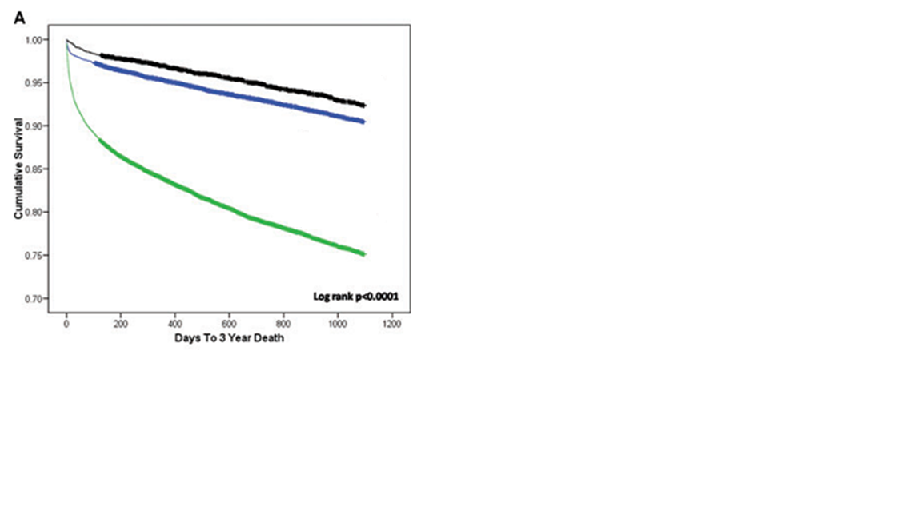
13. Impact of Catheter Ablation on Stroke Risk
Long-Term Survival Free of Death
AF, with ablation
No AF
AF, without ablation
J Cardiovasc Electrophysiol 2011;22:839-845

Slide 63
13. Impact of Catheter Ablation on Stroke Risk
Long-Term Survival Free of CVA
1.00
0.98
0.96
Event-Free Survival
No AF
0.94
AF, with ablation
0.92
AF, without ablation
0.90
Log rank P <0.0001
0
1000
2000
3000
4000
5000
6000
Days to CVA

Slide 64
13. Impact of Catheter Ablation on Stroke Risk
To date, there are no RCTs verifying the hypothesis that ablation lowers the long-term incidence of stroke or TIA.
1. The Intermountain Healthcare Database in Utah (4,212 ablated patients)
2. MarketScan Research Database (n = 805 in each group)
3. Taiwanese national health insurance claims database (846 ablated patients)
4. Swedish health registries (n = 2836 in each group)
Ablation was associated with a lower incidence of ischemic stroke than in nonablated
patients.
Ablation-treated patients without AF recurrence had a lower incidence of ischemic
strokes and TIAs compared with patients with AF recurrence or medically treated patients.
It is recognized that the retrospective nature of these studies makes them prone to bias.
Therefore, the above findings cannot be viewed as definitive and do not provide sufficient evidence that ablation reduces stroke risk. Instead, they reinforce the hypothesis behind studies such as the CABANA trial or the EAST trial, which will provide more definitive evidence.

Slide 65
OUTCOMES AND EFFICACY
Overview/ Published Literature Review: Clinical Trials Performed for FDA Approval
1. AF Ablation as Second-Line Rhythm Control Therapy
2. Outcomes and Efficacy of Catheter Ablation of AF as First-Line Rhythm Control Therapy
Published Literature Review: Survey Results
OUTCOMES OF AF ABLATION IN POPULATIONS NOT WELL REPRESENTED IN CLINICAL TRIALS
1. Outcomes of Catheter Ablation of Persistent and Long-Standing Persistent AF
2. Outcomes of AF Ablation in Elderly Patients
3. Outcomes of AF Ablation in Patients with Congestive Heart Failure and the
Impact of Ablation on Left Ventricular Function
4. Outcomes of AF Ablation in Patients with Hypertrophic Cardiomyopathy
5. Outcomes of AF Ablation in Young Patients
6. Outcomes of AF Ablation in Women
7. Outcomes of Cryoballoon Ablation
8. Outcome of Rotational Activity Ablation for AF
9. Outcomes of Laser Balloon Ablation
10. Long-Term Ablation Efficacy
11. Impact of Catheter Ablation of AF on QOL
12. Impact of Catheter Ablation of AF on LA Size and Function
13. Impact of Catheter Ablation on Stroke Risk
Predictors of Success Following AF Ablation
Cost-Effectiveness of AF Ablation

Slide 66
Predictors of Success Following AF Ablation
Predictors of a poorer outcome, at least in some studies, include
non-PAF and particularly long-term persistent AF
LV dysfunction
sleep apnea and obesity
increased LA size
increased age
hypertension
LA fibrosis as detected by cardiac MRI
Cost-Effectiveness of AF Ablation
Most formal cost-effectiveness studies have not found AF ablation to be cost neutral or cost saving in the short to intermediate term.
“Second-line” therapy in patients with PAF vs. “first-line” setting or in patients with persistent or long-term persistent AF.
AF ablation might only be cost-effective as first-line therapy in younger patients.

Slide 67
COMPLICATIONS
Overview
Cardiac Tamponade
Pulmonary Vein Stenosis
Atrial Esophageal Fistula, Atrial pericardial Fistula, and Esophageal Hematoma
Gastric Hypomotility and Periesophageal Vagal Nerve Injury
Phrenic Nerve Palsy
Stroke, TIA, and Silent Microemboli
Air Embolism
Vascular Complications
Acute Coronary Artery Occlusion and Stenosis
Radiation Exposure During Catheter Ablation of AF
Pericarditis
Mitral Valve Trauma and Curvilinear Catheter Entrapment
Mortality Risk with AF Ablation

Slide 68
COMPLICATIONS
Stiff Left Atrial Syndrome
Cough
Increase in Heart Rate and/or Sinus Tachycardia

Slide 69
Definitions of Complications Associated with AF Ablation
Asymptomatic cerebral embolism | Asymptomatic cerebral embolism is defined as an occlusion of a blood vessel in the brain due to an embolus that does not result in any acute clinical symptoms. Silent cerebral embolism is generally detected using a diffusion weighted MRI.
Atrioesophageal fistula | An atrioesophageal fistula is defined as a connection between the atrium and the lumen of the esophagus. Evidence supporting this diagnosis includes documentation of esophageal erosion combined with evidence of a fistulous connection to the atrium, such as air emboli, an embolic event, or direct observation at the time of surgical repair. A CT scan or MRI scan is the most common method of documentation of an atrioesophageal fistula.
Bleeding | Bleeding is defined as a major complication of AF ablation if it requires and/or is treated with transfusion or results in a 20% or greater fall in hematocrit.
Bleeding following cardiac surgery | Excessive bleeding following a surgical AF ablation procedure is defined as bleeding requiring reoperation or ≥2 units of PRBC transfusion within any 24 hours of the first 7 days following the index procedure.
Cardiac perforation | We recommend that cardiac perforation be defined together with cardiac tamponade. See “Cardiac tamponade/perforation.”
Cardiac tamponade | We recommend that cardiac tamponade be defined together with cardiac perforation. See “Cardiac tamponade/perforation.”
Cardiac tamponade/ perforation | Cardiac tamponade/perforation is defined as the development of a significant pericardial effusion during or within 30 days of undergoing an AF ablation procedure. A significant pericardial effusion is one that results in hemodynamic compromise, requires elective or urgent pericardiocentesis, or results in a 1-cm or more pericardial effusion as documented by echocardiography. Cardiac tamponade/perforation should also be classified as “early” or “late” depending on whether it is diagnosed during or following initial discharge from the hospital.
Notes:
stiff LA syndrome, cough, pulmonary injury, gastric hypomotility, and sinus tachycardia.

Slide 70
Deep sternal wound infection/mediastinitis following cardiac surgery | Deep sternal wound infection/mediastinitis following cardiac surgery requires one of the following: (1) an organism isolated from culture of mediastinal tissue or fluid; (2) evidence of mediastinitis observed during surgery; (3) one of the following conditions: chest pain, sternal instability, or fever (>38°C), in combination with either purulent discharge from the mediastinum or an organism isolated from blood culture or culture of mediastinal drainage.
Esophageal injury | Esophageal injury is defined as an erosion, ulceration, or perforation of the esophagus. The method of screening for esophageal injury should be specified. Esophageal injury can be a mild complication (erosion or ulceration) or a major complication (perforation).
Gastric motility/pyloric spasm disorders | Gastric motility/pyloric spasm disorder should be considered a major complication of AF ablation when it prolongs or requires hospitalization, requires intervention, or results in late disability, such as weight loss, early satiety, diarrhea, or GI disturbance.
Major complication | A major complication is a complication that results in permanent injury or death, requires intervention for treatment, or prolongs or requires hospitalization for more than 48 hours. Because early recurrences of AF/AFL/AT are to be expected following AF ablation, recurrent AF/AFL/AT within 3 months that requires or prolongs a patient’s hospitalization should not be considered to be a major complication of AF ablation.
Mediastinitis | Mediastinitis is defined as inflammation of the mediastinum. Diagnosis requires one of the following: (1) an organism isolated from culture of mediastinal tissue or fluid; (2) evidence of mediastinitis observed during surgery; (3) one of the following conditions: chest pain, sternal instability, or fever (>38°C), in combination with either purulent discharge from the mediastinum or an organism isolated from blood culture or culture of mediastinal drainage.
Myocardial infarction in the context of AF ablation | The universal definition of myocardial infarction cannot be applied in the context of catheter or surgical AF ablation procedures because it relies heavily on cardiac biomarkers (troponin and CPK), which are anticipated to increase in all patients who undergo AF ablation as a result of the ablation of myocardial tissue. Similarly, chest pain and other cardiac symptoms are difficult to interpret in the context of AF ablation both because of the required sedation and anesthesia and also because most patients experience chest pain following the procedure as a result of the associated pericarditis that occurs following catheter ablation. We therefore propose that a myocardial infarction, in the context of catheter or surgical ablation, be defined as the presence of any one of the following criteria: (1) detection of ECG changes indicative of new ischemia (new ST-T wave changes or new LBBB) that persist for more than 1 hour; (2) development of new pathological Q waves on an ECG; (3) imaging evidence of new loss of viable myocardium or new regional wall motion abnormality.

Slide 71
Pericarditis | Pericarditis should be considered a major complication following ablation if it results in an effusion that leads to hemodynamic compromise or requires pericardiocentesis, prolongs hospitalization by more than 48 hours, requires hospitalization, or persists for more than 30 days following the ablation procedure.
Phrenic nerve paralysis | Phrenic nerve paralysis is defined as absent phrenic nerve function as assessed by a sniff test. A phrenic nerve paralysis is considered to be permanent when it is documented to be present 12 months or longer following ablation.
Pulmonary vein stenosis | Pulmonary vein stenosis is defined as a reduction of the diameter of a PV or PV branch. PV stenosis can be categorized as mild <50%, moderate 50%–70%, and severe ≥70% reduction in the diameter of the PV or PV branch. A severe PV stenosis should be considered a major complication of AF ablation.
Serious adverse device effect | A serious adverse device effect is defined as a serious adverse event that is attributed to use of a particular device.
Stiff left atrial syndrome | Stiff left atrial syndrome is a clinical syndrome defined by the presence of signs of right heart failure in the presence of preserved LV function, pulmonary hypertension (mean PA pressure >25 mm Hg or during exercise >30 mm Hg), and large V waves ≥10 mm Hg or higher) on PCWP or left atrial pressure tracings in the absence of significant mitral valve disease or PV stenosis.
Stroke or TIA postablation | Stroke diagnostic criteria • Rapid onset of a focal or global neurological deficit with at least one of the following: change in level of consciousness, hemiplegia, hemiparesis, numbness or sensory loss affecting one side of the body, dysphasia or aphasia, hemianopia, amaurosis fugax, or other neurological signs or symptoms consistent with stroke • Duration of a focal or global neurological deficit ≥24 hours; OR <24 hours if therapeutic intervention(s) were performed (e.g., thrombolytic therapy or intracranial angioplasty); OR available neuroimaging documents a new hemorrhage or infarct; OR the neurological deficit results in death. • No other readily identifiable nonstroke cause for the clinical presentation (e.g., brain tumor, trauma, infection, hypoglycemia, peripheral lesion, pharmacological influences).^ • Confirmation of the diagnosis by at least one of the following: neurology or neurosurgical specialist; neuroimaging procedure (MRI or CT scan or cerebral angiography); lumbar puncture (i.e., spinal fluid analysis diagnostic of intracranial hemorrhage)
Stiff left atrial syndrome is a clinical syndrome defined by the presence of signs of right heart failure in the presence of preserved LV function, pulmonary hypertension (mean PA pressure >25 mm Hg or during exercise >30 mm Hg), and large V waves ≥10 mm Hg or higher) on PCWP or left atrial pressure tracings in the absence of significant mitral valve disease or PV stenosis.

Slide 72
Stroke or TIA postablation | Stroke definitions • Transient ischemic attack: new focal neurological deficit with rapid symptom resolution (usually 1 to 2 hours), always within 24 hours; neuroimaging without tissue injury • Stroke: (diagnosis as above, preferably with positive neuroimaging study); Minor—Modified Rankin score <2 at 30 and 90 days† Major—Modified Rankin score >2 at 30 and 90 days ^Patients with nonfocal global encephalopathy will not be reported as a stroke without unequivocal evidence based on neuroimaging studies. †Modified Rankin score assessments should be made by qualified individuals according to a certification process. If there is discordance between the 30- and 90-day modified Rankin scores, a final determination of major versus minor stroke will be adjudicated by the neurology members of the clinical events committee.
Unanticipated adverse device effect | Unanticipated adverse device effect is defined as complication of an ablation procedure that has not been previously known to be associated with catheter or surgical ablation procedures.
Vagal nerve injury | Vagal nerve injury is defined as injury to the vagal nerve that results in esophageal dysmotility or gastroparesis. Vagal nerve injury is considered to be a major complication if it prolongs hospitalization, requires hospitalization, or results in ongoing symptoms for more than 30 days following an ablation procedure.
Vascular access complication | Vascular access complications include development of a hematoma, an AV fistula, or a pseudoaneurysm. A major vascular complication is defined as one that requires intervention, such as surgical repair or transfusion, prolongs the hospital stay, or requires hospital admission.
AF = atrial fibrillation; CT = computed tomography; MRI = magnetic resonance imaging; PRBC = packed red blood cell; AFL = atrial flutter; AT = atrial tachycardia; CPK = creatine phosphokinase; ECG = electrocardiogram; LBBB = left bundle branch block.

Slide 73
Incidence, Prevention, Diagnosis, and Treatment of Selected Complications of AF Ablation
Complication | Incidence | Selected prevention techniques | Diagnostic testing | Selected treatment options
Air embolism | <1% | Sheath management | Nothing or cardiac catheterization | Supportive care with fluid, oxygen, head down tilt, hyperbaric oxygen
Asymptomatic cerebral emboli (ACE) | 2% to 15% | Anticoagulation, catheter and sheath management, TEE | Brain MRI | None
Atrial esophageal fistula | 0.02% to 0.11% | Reduce power, force, and RF time on posterior wall, monitor esophageal temp, use PPIs; avoid energy delivery over esophagus | CT scan of chest, MRI; avoid endoscopy with air insufflation | Surgical repair
Cardiac tamponade | 0.2% to 5% | Cather manipulation, transseptal technique, reduce power, force, and RF time | Echocardiography | Pericardiocentesis or surgical drainage
Coronary artery stenosis/occlusion | <0.1% | Avoid high-power energy delivery near coronary arteries | Cardiac catheterization | PTCA
Death | <0.1% to 0.4% | Meticulous performance of procedure, attentive postprocedure care | NA | NA
Gastric hypomotility | 0% to 17% | Reduce power, force, and RF time on posterior wall | Endoscopy, barium swallow, gastric emptying study | Metoclopramide, possibly intravenous erythromycin

Slide 74
Cardiac Tamponade
The incidence of pericardial complications increased from
0.74% in 2000 to 2.24% in 2010.
Causes:
Misdirected transseptal punctures
Direct mechanical trauma
Overheating during RF energy delivery
Excessive power, temperatures, and CF might also be contributory.
Re-Circuit Study
Comparison of uninterrupted dabigatran vs. uninterrupted warfarin:
Lower major bleeding events during and up to 8 weeks postablation (n = 635)
dabigatran than with warfarin (1.6% vs. 6.9%; RR reduction 77%).
Recent introduction of CF catheters would reduce the rate of tamponade—this has not been confirmed in clinical trials.

Slide 75
Incidence, Prevention, Diagnosis, and Treatment of Selected Complications of AF Ablation
Complication | Incidence | Selected prevention techniques | Diagnostic test | Selected treatment options
Mitral valve entrapment | <0.1% | Avoid circular catheter placement near or across mitral valve; clockwise torque on catheter | Echocardiography | Gentle catheter manipulation, surgical extraction
Pericarditis | 0% to 50% | None proven | Clinical history, ECG, sedimentation rate, echocardiogram | NSAID, colchicine, steroids
Permanent phrenic nerve paralysis | 0% to 0.4% | Monitor diaphragm during phrenic pacing, CMAP monitoring, phrenic pacing to identify location and adjust lesion location | CXR, sniff test | Supportive care
Pulmonary vein stenosis | <1% | Avoid energy delivery within PV | CT or MRI, V/Q wave scan | Angioplasty, stent, surgery
Radiation injury | <0.1% | Minimize fluoroscopy exposure, especially in obese and repeat ablation patients, X-ray equipment | None | Supportive care, rarely skin graft
Stiff left atrial syndrome | <1.5% | Limit extent of left atrial ablation | Echocardiography, cardiac catheterization | Diuretics
Permanent PN palsy resulting from CB ablation is far less common, with an incidence of 0.3% in the recently completed FIRE AND ICE trial.
In the HeartLight study of the laser balloon, PN injury occurred in 3.6% of the patients and was more common than with RF ablation. Persistent PN paralysis at 1 year occurred in 1.8% of the patients.

Slide 76
Complication | Incidence | Selected prevention techniques | Diagnostic test | Selected treatment options
Stroke and TIA | 0% to 2% | Pre-, post-, and intraprocedure anticoagulation, catheter and sheath management, TEE | Head CT or MRI, cerebral angiography | Thrombolytic therapy, angioplasty
Vascular complications | 0.2% to 1.5% | Vascular access techniques, US guided access, anticoagulation management | Vascular ultrasound CT scan | Conservative treatment, surgical repair, transfusion
The overall incidence of complications was 6.29%—increasing from 5.3% in 2000 to 7.5% in 2010. The in-hospital mortality was 0.46%.
Not surprisingly, lower operator and hospital procedure volume was an important predictor of complications.
These data are a stark reminder that our efforts to eliminate complications associated with AF ablation are incomplete and there is more work to do.

Slide 77
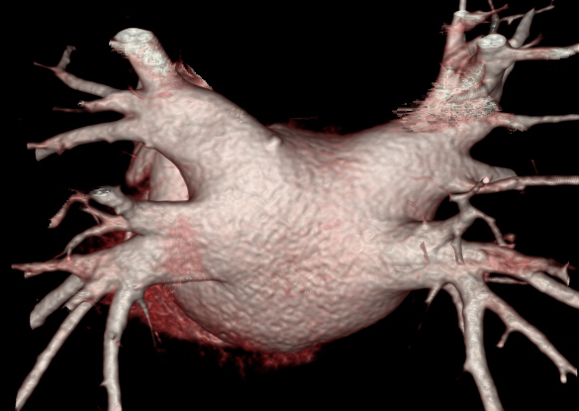
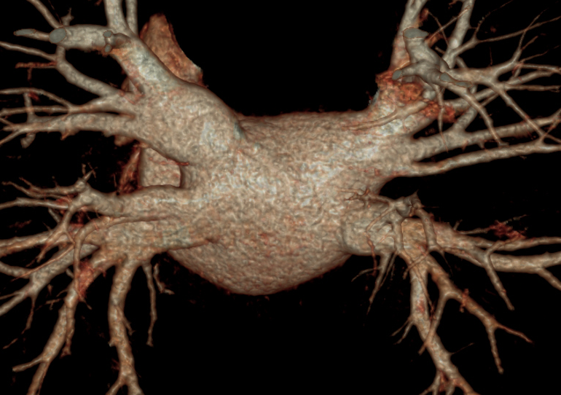

M/40, PeAF
Arrhythmia Center, KUMC
De Novo Redo
LA Size: 44 mm 42 mm
LA volume: 108 ml 78 ml

Slide 78
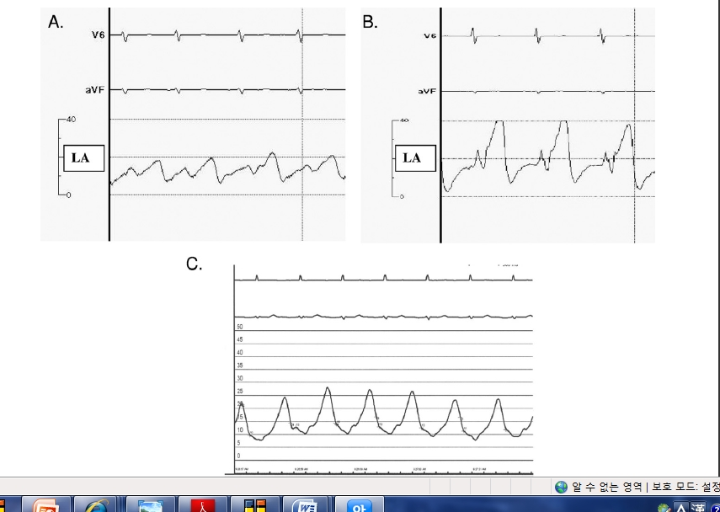
“Stiff LA Syndrome” After LA Ablation
Before Ablation at the LA
After LA Ablation,
Base at redo
*No significant MR
PA Wedge Pressure

Slide 79
Pilote L, Hüttner I, Marpole D, Sniderman A.
Stiff left atrial syndrome. Can J Cardiol 1988;4:255–257
Mehta S, Charbonneau F, Fitchett DH, Marpole DG, Patton R, Sniderman AD.
The clinical consequences of a stiff left atrium.
Am Heart J 1991;122:1184–1191

Slide 80
Gibson DN, Di Biase L, Mohanty P, Patel JD, Bai R, Sanchez J, Burkhardt JD, Heywood JT, Johnson AD, Rubenson DS, Horton R, Gallinghouse GJ, Beheiry S, Curtis GP, Cohen DN, Lee MY, Smith MR, Gopinath D, Lewis WR, Natale A.
Stiff left atrial syndrome after catheter ablation for atrial fibrillation: clinical characterization, prevalence, and predictors.
Heart Rhythm 2011;8:1364–1371

Slide 81
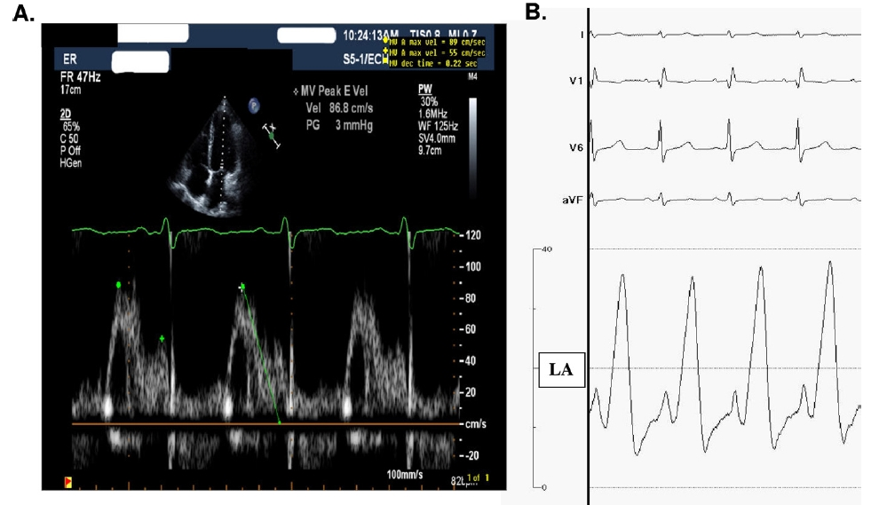
Atrial Diastolic Dysfunction with Preserved Atrial Systole
Heart Rhythm 2011;8:1364–1371

Slide 82
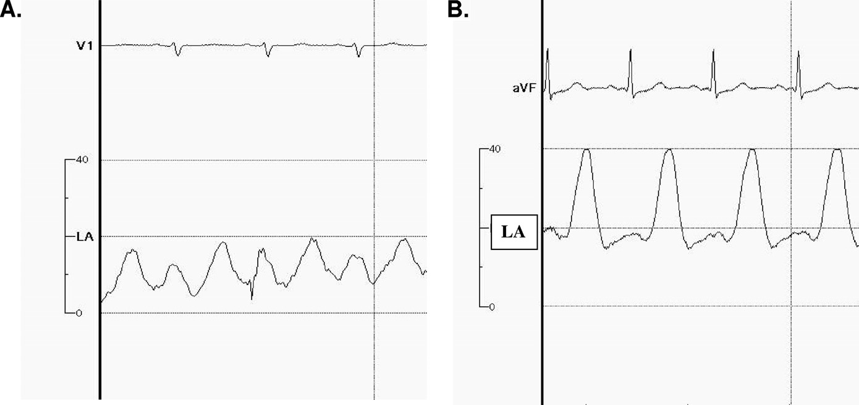
Atrial Diastolic Dysfunction Along with Systolic Dysfunction
After LA Ablation,
Base at redo
Before Ablation at the LA
Heart Rhythm 2011;8:1364–1371

Slide 83
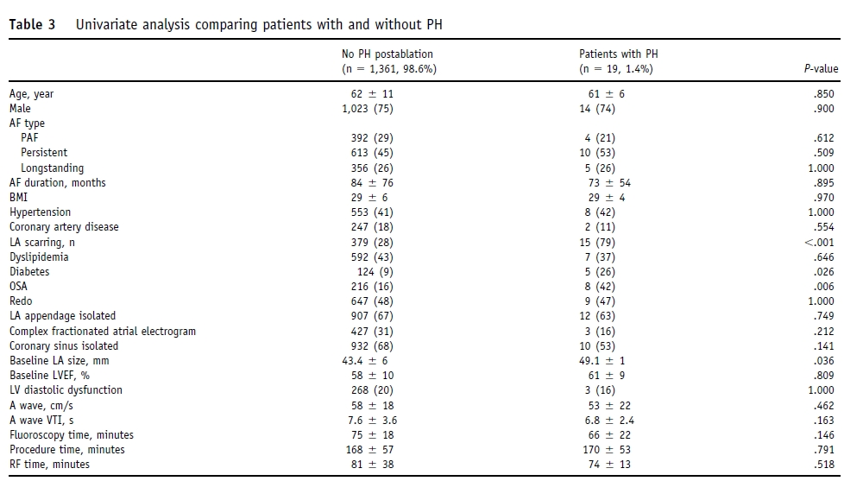
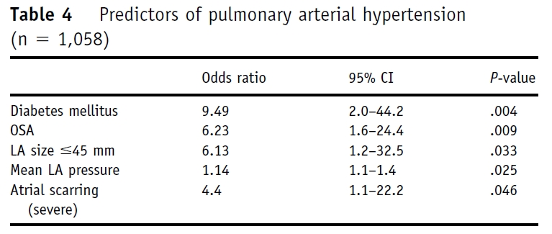
Heart Rhythm 2011;8:1364–1371

Slide 84
Stiff LA syndrome may be unrecognized if the clinician does not suspect it.
Predictors
Small LA
OSA
DM
Atrial scarring (>60%)
High LA pressure
Heart Rhythm 2011;8:1364–1371

Slide 85
Stiff LA syndrome
Fortunately responds well to diuretics, furosemide.
There was a case who was refractory to diuretics, but responded to “sildenafil.”
Wong GR et al. Novel use of sildenafil in the management of pulmonary hypertension due to post-catheter ablation ‘stiff left atrial syndrome.’ Int J Cardiol 2015;181:55–56.

Slide 86
Cough
It might be a sign of underlying PV stenosis, PN injury, direct bronchial injury, stiff LA syndrome, gastroesophageal reflux, pulmonary embolism, pericarditis, or other iatrogenic respiratory complications such as ventilator-associated pneumonia or postprocedure aspiration pneumonia.
Cough following CBA is more frequent.
1. CBA-induced PN injury (up to 11%)
2. Direct upper airway irritation during CBA
3. Direct and acute bronchial inflammation, bleeding, and
mucosal injury
4. Ice formation within the left main-stem bronchus

Slide 87
Increase in Heart Rate and/or Sinus Tachycardia
This phenomenon is related to shifts in autonomic tone following ablation and is predictive of ablation success.
This shift in autonomic tone results from ablation of GP that are commonly located near the PV antra, and these signs have been associated with improved procedural outcomes.
Although the increase in heart rate and reduction in HRV after ablation typically follow a transient time course, with resolution within 3 months, some studies have shown that the long-term persistence of these autonomic changes is associated with improved clinical outcomes.

Slide 88
FOLLOW-UP CONSIDERATIONS
OUTCOMES AND EFFICACY
COMPLICATIONS
Up-to-date review with a large number of recently published randomized trials, non-RCT, and consensus of writing group.
Provide data and evidence with well-organized tables.
Many unanswered questions in AF ablation are described for future investigation and consensus statement.

Slide 89
Hugh Calkins, MD (Chair)
Gerhard Hindricks, MD (Vice-Chair); Riccardo Cappato, MD (Vice-Chair); Young-Hoon Kim, MD, PhD (Vice-Chair); Eduardo B. Saad, MD, PhD (Vice-Chair)
Section Chairs
Definitions, Mechanisms, and Rationale for AF Ablation: Shih-Ann Chen, MD, Taiwan
Modifiable Risk Factors for AF and Impact on Ablation: Jonathan M. Kalman, MBBS, PhD, Australia
Indications: Claudio Tondo, MD, PhD, Italy
Strategies, Techniques, and Endpoints: Karl Heinz Kuck, MD, PhD, Germany
Technology and Tools: Andrea Natale, MD, USA
Technical Aspects of Ablation to Maximize Safety and Anticoagulation: David E. Haines, MD, USA
Follow-up Considerations: Francis E. Marchlinski, MD, USA
Outcomes and Efficacy: Matthew R. Reynolds, MD, MSc, USA
Complications: D. Wyn Davies, MD, United Kingdom
Training Requirements: Bruce D. Lindsay, MD, USA
Surgical and Hybrid AF Ablation: James R. Edgerton, MD, USA
Clinical Trial Design: Atul Verma, MD, Canada
Luis Aguinaga, MD, PhD; Joseph G. Akar, MD, PhD; Vinay Badhwar, MD; Josep Brugada, MD, PhD; John Camm, MD; Peng-Sheng Chen, MD; Shih-Ann Chen, MD; Mina K. Chung, MD; Jens Cosedis Nielsen, DMSc, PhD; Anne B. Curtis, MD; D. Wyn Davies, MD; John D. Day, MD; André d’Avila, MD, PhD; N.M.S. (Natasja) de Groot, MD, PhD; Luigi Di Biase, MD, PhD; Mattias Duytschaever, MD, PhD; James R. Edgerton, MD; Kenneth A. Ellenbogen, MD; Patrick T. Ellinor, MD, PhD; Sabine Ernst, MD, PhD; Guilherme Fenelon, MD, PhD; Edward P. Gerstenfeld, MS, MD; David E. Haines, MD; Michel Haissaguerre, MD; Robert H. Helm, MD; Elaine Hylek, MD, MPH; Warren M. Jackman, MD; Jose Jalife, MD; Jonathan M. Kalman, MBBS, PhD; Josef Kautzner, MD, PhD; Hans Kottkamp, MD; Karl Heinz Kuck, MD, PhD; Koichiro Kumagai, MD, PhD; Richard Lee, MD, MBA; Thorsten Lewalter, MD, PhD; Bruce D. Lindsay, MD; Laurent Macle, MD; Moussa Mansour, MD; Francis E. Marchlinski, MD; Gregory F. Michaud, MD; Hiroshi Nakagawa, MD, PhD; Andrea Natale, MD; Stanley Nattel, MD; Ken Okumura, MD, PhD; Douglas Packer, MD; Evgeny Pokushalov, MD, PhD; Matthew R. Reynolds, MD, MSc; Prashanthan Sanders, MBBS, PhD; Mauricio Scanavacca, MD, PhD; Richard Schilling, MD; Claudio Tondo, MD, PhD; Hsuan-Ming Tsao, MD; Atul Verma, MD; David J. Wilber, MD; Teiichi Yamane, MD, PhD

Slide 90
Definitions for Use When Reporting Outcomes of AF Ablation and in Designing Clinical Trials of Catheter or Surgical Ablation of AF
Acute procedural success (pulmonary vein isolation) | Acute procedural success is defined as electrical isolation of all pulmonary veins. A minimal assessment of electrical isolation of the PVs should consist of an assessment of entrance block. If other methods are used to assess PVI, including exit block and/or the use of provocative agents such as adenosine or isoproterenol, they should be prespecified. Furthermore, it is recommended that the wait time used to screen for early recurrence of PV conduction once initial electrical isolation is documented be specified in all prospective clinical trials.
Acute procedural success (not related by pulmonary vein isolation) | Typically, this would apply to substrate ablation performed in addition to PVI for persistent AF. Although some have proposed AF termination as a surrogate for acute procedural success, its relationship to long-term success is controversial. Complete elimination of the additional substrate (localized rotational activation, scar region, non-PV trigger, or other target) and/or demonstration of bidirectional conduction block across a linear ablation lesion would typically be considered the appropriate endpoint.
One-year success* | One-year success is defined as freedom from AF/AFL/AT after removal from antiarrhythmic drug therapy as assessed from the end of the 3month blanking period to 12 months following the ablation procedure. Because cavotricuspid isthmus-dependent atrial flutter is easily treated with cavotricuspid isthmus ablation and is not an iatrogenic arrhythmia following a left atrial ablation procedure for AF, it is reasonable for clinical trials to choose to prespecify that occurrence of isthmus-dependent atrial flutter, if confirmed by entrainment maneuvers during electrophysiology testing, should not be considered an ablation failure or primary effectiveness endpoint.

Slide 91
Alternative one-year success | Although the one-year success definition provided above remains the recommended end point that should be reported in all AF ablation trials, and the endpoint for which the objective performance criteria listed below were developed, the Task Force recognizes that alternative definitions for success can be used if the main goal of therapy in the study is to relieve AF-related symptoms and to improve patient quality of life. In particular, it is appropriate for clinical trials to define success as freedom from only symptomatic AF/AFL/AT after removal from antiarrhythmic drug therapy as assessed from the end of the 3-month blanking period to 12 months following the ablation procedure if the main goal of therapy in the study is to relieve AF-related symptoms and to improve patient quality of life. However, because symptoms of AF can resolve over time, and because studies have shown that asymptomatic AF represents a greater proportion of all AF postablation than prior to ablation, clinical trials need to continue to report freedom from both symptomatic and asymptomatic AF even if this alternative one year success definition is used as the primary trial endpoint.
Clinical/partial success* | It is reasonable for clinical trials to define and incorporate one or more secondary definitions of success that can be referred to as “clinical success” or “partial success.” If these alternative definitions of success are included, they should be defined prospectively. In prior Consensus Documents the Task Force has proposed that clinical/partial success be defined as a “75% or greater reduction in the number of AF episodes, the duration of AF episodes, or the % time a patient is in AF as assessed with a device capable of measuring AF burden in the presence or absence of previously ineffective antiarrhythmic drug therapy.” Because there is no firm scientific basis for selecting the cutoff of 75% rather than a different cutoff, this prior recommendation is provided only as an example of what future clinical trials may choose to use as a definition of clinical/partial success.
Long-term success* | Long-term success is defined as freedom from AF/AFL/AT recurrences following the 3-month blanking period through a minimum of 36-month follow-up from the date of the ablation procedure in the absence of Class I and III antiarrhythmic drug therapy.
*When reporting outcomes of AF ablation, the development of atrial tachycardia or atrial flutter should be included in the broad definition of recurrence following AF ablation. All studies should report freedom from AF, atrial tachycardia, and atrial flutter. These endpoints can also be reported separately. All studies should also clearly specify the type and frequency of ECG monitoring as well as the degree of compliance with the prespecified monitoring protocol.

Slide 92
Recurrent AF/AFL/AT | Recurrent AF/AFL/AT is defined as AF/AFL/AT of at least 30 seconds’ duration that is documented by an ECG or device recording system and occurs following catheter ablation. Recurrent AF/AFL/AT may occur within or following the post ablation blanking period. Recurrent AF/AFL/AT that occurs within the postablation blanking period is not considered a failure of AF ablation.
Early recurrence of AF/AFL/AT | Early recurrence of AF/AFL/AT is defined as a recurrence of atrial fibrillation within three months of ablation. Episodes of atrial tachycardia or atrial flutter should also be classified as a “recurrence.” These are not counted toward the success rate if a blanking period is specified.
Recurrence of AF/AFL/AT | Recurrence of AF/AFL/AT postablation is defined as a recurrence of atrial fibrillation more than 3 months following AF ablation. Episodes of atrial tachycardia or atrial flutter should also be classified as a “recurrence.”
Late recurrence of AF/AFL/AT | Late recurrence of AF/AFL/AT is defined as a recurrence of atrial fibrillation 12 months or more after AF ablation. Episodes of atrial tachycardia or atrial flutter should also be classified as a “recurrence.”
Blanking period | A blanking period of three months should be employed after ablation when reporting efficacy outcomes. Thus, early recurrences of AF/AFL/AT within the first 3 months should not be classified as treatment failure. If a blanking period of less than 3 months is chosen, it should be prespecified and included in the Methods section.
Stroke screening | A risk-based approach to determine the level of postablation stroke screening in clinical trials is recommended by the Task Force. For ablation devices with a lower risk of stroke and for which a stroke signal has not been reported, a minimum standardized neurological assessment of stroke should be conducted by a physician at baseline and at hospital discharge or 24 hours after the procedure, whichever is later. If this neurological assessment demonstrates new abnormal findings, the patient should have a formal neurological consult and examination with appropriate imaging (i.e., DW-MRI), used to confirm any suspected diagnosis of stroke. For devices in which a higher risk of stroke is suspected or revealed in prior trials, a formal neurological examination by a neurologist at discharge or 24 hours after the procedure, whichever is later, is recommended. Appropriate imaging should be obtained if this evaluation reveals a new neurological finding. In some studies in which delayed stroke is a concern, repeat neurological screening at 30 days postablation might be appropriate.

Slide 93
Detectable AF/AFL/AT | Detectable AF is defined as AF/AFL/AT of at least 30 seconds’ duration when assessed with ECG monitoring. If other monitoring systems are used, including implantable pacemakers, implantable defibrillators, and subcutaneous ECG monitoring devices, the definition of detectable AF needs to be prespecified in the clinical trial based on the sensitivity and specificity of AF detection with the particular device. We recommend that episodes of atrial flutter and atrial tachycardia be included within the broader definition of a detectable AF/AFL/AT episode.
AF/AFL/AT burden | It is reasonable for clinical trials to incorporate AF/AFL/AT burden as a secondary endpoint in a clinical trial of AF ablation. In stating this it is recognized that there are no conclusive data that have validated a rate of AF burden reduction as a predictor of patient benefit (i.e., reduction in mortality and major morbidities such as stroke, CHF, QOL, or hospitalization). If AF burden is included, it is important to predefine and standardize the monitoring technique that will be used to measure AF burden. Available monitoring techniques have been discussed in this document. Should AF burden be selected as an endpoint in a clinical trial, the chosen monitoring technique should be employed at least a month prior to ablation to establish a baseline burden of AF.
Entrance block | Entrance block is defined as the absence, or if present, the dissociation, of electrical activity within the PV antrum. Entrance block is most commonly evaluated using a circular multielectrode mapping catheter positioned at the PV antrum. Entrance block can also be assessed using detailed point-by-point mapping of the PV antrum guided by an electroanatomical mapping system. The particular method used to assess entrance block should be specified in all clinical trials. Entrance block of the left PVs should be assessed during distal coronary sinus or left atrial appendage pacing in order to distinguish far-field atrial potentials from PV potentials. It is recommended that reassessment of entrance block be performed a minimum of 20 minutes after initial establishment of PV isolation.
Procedural endpoints for AF ablation strategies not targeting the PVs | Procedural endpoints for AF ablation strategies not targeting the PVs: The acute procedural endpoints for ablation strategies not targeting the PVs vary depending on the specific ablation strategy and tool. It is important that they be prespecified in all clinical trials. For example, if a linear ablation strategy is used, documentation of bidirectional block across the ablation line must be shown. For ablation of CFAEs, rotational activity, or non-PV triggers, the acute endpoint should at a minimum be elimination of CFAEs, rotational activity, or non-PV triggers. Demonstration of AF slowing or termination is an appropriate procedural endpoint, but it is not required as a procedural endpoint for AF ablation strategies not targeting the PVs.

Slide 94
Esophageal temperature monitoring | Esophageal temperature monitoring should be performed in all clinical trials of AF ablation. At a minimum, a single thermocouple should be used. The location of the probe should be adjusted during the procedure to reflect the location of energy delivery. Although this document does not provide formal recommendations regarding the specific temperature or temperature change at which energy delivery should be terminated, the Task Force does recommend that all trials prespecify temperature guidelines for termination of energy delivery.
Enrolled subject | An enrolled subject is defined as a subject who has signed written informed consent to participate in the trial in question.
Exit block | Exit block is defined as the inability to capture the atrium during pacing at multiple sites within the PV antrum. Local capture of musculature within the pulmonary veins and/or antrum must be documented to be present to make this assessment. Exit block is demonstrated by a dissociated spontaneous pulmonary vein rhythm.
Nonablative strategies | The optimal nonablative therapy for patients with persistent and long-standing persistent AF who are randomized to the control arm of an AF ablation trial is a trial of a new Class 1 or 3 antiarrhythmic agent or a higher dose of a previously failed antiarrhythmic agent. For patients with persistent or long-standing persistent AF, performance of a direct-current cardioversion while taking the new or dose adjusted antiarrhythmic agent should be performed, if restoration of sinus rhythm is not achieved following initiation and/or dose adjustment of antiarrhythmic drug therapy. Failure of pharmacological cardioversion alone is not adequate to declare this pharmacological strategy unsuccessful.
Noninducibility of atrial fibrillation | Noninducibility of atrial fibrillation is defined as the inability to induce atrial fibrillation with a standardized prespecified pharmacological or electrical stimulation protocol. The stimulation protocol should be prespecified in the specific clinical trial. Common stimulation approaches include a high-dose isoproterenol infusion protocol or repeated atrial burst pacing at progressively more rapid rates.
Patient populations for inclusion in clinical trials | It is considered optimal for clinical trials to enroll patients with only one type of AF: paroxysmal, persistent, or long-standing persistent. If more than one type of AF patient is enrolled, the results of the trial should also be reported separately for each of the AF types. It is recognized that “early persistent” AF responds to AF ablation to a similar degree as patients with paroxysmal AF and that the response of patients with “late persistent AF” is more similar to that in those with long-standing persistent AF.

Slide 95
Therapy consolidation period | Following a 3-month blanking period, it is reasonable for clinical trials to incorporate an additional 1- to 3-month therapy consolidation period. During this time, adjustment of antiarrhythmic medications and/or cardioversion can be performed. Should a consolidation period be incorporated into a clinical trial design, the minimum follow-up duration should be 9 months following the therapy consolidation period. Performance of a repeat ablation procedure during the blanking or therapy consolidation period would “reset” the endpoint of the study and trigger a new 3-month blanking period. Incorporation of a therapy consolidation period can be especially appropriate for clinical trials evaluating the efficacy of AF ablation for persistent or long-standing persistent AF. The challenge of this approach is that it prolongs the overall study duration. Because of this concern regarding overall study duration, we suggest that the therapy consolidation period be no more than 3 months in duration following the 3-month blanking period.
Recommendations regarding repeat ablation procedures | It is recommended that all clinical trials report the single procedure efficacy of catheter ablation. Success is defined as freedom from symptomatic or asymptomatic AF/AFL/AT of 30 seconds or longer at 12 months postablation. Recurrences of AF/AFL/AT during the first 3-month blanking period post-AF ablation are not considered a failure. Performance of a repeat ablation procedure at any point after the initial ablation procedure should be considered a failure of a single procedure strategy. It is acceptable for a clinical trial to choose to prespecify and use a multiprocedure success rate as the primary endpoint of a clinical trial. When a multiprocedure success is selected as the primary endpoint, efficacy should be defined as freedom from AF/flutter or tachycardia at 12 months after the final ablation procedure. In the case of multiple procedures, repeat ablation procedures can be performed at any time following the initial ablation procedure. All ablation procedures are subject to a 3-month post blanking window, and all ablation trials should report efficacy at 12 months after the final ablation procedure.
Cardioversion definitions
Failed electrical cardioversion | Failed electrical cardioversion is defined as the inability to restore sinus rhythm for 30 seconds or longer following electrical cardioversion.
Successful electrical cardioversion | Successful electrical cardioversion is defined as the ability to restore sinus rhythm for at least 30 seconds following cardioversion.

Slide 96
Immediate AF recurrence postcardioversion | Immediate AF recurrence postcardioversion is defined as a recurrence of AF within 24 hours following cardioversion. The most common time for an immediate recurrence is within 30–60 minutes postcardioversion.
Early AF recurrence postcardioversion | Early AF recurrence postcardioversion is defined as a recurrence of AF within 30 days of a successful cardioversion.
Late AF recurrence postcardioversion | Late AF recurrence postcardioversion is defined as recurrence of AF more than 30 days following a successful cardioversion.
Surgical ablation definitions
Hybrid AF surgical ablation procedure | Hybrid AF surgical ablation procedure is defined as a joint AF ablation procedure performed by electrophysiologists and cardiac surgeons either as part of a single “joint” procedure or performed as two preplanned separate ablation procedures separated by no more than 6 months.
Surgical Maze ablation procedure | Surgical Maze ablation procedure is defined as a surgical ablation procedure for AF that includes, at a minimum, the following components: (1) line from SVC to IVC; (2) line from IVC to the tricuspid valve; (3) isolation of the PVs; (4) isolation of the posterior left atrium; (5) line from MV to the PVs; (6) management of the LA appendage.
Stand-alone surgical AF ablation | A surgical AF ablation procedure during which other cardiac surgical procedures are not performed such as CABG, valve replacement, or valve repair.
Nomenclature for types of surgical AF ablation procedures | We recommend that the term “Maze” procedure is appropriately used only to refer to the biatrial lesion set of the Cox-Maze operation. It requires ablation of the RA and LA isthmuses. Less extensive lesion sets should not be referred to as a “Maze” procedure, but rather as a surgical AF ablation procedure. In general, surgical ablation procedures for AF can be grouped into three different groups: (1) a full biatrial Cox-Maze procedure; (2) PVI alone; and (3) PVI combined with left atrial lesion sets.
Hybrid epicardial and endocardial AF ablation | This term refers to a combined AF ablation procedure involving an off-pump minimally invasive surgical AF ablation as well as a catheter-based AF ablation procedure designed to complement the surgical lesion set. Hybrid ablation procedures may be performed in a single-procedure setting in a hybrid operating room or a cardiac catheterization laboratory environment, or it can be staged. When staged, it is most typical to have the patient undergo the minimally invasive surgical ablation procedure first following by a catheter ablation procedure 1 to 3 months later. This latter approach is referred to as a “staged Hybrid AF ablation procedure.”

Slide 97
Minimum AF documentation, endpoints, TEE performance, and success rates in clinical trials
Minimum documentation for paroxysmal AF | The minimum AF documentation requirement for paroxysmal AF is (1) physician’s note indicating recurrent self-terminating AF; and (2) one electrocardiographically documented AF episode within 6 months prior to the ablation procedure.
Minimum documentation for persistent AF | The minimum AF documentation requirement for persistent AF is (1) physician’s note indicating continuous AF >7 days but no more than 1 year; and (2) a 24-hour Holter within 90 days of the ablation procedure showing continuous AF.
Minimum documentation for early persistent AF | The minimum AF documentation requirement for persistent AF is (1) physician’s note indicating continuous AF >7 days but no more than 3 months; and (2) a 24-hour Holter showing continuous AF within 90 days of the ablation procedure.
Minimum documentation for long-standing persistent AF | The minimum AF documentation requirement for long-standing persistent AF is as follows: physician’s note indicating at least 1 year of continuous AF plus a 24-hour Holter within 90 days of the ablation procedure showing continuous AF. The performance of a successful cardioversion (sinus rhythm >30 seconds) within 12 months of an ablation procedure with documented early recurrence of AF within 30 days should not alter the classification of AF as long-standing persistent.
Symptomatic AF/AFL/AT | AF/AFL/AT that results in symptoms that are experienced by the patient. These symptoms can include but are not limited to palpitations, presyncope, syncope, fatigue, and shortness of breath. For patients in continuous AF, reassessment of symptoms after restoration of sinus rhythm is recommended to establish the relationship between symptoms and AF.
Documentation of AF-related symptoms | Documentation by a physician evaluating the patient that the patient experiences symptoms that could be attributable to AF. This does not require a time-stamped ECG, Holter, or event monitor at the precise time of symptoms. For patients with persistent AF who initially report no symptoms, it is reasonable to reassess symptom status after restoration of sinus rhythm with cardioversion.
Minimum effectiveness endpoint for patients with symptomatic and asymptomatic AF | The minimum effectiveness endpoint is freedom from symptomatic and asymptomatic episodes of AF/AFL/AT recurrences at 12 months following ablation, free from antiarrhythmic drug therapy, and including a prespecified blanking period.

Slide 98
Minimum chronic acceptable success rate: paroxysmal AF at 12-month follow-up | If a minimum chronic success rate is selected as an objective effectiveness endpoint for a clinical trial, we recommend that the minimum chronic acceptable success rate for paroxysmal AF at 12-month follow-up is 50%.
Minimum chronic acceptable success rate: persistent AF at 12-month follow-up | If a minimum chronic success rate is selected as an objective effectiveness endpoint for a clinical trial, we recommend that the minimum chronic acceptable success rate for persistent AF at 12-month follow-up is 40%.
Minimum chronic acceptable success rate: long-standing persistent AF at 12-month follow-up | If a minimum chronic success rate is selected as an objective effectiveness endpoint for a clinical trial, we recommend that the minimum chronic acceptable success rate for long-standing persistent AF at 12-month follow-up is 30%.
Minimum follow-up screening for paroxysmal AF recurrence | For paroxysmal AF, the minimum follow-up screening should include (1) 12-lead ECG at each follow-up visit; (2) 24-hour Holter at the end of the follow-up period (e.g., 12 months); and (3) event recording with an event monitor regularly and when symptoms occur from the end of the 3-month blanking period to the end of follow-up (e.g., 12 months).
Minimum follow-up screening for persistent or long-standing AF recurrence | For persistent and long-standing persistent AF, the minimum follow-up screening should include (1) 12-lead ECG at each follow-up visit; (2) 24-hour Holter every 6 months; and (3) symptom-driven event monitoring.
Requirements for transesophageal echocardiogram | It is recommended that the minimum requirement for performance of a TEE in a clinical trial should be those requirements set forth in ACC/AHA/HRS 2014 Guidelines for AF Management pertaining to anticoagulation at the time of cardioversion. Prior to undergoing an AF ablation procedure a TEE should be performed in all patients with AF of >48 hours’ duration or of unknown duration if adequate systemic anticoagulation has not been maintained for at least 3 weeks prior to AF ablation. If a TEE is performed for this indication, it should be performed within 24 hours of the ablation procedure.
AF = atrial fibrillation; DW-MRI = diffusion-weighted magnetic resonance imaging; CHF = congestive heart failure; QOL = quality of life; ECG = electrocardiogram; CABG = coronary artery bypass graft; PV = pulmonary vein; SVC = superior vena cava; IVC = inferior vena cava; CFAE = complex fractionated atrial electrogram; PVI = pulmonary vein isolation; AFL = atrial flutter; AT = atrial tachycardia; ACC = American College of Cardiology; AHA = American Heart Association; HRS = Heart Rhythm Society.

Slide 99
Quality of Life Scales, Definitions, and Strengths
Scale | Definition/Details | Strengths/Weaknesses
Short Form (36) Health Survey (SF36) (General) | Consists of 8 equally weighted, scaled scores in the following sections: vitality, physical functioning, bodily pain, general health perceptions, physical role functioning, emotional role functioning, social role functioning, mental health. Each section receives a scale score from 0 to 100. Physical component summary (PCS) and mental component summary (MCS) is an average of all the physically and mentally relevant questions, respectively. The Short Form (12) Health Survey (SF12) is a shorter version of the SF-36, which uses just 12 questions and still provides scores that can be compared with SF-36 norms, especially for summary physical and mental functioning. Gives more precision in measuring QOL than EQ-5D but can be harder to transform into cost utility analysis. | Advantages: extensively validated in a number of disease and health states. Might have more resolution than EQ-50 for AF QOL. Disadvantages: not specific for AF, so might not have resolution to detect AF-specific changes in QOL.

Slide 100
Quality of Life Scales, Definitions, and Strengths
EuroQol Five Dimensions Questionnaire (EQ-5D)39 (General) | Two components: Health state description is measured in five dimensions: mobility, self-care, usual activities, pain/discomfort, anxiety/depression. Answers may be provided on a three-level (3l) or five-level (SL) scale. In the Evaluation section, respondents evaluate their overall health status using a visual analogue scale (EQ-VAS). Results can easily be converted to quality-adjusted life years for cost utility analysis. | Advantages: extensively validated in a number of disease and health states. Can easily be converted into quality adjusted life years (QALY) for cost-effectiveness analysis. Disadvantages: might not be specific enough to detect AF-specific changes in QOL. Might be less specific than SF-36.
AF effect on Quality of Life Survey (AFEQT)40 (AF specific) | 20 questions: 4 targeting AF-related symptoms, 8 evaluating daily function, and 6 assessing AF treatment concerns. Each item scored on a 7-point Likert scale. | Advantages: brief, simple, very responsive to AF interventions. Good internal validity and well validated against a number of other global and AF-specific QOL scales. Used in CABANA. Disadvantages: validation in only two published studies (approximately 219 patients).
Quality of Life Questionnaire for Patients with AF (AF-QoL)41 (AF specific) | 18-item self-administered questionnaire with three domains: psychological, physical, and sexual activity. Each item scores on a 5-point Likert scale. | Advantages: brief, simple, responsive to AF interventions; good internal validity; used in SARA trial. Disadvantages: external validity compared only to SF-36; formal validation in 1 study (approximately 400 patients).
Arrhythmia-Related Symptom Checklist (SCL)42 (AF specific) | 16 items covering AF symptom frequency and symptom severity. | Advantages: most extensively validated in a number of arrhythmia cohorts and clinical trials. Disadvantages: time-consuming and uncertain generalizability.

Slide 101
Mayo AF Specific Symptom Inventory (MAFSI)43 (AF specific) | 10 items covering AF symptom frequency and severity. Combination of 5- point and 3-point Likert scale responses. Used in CABANA trial. | Advantages: validated in an AF ablation population and responsive to ablation outcome; used in CABANA trial. Disadvantages: external validity compared only to SF-36; 1 validation study (approximately 300 patients).
University of Toronto Atrial Fibrillation Severity Scale (AFSS)44 (AF specific) | 10 items covering frequency, duration, and severity. 7-point Likert scale responses. | Advantages: validated and reproducible; used in CTAF trial. Disadvantages: time-consuming and uncertain generalizability.
Arrhythmia Specific Questionnaire in Tachycardia and Arrhythmia (ASTA)45 (AF specific) | Records number of AF episodes and average episode duration during last 3 months. 8 symptoms and 2 disabling symptoms are recorded with scores from 1–4 for each. | Advantages: validated in various arrhythmia groups; external validity compared with SCL, EQ5D, and SF-36; used in MANTRA-PAF; brief; simple. Disadvantages: one validation study (approximately 300 patients).
European Heart Rhythm Association (EHRA)46 (AF specific) | Like NYHA scale. I = no symptoms, II = mild symptoms not affecting daily activity, III = severe symptoms affecting daily activity, and IV = disabling symptoms terminating daily activities. | Advantage: very simple, like NYHA. Disadvantages: not used in studies and not well validated; not very specific; unknown generalizability.

Slide 102
Canadian Cardiovascular Society Severity of Atrial Fibrillation Scale (CCS-SAF)47 (AF specific) | Like NYHA scale. O = asymptomatic, I = AF symptoms have minimal effect on patient’s QOL, II = AF symptoms have minor effect on patient QOL, III = symptoms have moderate effect on patient QOL, IV= AF symptoms have severe effect on patient QOL. | Advantages: very simple, like NYHA; validated against SF-36 and University of Toronto AFSS. Disadvantages: poor correlation with subjective AF burden; not very specific.
AF = atrial fibrillation; QOL = quality of life; CABANA = Catheter Ablation vs Anti-arrhythmic Drug Therapy for Atrial Fibrillation; SARA = Study of Ablation Versus antiaRrhythmic Drugs in Persistent Atrial Fibrillation; CTAF = Canadian Trial of Atrial Fibrillation; MANTRA-PAF = Medical ANtiarrhythmic Treatment or Radiofrequency Ablation in Paroxysmal Atrial Fibrillation; NYHA = New York Heart Association; AFSS = atrial fibrillation severity scale.

Slide 103
Non-AF Recurrence–Related Endpoints for Reporting in AF Ablation Trials
Stroke and bleeding endpoints | Definitions/details
Stroke (2014 ACC/AHA Key Data Elements) | An acute episode of focal or global neurological dysfunction caused by brain, spinal cord, or retinal vascular injury as a result of hemorrhage or infarction. Symptoms or signs must persist ≥24 hours, or if documented by CT, MRI or autopsy, the duration of symptoms/signs may be less than 24 hours. Stroke may be classified as ischemic (including hemorrhagic transformation of ischemic stroke), hemorrhagic, or undetermined. Stroke disability measurement is typically performed using the modified Rankin Scale (mRS).
Transient ischemic attack (2014 ACC/AHA Key Data Elements) | Transient episode of focal neurological dysfunction caused by brain, spinal cord, or retinal ischemia without acute infarction and with signs and symptoms lasting less than 24 hours.
Major bleeding (ISTH definition) | Fatal bleeding AND/OR symptomatic bleeding in a critical area or organ, such as intracranial, intraspinal, intraocular, retroperitoneal, intraarticular, pericardial, or intramuscular with compartment syndrome AND/OR bleeding causing a fall in hemoglobin level of 2 g/dL (1.24 mmol/L) or more, or leading to transfusion of two or more units of blood.
Clinically relevant nonmajor bleed (ISTH definition) | An acute or subacute clinically overt bleed that does not meet the criteria for a major bleed but prompts a clinical response such that it leads to one of the following: hospital admission for bleeding; physician-guided medical or surgical treatment for bleeding; change in antithrombotic therapy (including interruption or discontinuation).

Slide 104
Stroke and bleeding endpoints | Definitions/details
Minor bleeding (ISTH definition) | All nonmajor bleeds. Minor bleeds are further divided into clinically relevant and not.
Incidence and discontinuation of oral anticoagulation | The number of patients receiving oral anticoagulation and the type of oral anticoagulation should be documented at the end of follow-up. If patients have their oral anticoagulation discontinued, the number of patients discontinuing, the timing of discontinuation, and the reasons for discontinuation of oral anticoagulation, as well as the clinical characteristics and stroke risk profile of the patients should be reported.
AF = atrial fibrillation; CT = computed tomography; MRI = magnetic resonance imaging.

Slide 105
Advantages and Disadvantages of AF-Related Endpoints in AF Ablation Trials
Endpoint | Advantages | Disadvantages | Relevance and comments
Freedom from AF/AFL/AT recurrence “gold standard” is 30 seconds | -Has been in use for many years -Can be used to compare results of new trials with historical trials -Sets a high bar for AF elimination | -Can systematically underestimate the efficacy of AF ablation, particularly for persistent AF, if 30-second cutoff is used | -Particularly well suited for paroxysmal AF outcomes -Reporting of cutoffs other than 30 seconds encouraged as secondary endpoints to better contextualize results -May be reported as proportion of patients free from arrhythmia or time to recurrence
Freedom from stroke- relevant AF/AFL/AT- duration cutoff of 1 hour | -Useful for trials in which interest is more for prognostic change conferred by ablation rather than elimination of all arrhythmias | -No consistent definition of what a stroke-relevant duration of AF is: ranges from 6 minutes to 24 hours in literature | -More than 1 hour could be a useful cutoff based on results of 505 trial -May be reported as proportion of patients free from arrhythmia or time to recurrence
Freedom from AF/AFL/AT requiring intervention (emergency visits, cardioversion, urgent care visit, reablation, etc.) | -Can provide an endpoint more relevant to systemic costs of AF recurrence -Clinically relevant | -Will overestimate efficacy of ablation by ignoring shorter episodes not requiring intervention that still might be important to quality of life or stroke | -Determination of what is an “intervention” must be prespecified in protocol and biases mitigated to avoid over- or underintervention in the trial
Freedom from persistent AF/AFL/AT-duration cutoff of 7 days | -Useful for trials assessing additional substrate modification in persistent AF | -Can systematically overestimate the efficacy of AF ablation, particularly for persistent AF | -Can require continuous monitoring to definitively assess if episode is >7 days

Slide 106
Endpoint | Advantages | Disadvantages | Relevance and Comments
Freedom from AF/AFL/AT on previously ineffective antiarrhythmic therapy | -If patient maintains sinus rhythm on previously ineffective drug therapy, this may be considered a clinically relevant, successful outcome | -Will increase the success rate compared with off-drug success -May not be relevant to patients hoping to discontinue drug therapy | -Postablation drug and dosage of drug should be identical to preablation drug and dosage
Significant reduction in AF burden: >75% reduction from pre- to postablation and/or total postablation burden <12% | -Can be useful in persistent AF studies, but might not be suited for early, paroxysmal AF studies | -Ideally requires continuous monitoring using an implantable device -No scientific basic exists showing that a 75% reduction in AF burden impacts hard endpoints, including heart failure, stroke, and mortality | -AF burden can be estimated by intermittent monitoring and reporting of patient symptoms and recurrences like a “time in therapeutic range” report for oral anticoagulation; see text -Could also see 75% reduction in number and duration of AF episodes -Because there is no firm scientific basis for selecting the cutoff of 75%, this prior recommendation is provided only as an example of what future clinical trials may choose to use as a definition of clinical/partial success
Prevention in AF progression: time to first episode of persistent AF (>7 days) | -Does not assume that total elimination of AF is required -Well suited for paroxysmal or “early” AF studies in which goal is to prevent progression to persistent AF | -Prevention in progression might be irrelevant for stroke or thromboembolic outcomes -Long follow-up time might be required unless population is “enriched” -Can ideally require continuous implantable monitoring | -Might be useful for specific populations such as heart failure or hypertrophic cardiomyopathy, in which progression to persistent AF can lead to increased hospitalization

Slide 107
Endpoint | Advantages | Disadvantages | Relevance and Comments
Regression of AF: reduction in burden to a given threshold or conversion of persistent to paroxysmal AF | -Does not assume that total elimination of AF is required -Well suited for persistent “late” AF studies in which goal is to regress to paroxysmal AF, which might be easier to control with drug therapy | -Regression endpoint will overestimate efficacy of AF ablation -Might ideally require continuous implantable monitoring -Patients will require ongoing drug therapy | -Could be particularly useful for long-standing persistent AF populations with structural heart disease, heart failure, etc.
Acute AF termination during ablation procedure | -Could provide indication of successful modification of substrate responsible for maintaining AF, most relevant to persistent or long-standing persistent AF -Limited studies have linked acute AF termination to long-term success | -Relevance of acute AF termination has not consistently been shown to correlate to long-term success -Endpoint might not be relevant to paroxysmal AF patients in whom AF might terminate spontaneously -Some studies employ administration of intravenous or oral antiarrhythmics during ablation that could cause spontaneous termination -Studies consider termination as reversion to sinus rhythm, whereas others consider reversion to any regular tachycardia as termination | -Intraprocedural administration of preprocedural oral antiarrhythmics or intraprocedural intravenous antiarrhythmics are discouraged -If antiarrhythmics are used, their use and dosage before and during the ablation should be clearly documented -Termination to sinus rhythm and termination to another regular tachycardia (AT or AFL) should be separately reported
AF = atrial fibrillation; AFL = atrial flutter; AT = atrial tachycardia

Slide 108
2017 HRS/EHRA/ECAS/APRHS/SOLAECE Expert Consensus Statement on Catheter and Surgical Ablation of Atrial Fibrillation
Gerhard Hindricks, MD

Slide 109
Presenter Disclosure Information
Gerhard Hindricks/Department of Electrophysiology has received scientific grants and research grants through the University Leipzig / Heart Center from St. Jude Medical, Biotronik, Boston Scientific, and Volkswagen Foundation.
No personal financial relations to disclose.

Slide 110
Agenda
Definitions, mechanisms, and rationale for ablation
Modifiable risk factors for AF and implications for catheter ablation
Indications - catheter ablation of AF - surgical ablation of AF

Slide 111
Significance of AF
33 million people have AF world wide
3–5 million people in the United States
By 2050, app. 8 million people will be affected in the United States
AF increases risk of stroke on average 5-fold
AF increases heart failure, dementia, and total mortality
450000 hospitalizations in the United States
90000 deaths related to AF in the United States

Slide 112

AF Definitions: Speaking the Same Language…

Slide 113
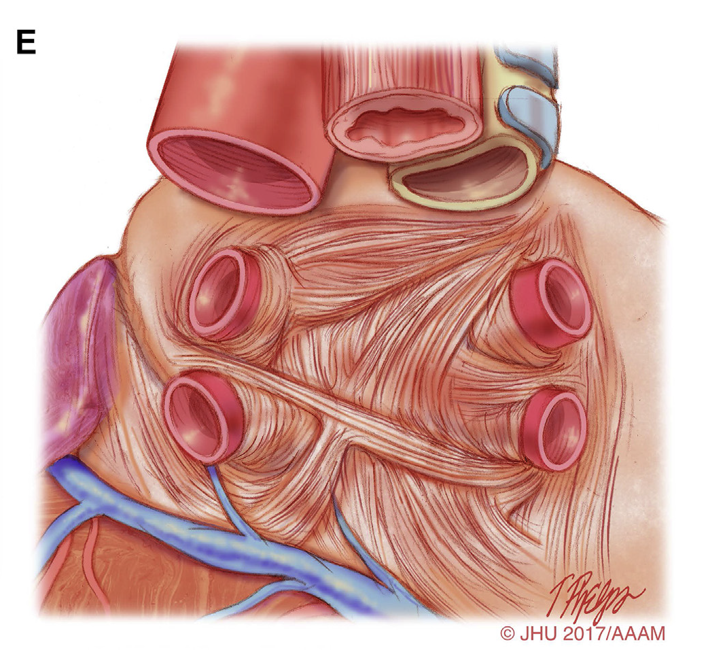
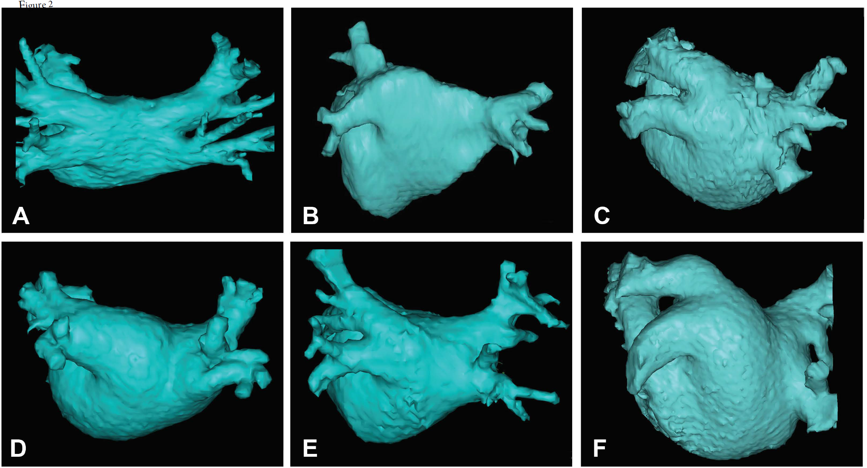
Anatomy of the LA and AF

Slide 114
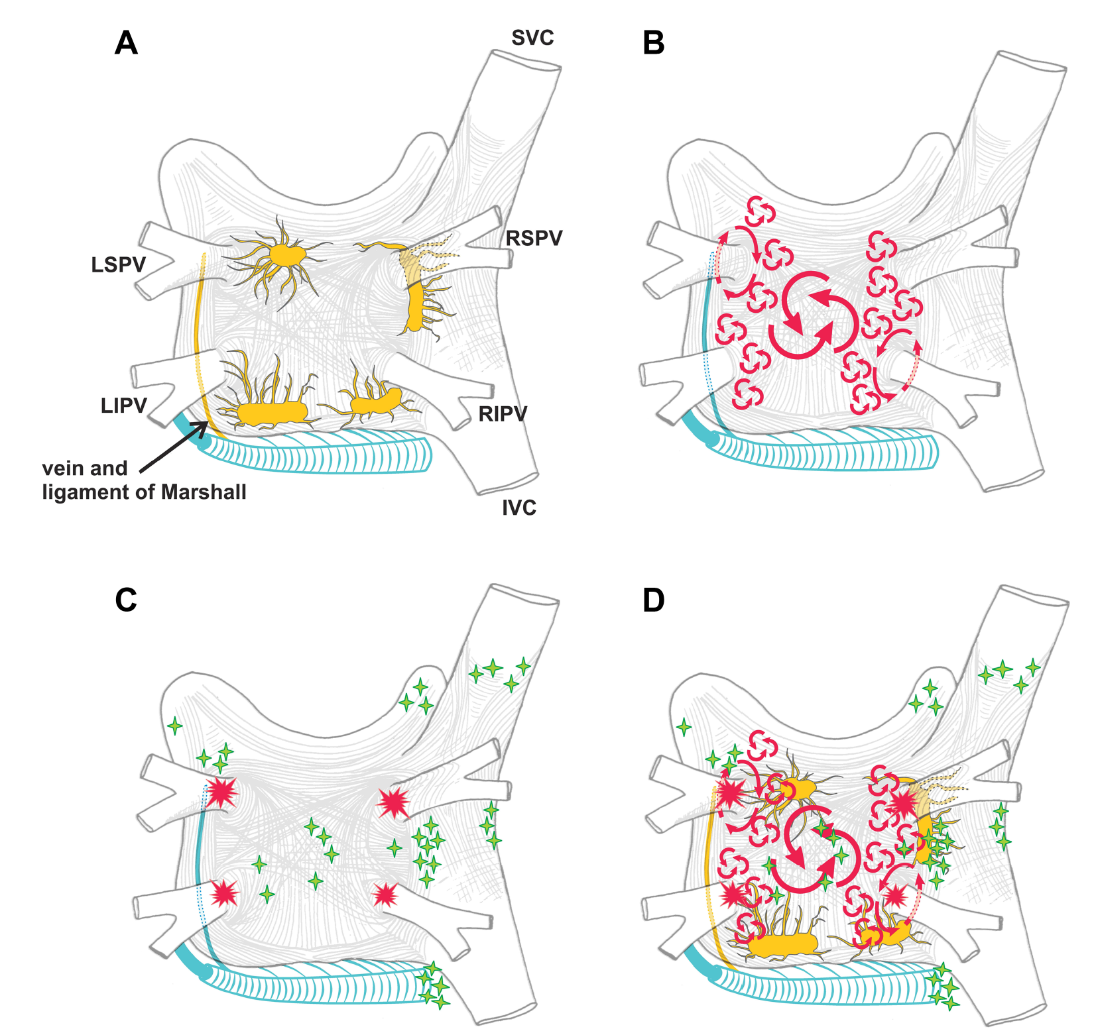
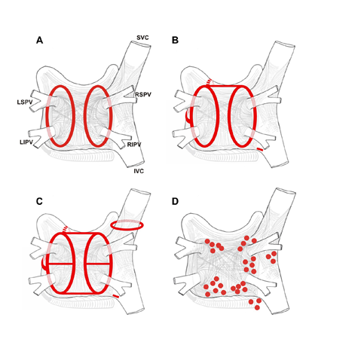
AF Mechanisms and Ablation Concepts

Slide 115
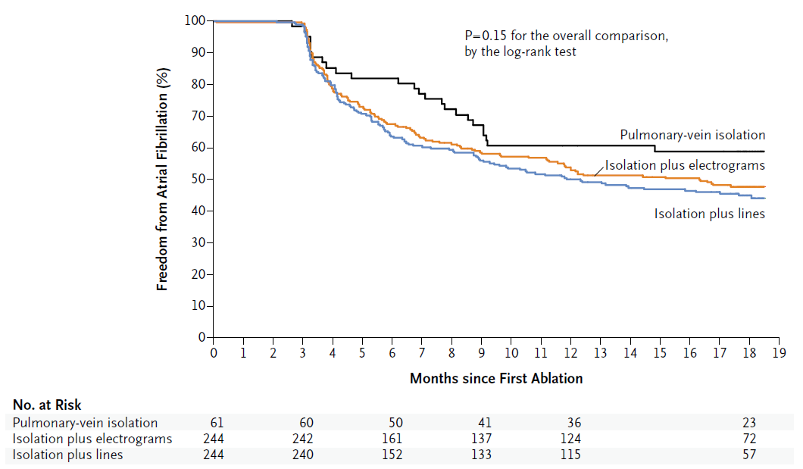
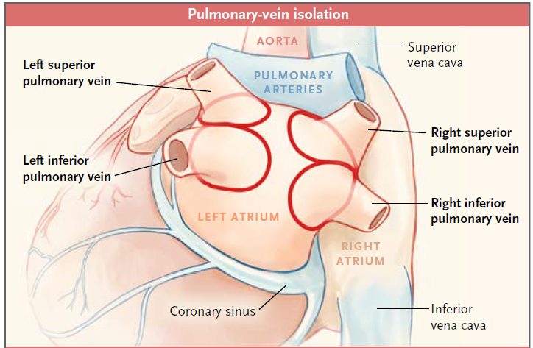
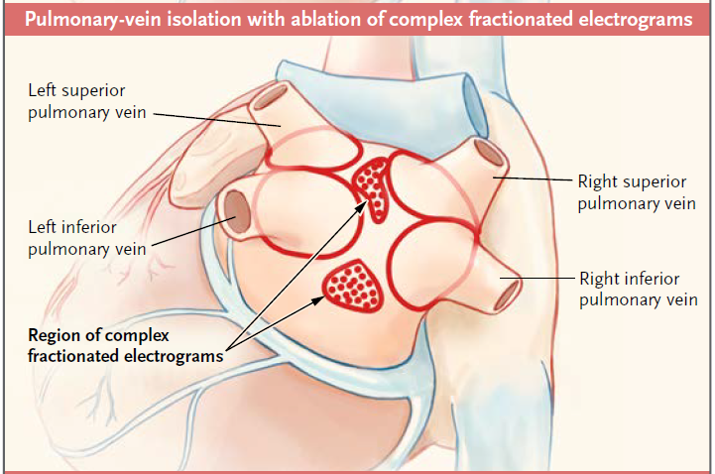
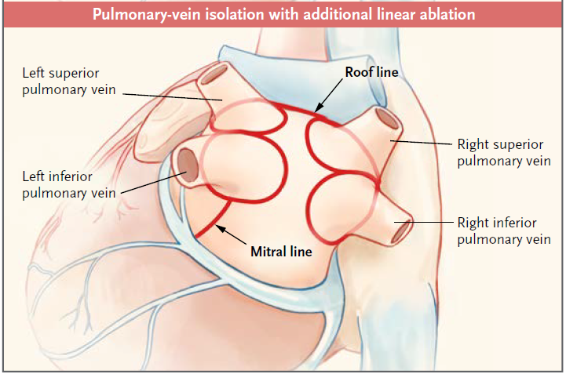
Catheter Ablation of Persistent AF

Slide 116
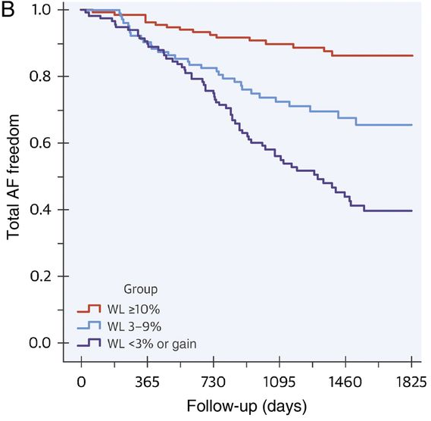
Risk Factors and Their Interaction with AF
Obesity
Sleep apnea
Hypertension
Diabetes
Alcohol
Exercise
Control of risk factors has a significant impact on AF burden
Pathak et al. 2015

Slide 117
Risk Factors and Their Interaction with AF
Obesity
Sleep apnea
Hypertension
Diabetes
Alcohol
Exercise
Control of risk factors has a significant impact on AF burden
Comorbidity | Association with AF
Heart failure vs. none | HR 1.43 (95% CI 0.85–2.40)
Hypertension (treated) vs. none | HR 1.32 (95% CI 1.08–1.60)
Obesity None (BMI <25 kg/m²) Overweight (BMI 25–30 kg/m²) Obese (BMI ≥31 kg/m²) | HR: 1.00 (reference) 1.13 (95% CI 0.87–1.46) 1.37 (95% CI 1.05–1.78)
Diabetes mellitus vs. none | HR 1.25 (95% CI 0.98–1.60)
Obstructive sleep apnea vs. none | HR 2.18 (95% CI 1.34–3.54)
Chronic obstructive pulmonary disease FEV1 ≥80% FEV1 60–80% FEV1 <60% | RR: 1.00 (reference) 1.28 (95% CI 0.79–2.06) 2.53 (95% CI 1.45–4.42)

Slide 118
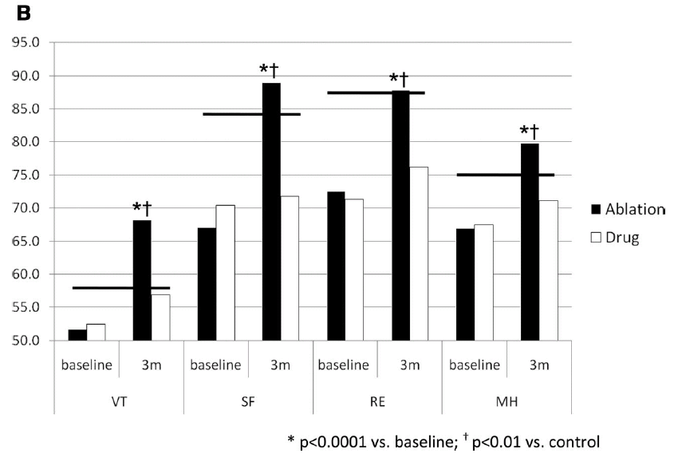
Benefits of AF Ablation
quality of life
hospitalizations
dementia
stroke
mortality
Reynolds et al. Circ Cardiovasc Qual Outcomes 2010;3:615-623

Slide 119
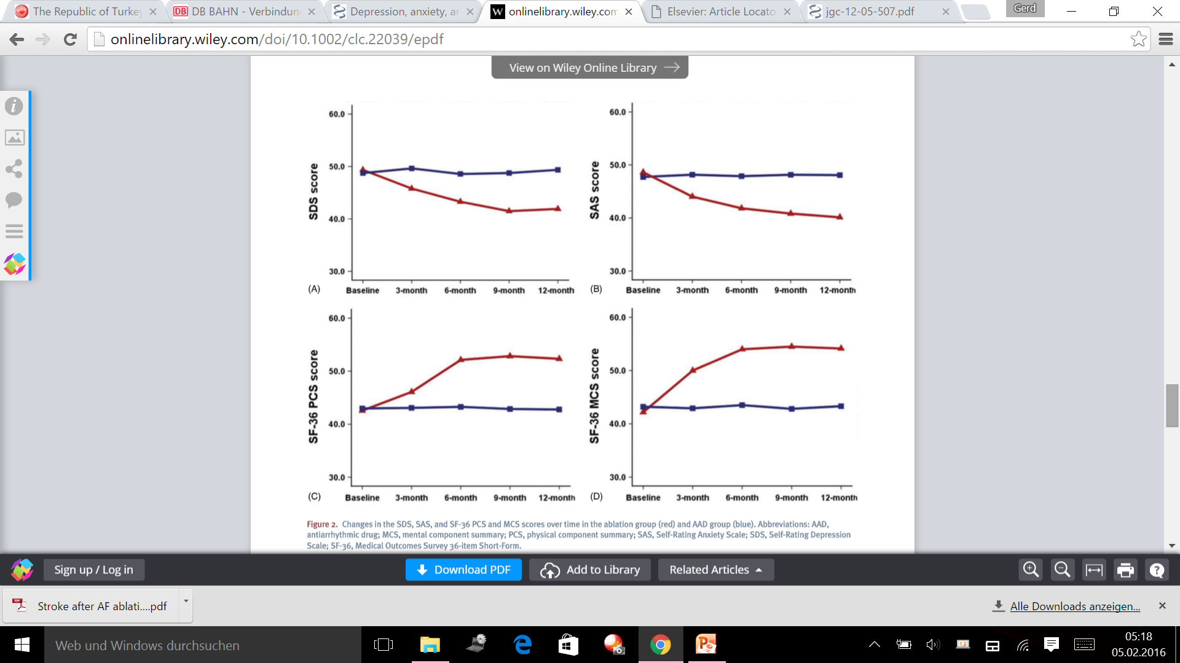
Benefits of AF Ablation
quality of life
hospitalizations
dementia
stroke
mortality
Depression
Anxiety
AF Abl.
Physical component
Mental component
AA Drugs
Sang et al. Clin Cardiol 2013

Slide 120
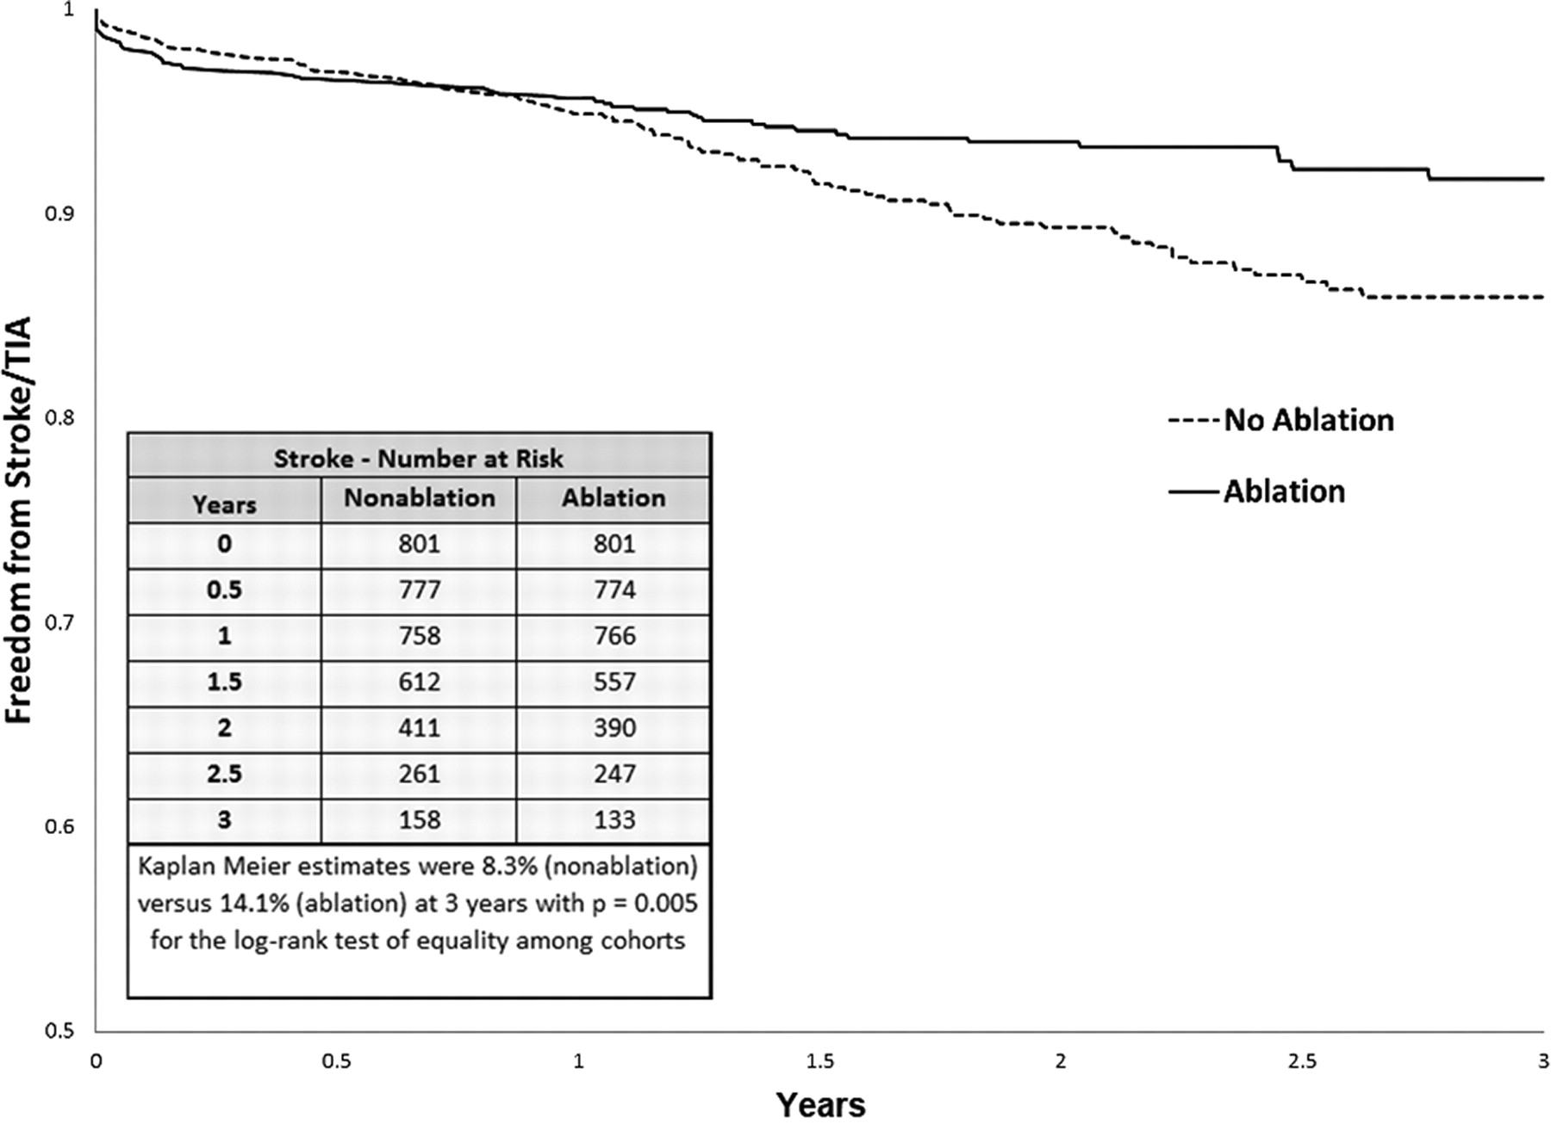
Benefits of AF Ablation
quality of life
hospitalizations
dementia
stroke
mortality
>9.000 patients
~40% CHADS≥2
Reynolds et al. Circ Cardiovasc Qual Outcomes 2012;5:171-181

Slide 121
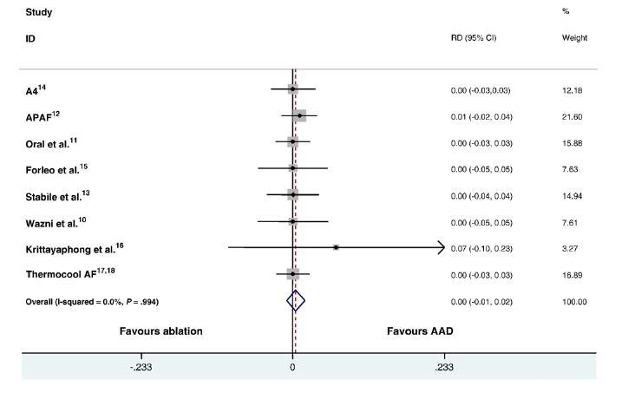
Benefits of AF Ablation
quality of life
hospitalizations
dementia
stroke
mortality
Dagres et al. Am Heart J 2009;158:15-20

Slide 122
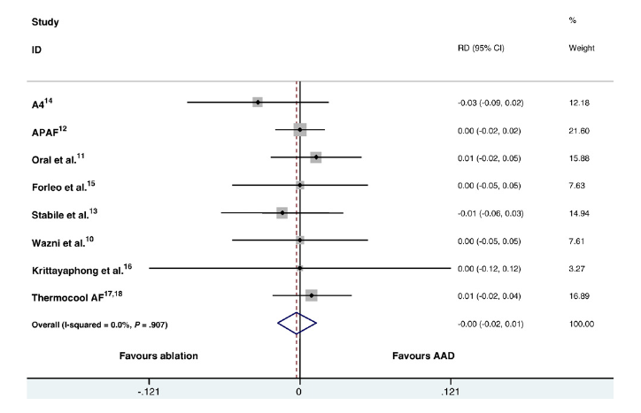
Benefits of AF Ablation
quality of life
hospitalizations
dementia
stroke
mortality
CABANA and EAST?
Dagres et al. Am Heart J 2009;158:15-20

Slide 123
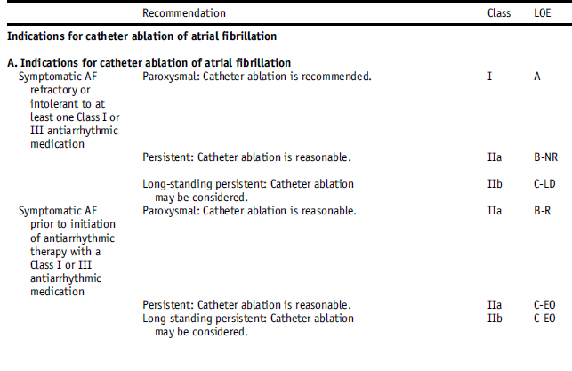
Indications for AF Ablation

Slide 124
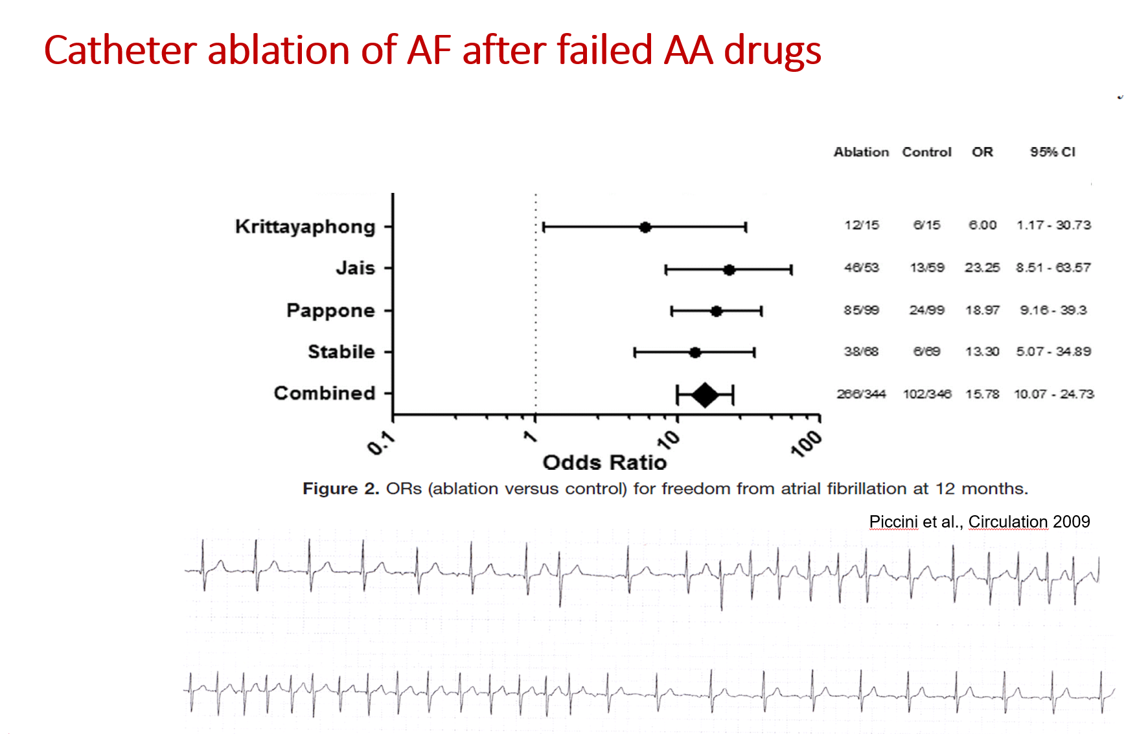
Indications for AF Ablation

Slide 125
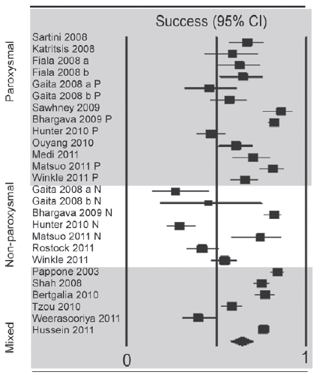
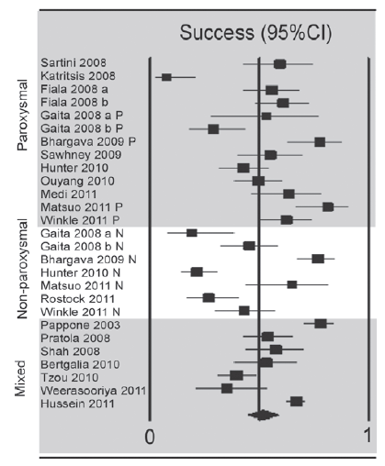
Ablation Outcome: “Early” and “Late” Procedural Success
66.6%
54.1%
41.8%
51.9%
64.2%
53.1%
Ganesan et al. J Am Heart Assoc 2013

Slide 126
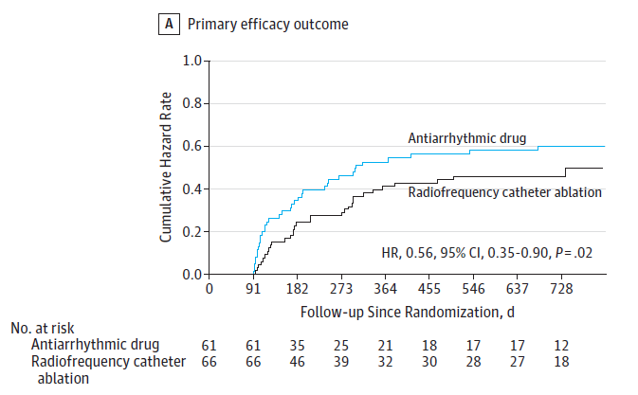
First-Line AF Catheter Ablation: RAAFT-2
Natale and colleagues. JAMA 2014

Slide 127
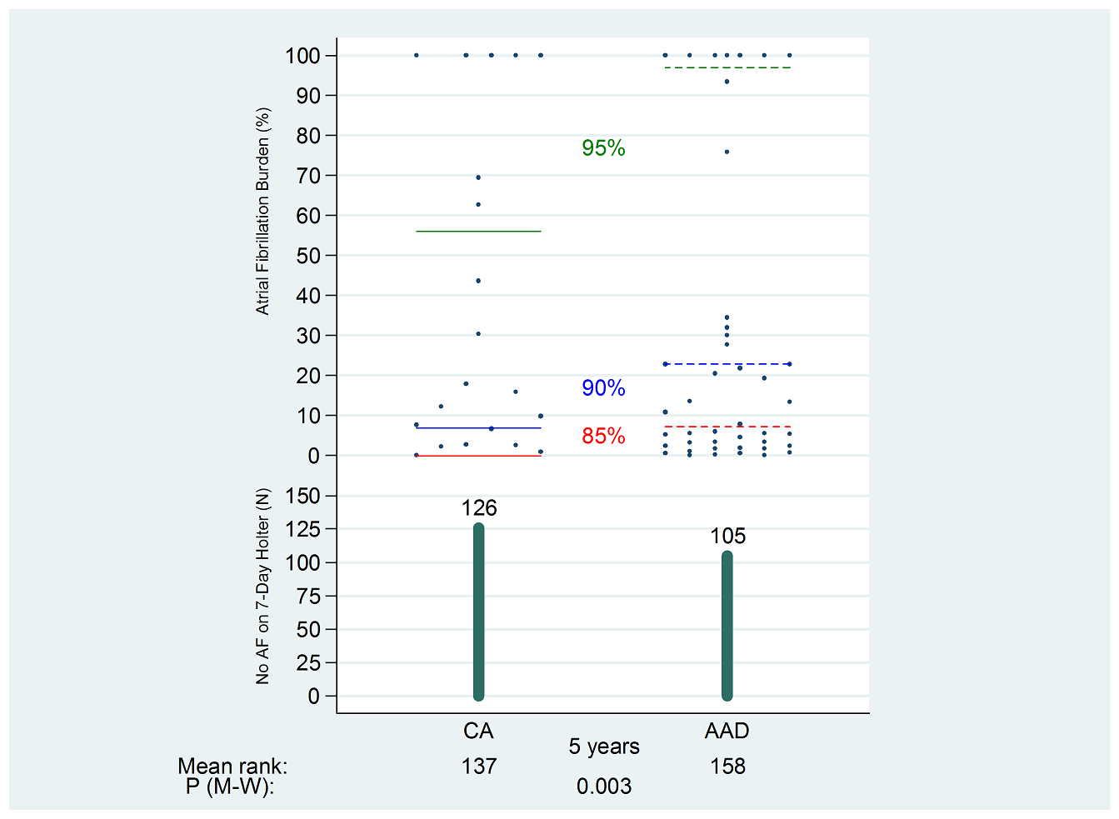
Catheter Ablation of AF: MANTRA-PAF Trial at 5 yrs
Nielsen et al. 2016

Slide 128
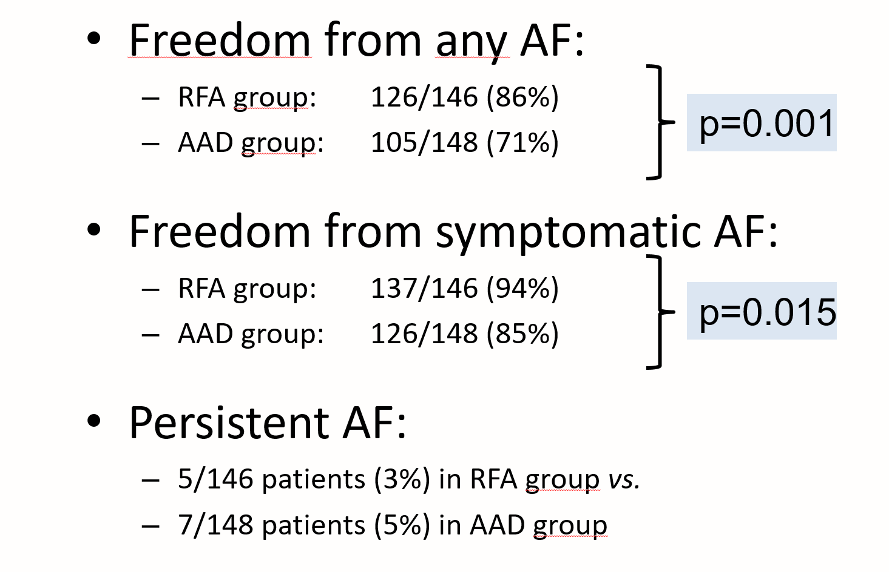
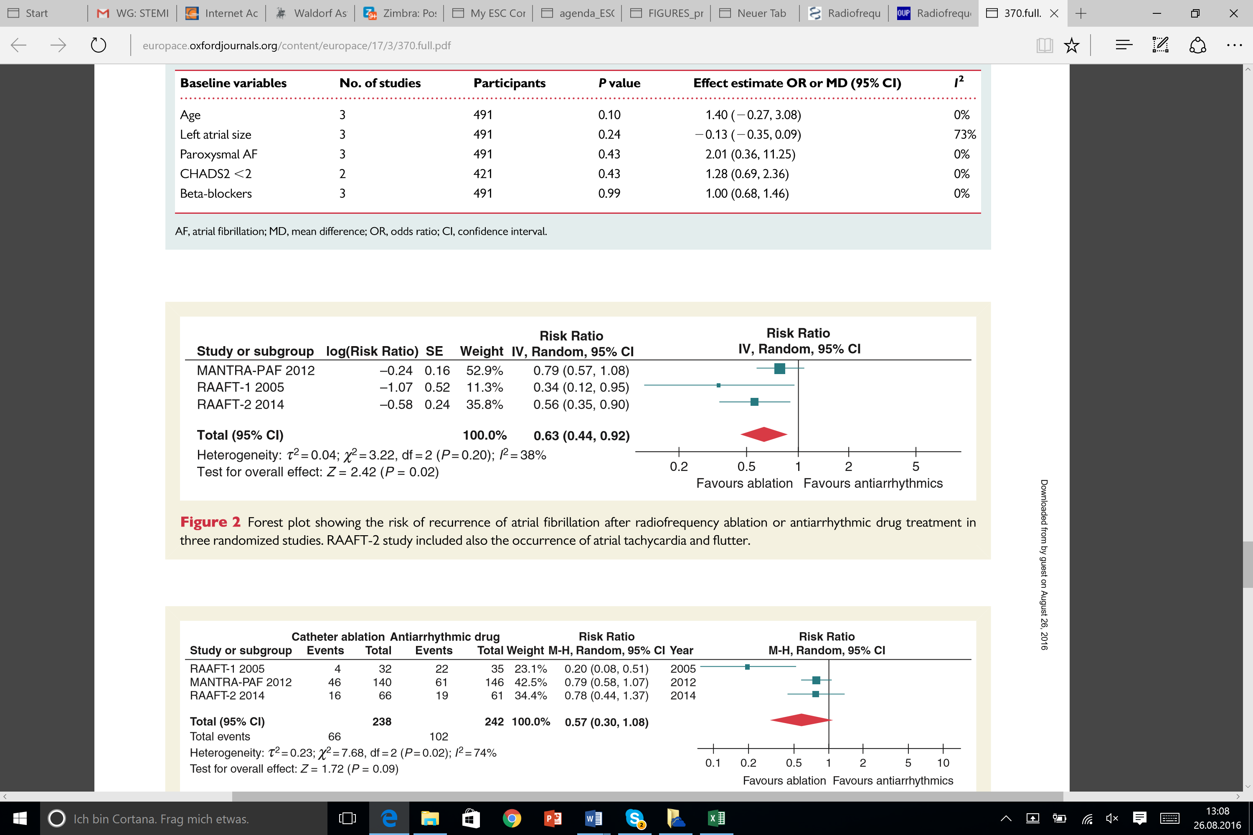
Catheter Ablation of AF: MANTRA-PAF Trial at 5 yrs.
Hakalahti A et al.; Europace 2015
Nielsen et al. 2016

Slide 129

Indications for AF Ablation

Slide 130

Indications for Surgical AF Ablation

Slide 131

Indications for AF Ablation
**A decision to perform AF ablation in an asymptomatic patient requires additional discussion with the patient because the potential benefits of the procedure for the patient without symptoms are uncertain.

Slide 132
Evidence for a Better Prognosis after Catheter Ablation of Atrial Fibrillation in Heart Failure Patients?
Rationale:
Patients with atrial fibrillation, heart failure, and highly reduced ejection fraction have a poor prognosis.
Nonpharmacological restoration of sinus rhythm with catheter ablation may improve ejection fraction.
Improvement of ejection fraction may reduce mortality.

Slide 133




AF Ablation for Rhythm Control in CHF Patients
+ 24±10%
+ 16±14%
+ 23±10%
+ 17±15%
N Engl J Med 2004;351:2373-2383

Slide 134



PABA – CHF
PABA – CHF
→ Adverse effects of AA drugs and AV nodal blocking agents minimized !
→ Rhythm control by PVI is superior to best possible rate-control strategy !
N Engl J Med 2008;359:1778-1785

Slide 135

Randomized Controlled Trial on CA of AF in HF: AATAC
Di Biase et al. Circulation 2016

Slide 136


Randomized Controlled Trial on CA of AF in HF: AATAC
Di Biase et al. Circulation 2016

Slide 137
Catheter Ablation of Asymptomatic AF?
What is the benefit?
1. Will you live better?
2. You will live longer!
3. You will live longer and better!

Slide 138


Catheter Ablation of Asymptomatic Persistent AF
Mohanty et al. J Cardiovasc Electrophysiol 2014

Slide 139


Catheter Ablation of Asymptomatic Persistent AF
Mohanty et al. J Cardiovasc Electrophysiol 2014

Slide 140


Catheter Ablation of Asymptomatic Persistent AF
66 pts with asymptomatic persistent AF
compared with 132 matched controls with
symptomatic persistent AF
Before ablation
1 year after ablation
Wu et al. J Cardiovasc Electrophysiol 2016

Slide 141


Catheter Ablation of Asymptomatic Persistent AF
66 pts with asymptomatic persistent AF
compared to 132 matched controls with
symptomatic persistent AF
Before ablation
1 year after ablation
Wu et al. J Cardiovasc Electrophysiol 2016

Slide 142
Perspective
AMICA (NCT00652522) Atrial Fibrillation Management In Congestive Heart Failure with Ablation
ARC-HF (NCT00878384) Catheter Ablation versus Medical Rate Control for Atrial Fibrillation in Patients with Heart Failure
CASTLE-AF (NCT00643188) Catheter Ablation versus Standard Conventional Treatment in Patients with LEft Ventricular Dysfunction and Atrial Fibrillation
CABANA (NCT00578617) Catheter ABlation versus ANtiarrhythmic Drug Therapy for Atrial Fibrillation

Slide 143
2017 HRS/EHRA/ECAS/APRHS/SOLAECE Expert Consensus Statement on Catheter and Surgical Ablation of Atrial Fibrillation
Riccardo Cappato, MD

Slide 144
Disclosure Statement of Financial Interest
Consultant to: Boston Scientific, Medtronic, St. Jude, Biosense Webster, ELA Sorin, Boehringer Ingelheim, Bayer HealthCare, Abbott, Pfizer
Speaker’s Bureau: Boston Scientific, Medtronic, St. Jude, Biosense Webster, BARD, Sanofi, Boehringer Ingelheim, Bayer HealthCare, Abbott
Investigator: Medtronic, Biosense Webster, Sanofi, Cameron Health, BARD, Bayer HealthCare, Abbott, Pfizer
Grants: Boston Scientific, Medtronic, St. Jude, Biosense Webster, BARD, ELA Sorin
Equity and Intellectual Property Rights: Cameron Health

Slide 145
Expert Consensus Statement on AF Ablation
Introduction
Definition, risk factors, and indications
Strategies, technology, and technical aspects
Follow-up, outcomes, and complications
Training, surgical ablation, and clinical trial design
Notes:
Cardioversion is a common procedure used worldwide to restore normal rhythm in patients with AF
Without adequate anticoagulation, the periprocedural risk of thromboembolic events associated with cardioversion is between 5 and 7%
The current standard for anticoagulation is VKAs, with some evidence supporting use of novel OACs in this setting
References
1. Hernandez-Madrid A et al. Europace 2013;15:915–918
2. Stellbrink C et al. Circulation 2004;109:997–1003
3. Gallagher et al. J Am Coll Cardiol 2002;4:926–933
4. Camm AJ et al. Eur Heart J 2012; 33:2719–2747
5. Piccini JP et al. J Am Coll Cardiol 2013;61:1998–2006
6. Nagarakanti R et al. Circulation 2011;123:131–136
7. Flaker G et al. J Am Coll Cardiol 2014;63:1082–1087

Slide 146
Expert Consensus Statement on AF Ablation
Technology and Tools
Ablation
Radiofrequency energy
Contact force
Cryoablation
Laser balloon technology
Other balloon technologies
Multielectrode circumferential ablation catheters (PVAC)

Slide 147
Expert Consensus Statement on AF Ablation
Technology and Tools
Mapping
Electroanatomic
CARTO
NavX
Rhythmia
Robotic and magnetic navigation system
Ultrasound (ICE)
PV venography
CT and/or MRI scans and rotational angiography
MRI of atrial fibrosis and RF lesions and MRI-guided ablation

Slide 148

Expert Consensus Statement on AF Ablation
Atrial Fibrillation Ablation: Strategies, Techniques, and Endpoints
Calkins et al. 2017

Slide 149

Expert Consensus Statement on AF Ablation
Atrial Fibrillation Ablation: Strategies, Techniques, and Endpoints
Calkins et al. 2017

Slide 150



Expert Consensus Statement on AF Ablation
Atrial Fibrillation Ablation: Strategies, Techniques, and Endpoints
Calkins et al. 2017

Slide 151

Expert Consensus Statement on AF Ablation
Atrial Fibrillation Ablation: Strategies, Techniques, and Endpoints
Calkins et al. 2017

Slide 152


Expert Consensus Statement on AF Ablation
Atrial Fibrillation Ablation: Strategies, Techniques, and Endpoints
Calkins et al. 2017

Slide 153

Expert Consensus Statement on AF Ablation
Atrial Fibrillation Ablation: Strategies, Techniques, and Endpoints
Calkins et al. 2017

Slide 154
Access the Consensus Statement and Summary Tools
To access the complete clinical document and related summary tools, please
visit http://www.hrsonline.org/Policy-Payment/Clinical-Guidelines-Documents
Executive Summary
Full document
Presentation slides

